Slide 1
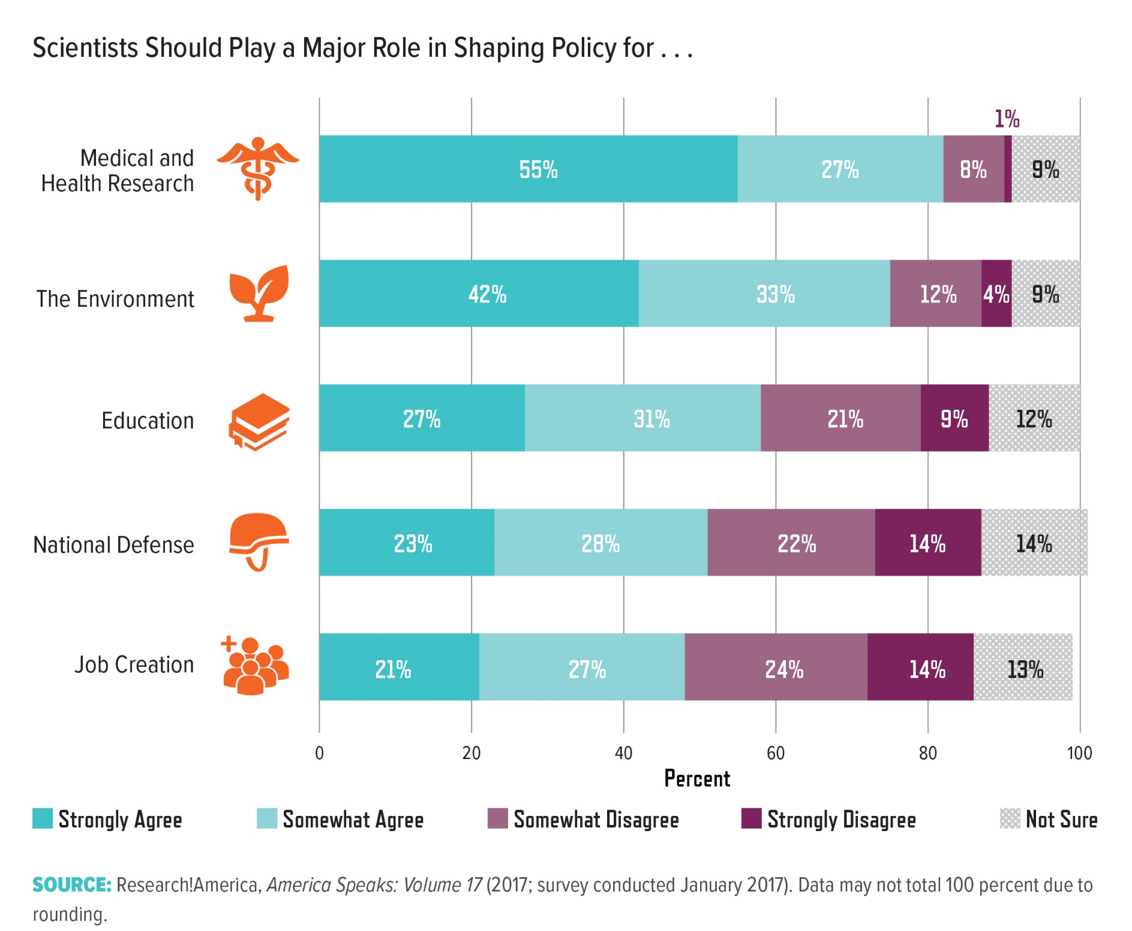
Notes:
Views on scientists’ role in shaping policy vary based on the issue. While 82 percent of respondents to a Research!America market research survey agreed that scientists should help shape medical and health research policy, fewer support scientist participation in job creation and national defense policy. This gap aligns with the prioritization of research to find disease cures rather than drive economic growth or develop military technology (page 9). Likewise, Pew Research Center studies show that 73 percent of Americans say medical scientists should have a major role in childhood vaccine policy12 and 67 percent say climate scientists should be involved with global climate change policy.13 More research is necessary into how a person’s understanding of science’s role in policy affects his or her perceptions.

