Slide 1
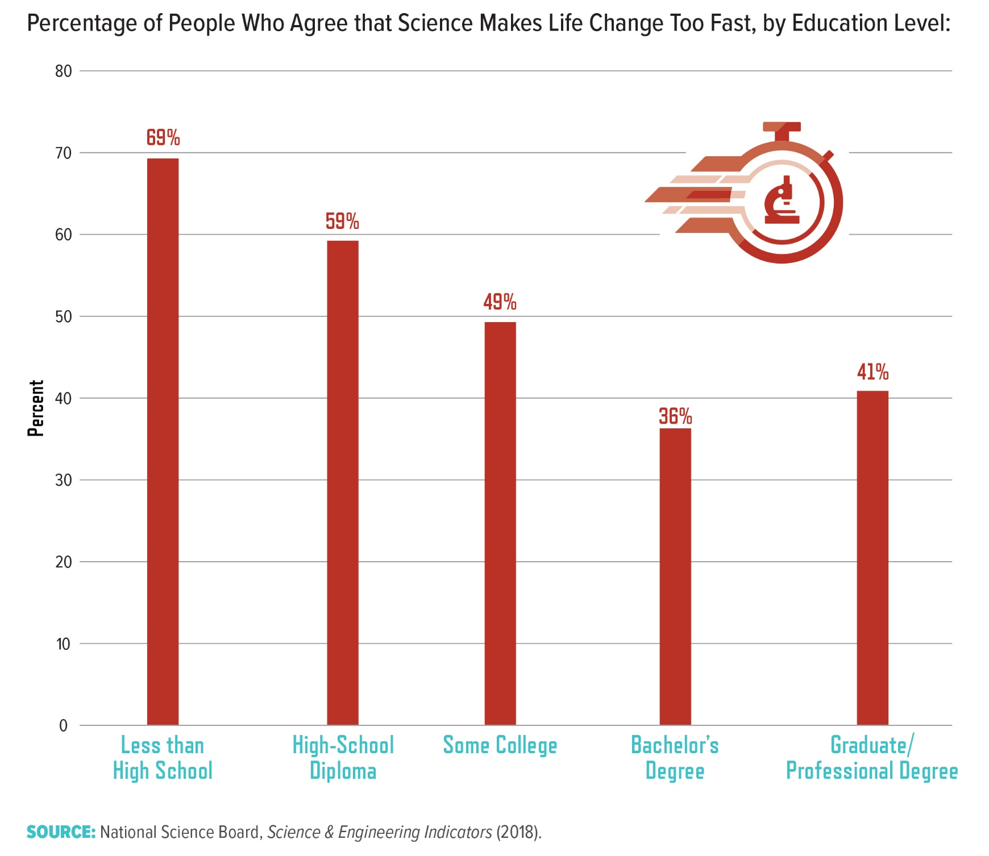
Notes:
People were also asked about the extent to which they agree or disagree with the statement “Science makes our way of life change too fast.” For the approximately 10 percent of Americans who did not complete high school, the vast majority (69 percent) agreed that science makes life change too fast.17 In comparison, 36 percent of those with a bachelor’s degree expressed this sentiment. Consistent with the strong correlation between education and income in the United States,18 respondents with lower family income also were more likely to agree with the statement (data not shown)

