Slide 1
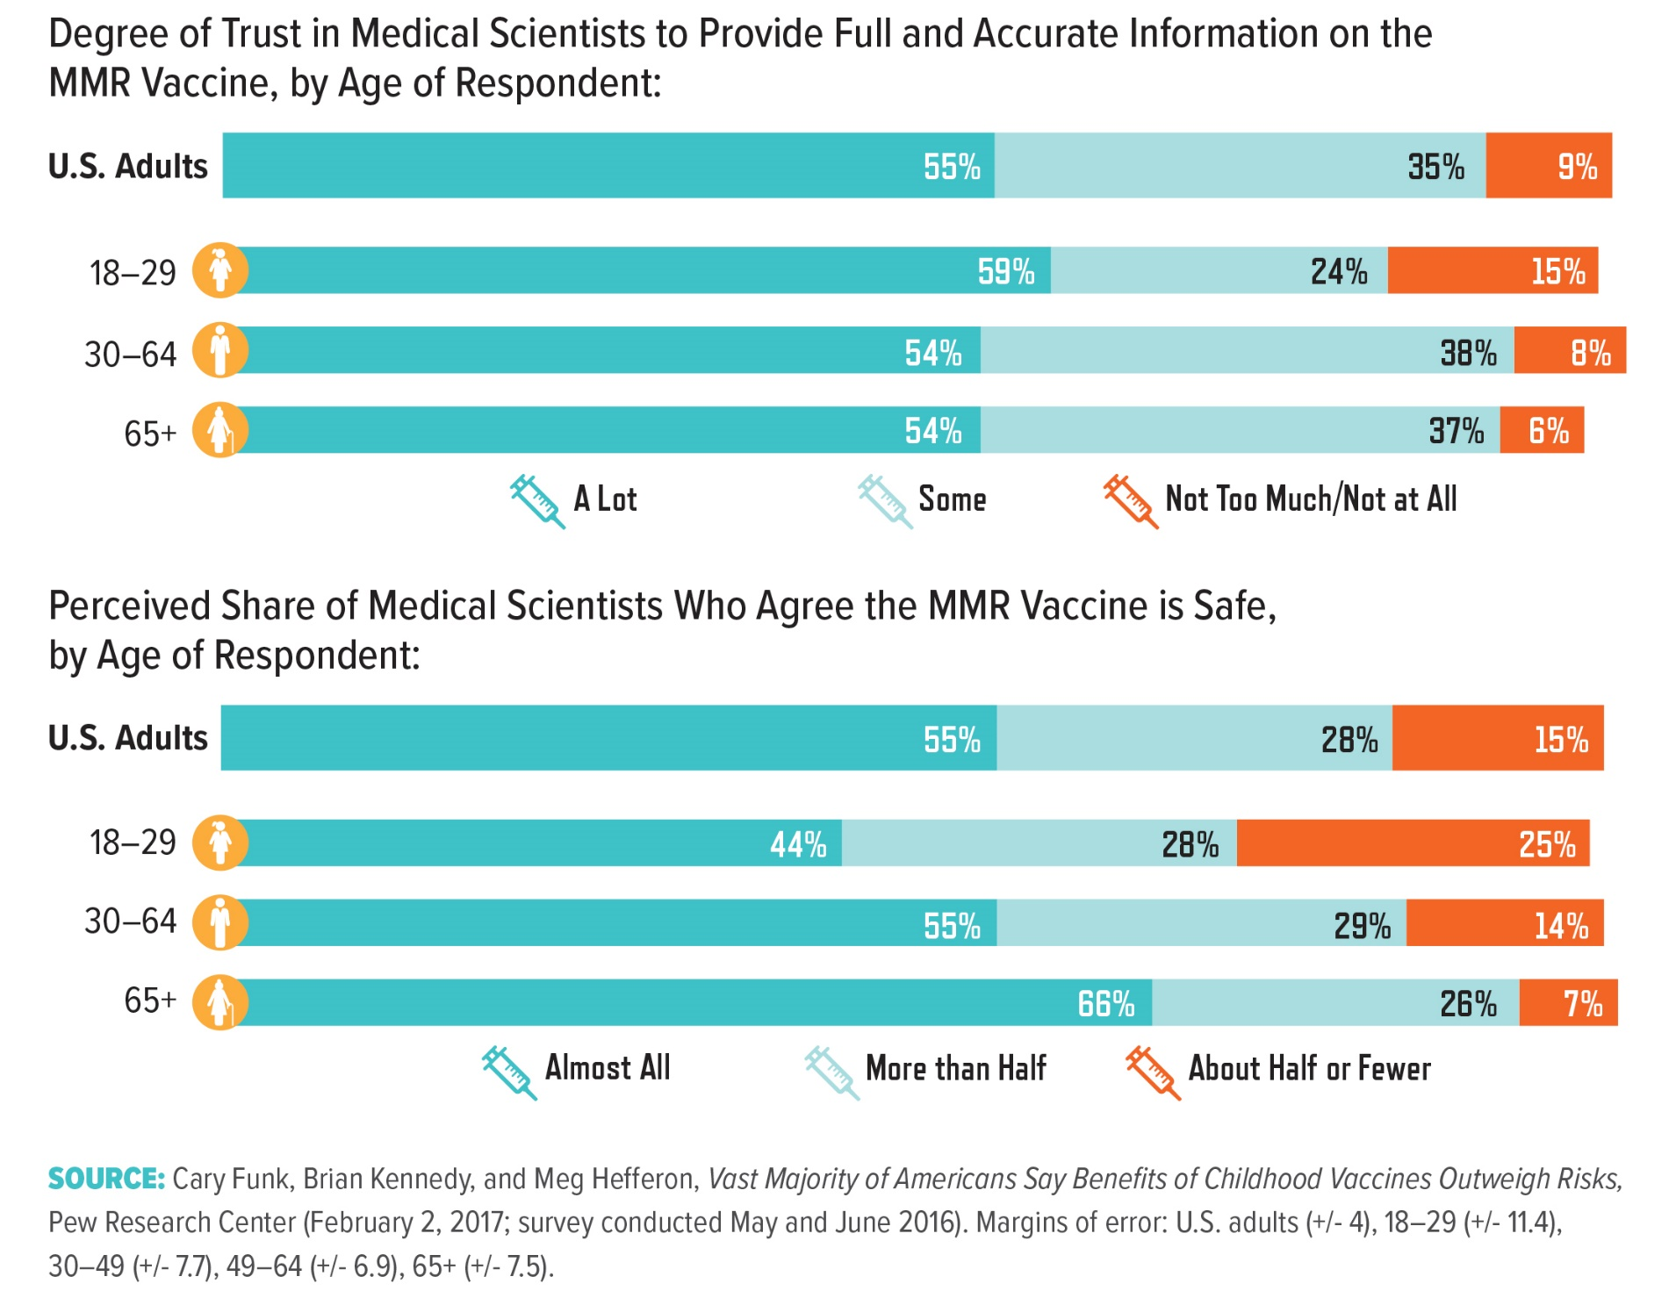
Notes:
A 2017 Pew report found no statistical difference in the extent to which younger and older Americans trust medical scientists to provide accurate information about the safety of the mmr (mumps, measles, and rubella) vaccine, yet younger people expressed more skepticism of the scientific consensus that childhood vaccines are in fact safe. Researchers do not yet understand this discrepancy, since these data do not reveal respondents’ justifications for their beliefs. For instance, researchers do not know whether the differences in views are related to the shared generational experiences of a given age group, a change in perception associated with the process of aging, lack of personal experience with vaccine-preventative diseases, or some other factor or combination of factors. More research is necessary to determine the underlying causative relationships between population demographics and views on vaccine safety.

