Slide 1
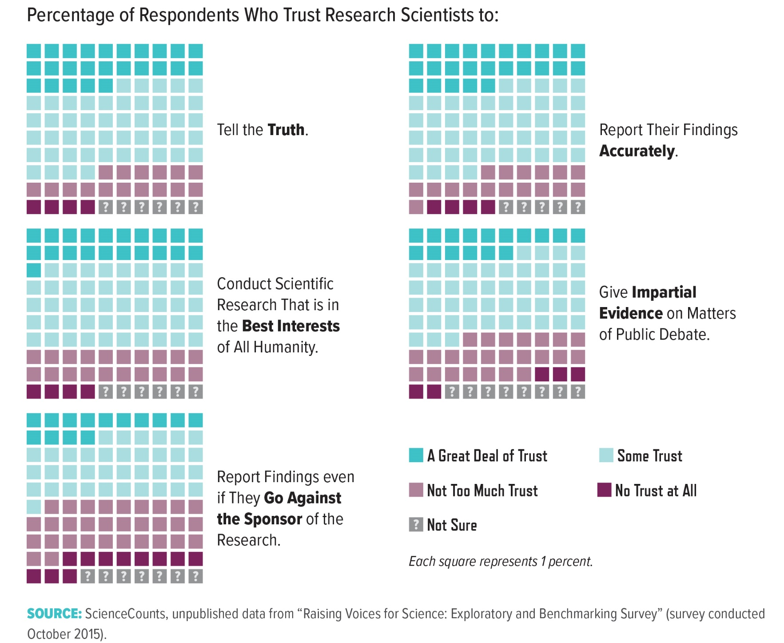
Notes:
Although overall confidence remains high, the level of trust in research scientists may vary based on their perceived responsibilities. In a recent exploratory market research study by ScienceCounts, approximately three-quarters of respondents placed either a “great deal” or “some” trust in research scientists to tell the truth and to report their findings accurately. By comparison, respondents expressed less trust in scientists to report findings that disagree with the interests of the research sponsor. Recent studies suggest that communicators should use approaches that convey trustworthy intentions rather than attempts at persuasion, which may be seen as indicative of an underlying agenda.6

