Slide 1
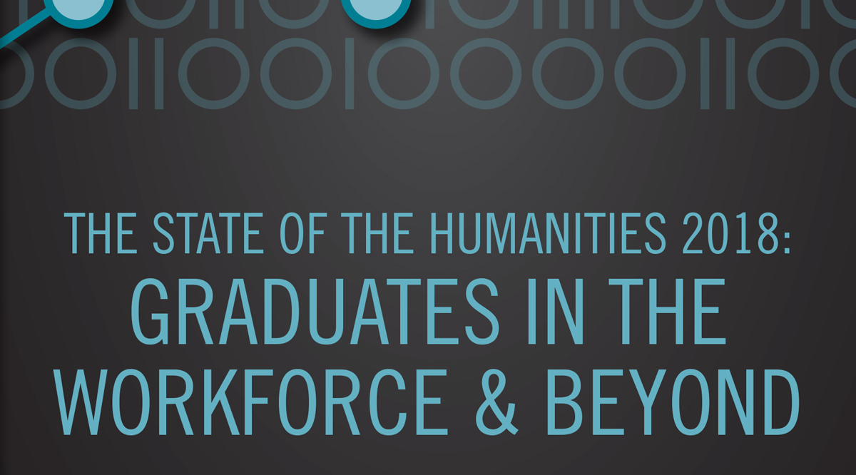

Slide 2
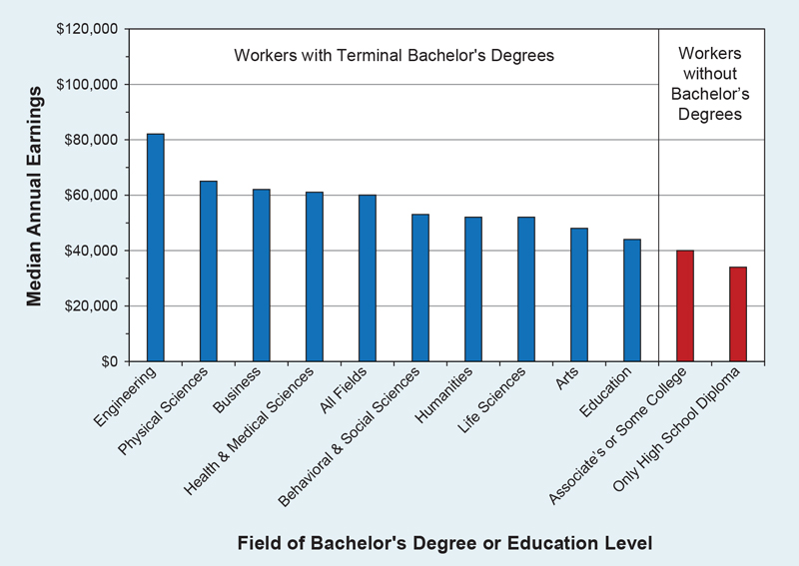
Earnings Comparison: Workers with a Terminal Bachelor’s Degree
(by Field) Versus Those Without a Four-Year Degree, 2015
Notes:
Earnings are often the key data point in conversations about the value of college degrees—in part because they are relatively easy to measure. Median annual earnings for workers with just a terminal bachelor’s degree in the humanities stood at $52,000 in 2015, which was somewhat lower than the median for all college graduates ($60,000) and substantially lower than the median for those in engineering ($82,000). Nevertheless, the median for the humanities was equal to the earnings for graduates from the life sciences and higher than those with a baccalaureate degree in the arts ($48,000) and education ($44,000).
While humanities earnings are lower than those among STEM and business graduates, they are higher than those of workers who lack bachelor’s degrees—either those with an associate’s degree or some college ($40,000) or those with only a high school diploma ($34,000).

Slide 3
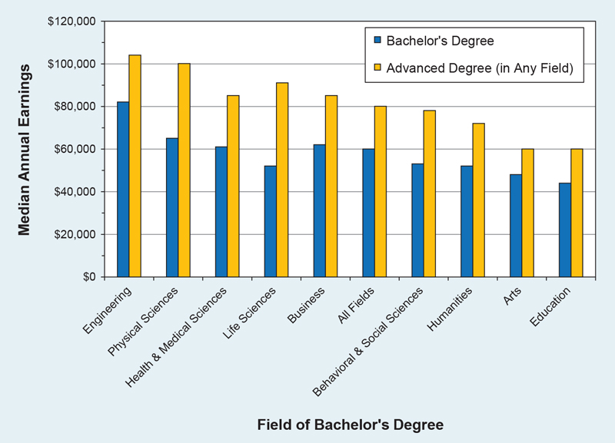
Earnings of Workers with a Bachelor’s Degree, by Highest Degree
and Field of Bachelor’s, 2015
Notes:
Obtaining an advanced degree makes a substantial difference in the earnings of college graduates. Among humanities graduates, advanced degree holders had median earnings that were 38% higher than those of workers with only a bachelor’s degree ($72,000 as compared to $52,000). In 2015, 41% of humanities bachelor’s degree holders had also earned an advanced degree (which was 5 percentage points above the share of graduates in all fields combined). Taking all fields together, advanced degree holders earned 33% more than their counterparts with just a bachelor’s degree.
For every humanities discipline, advanced degree holders made substantially more than workers with only bachelor’s degrees. The earnings differential ranged from $15,000 (in communication) to $27,000 (for graduates from area studies, ethnic studies, and history).

Slide 4
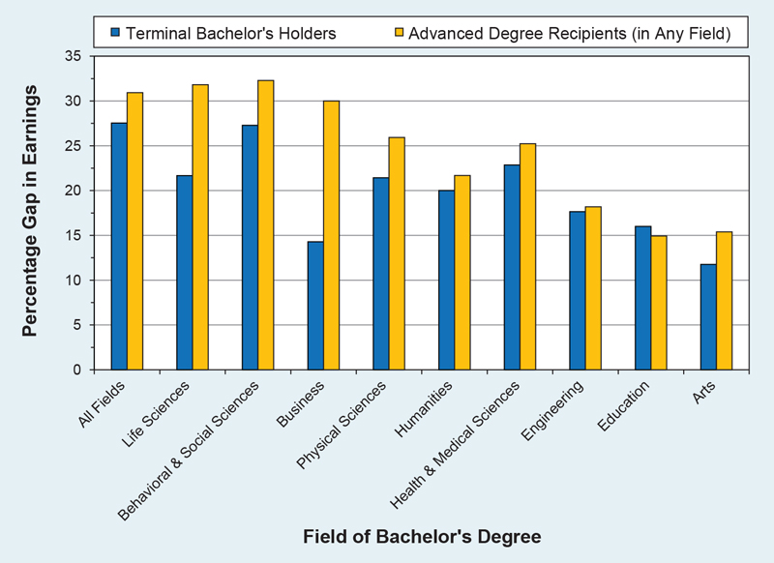
Gender Earnings Gap among Workers with at Least a Bachelor’s Degree,
by Highest Degree and Field of Bachelor’s, 2015
Notes:
Unfortunately, gender also makes a substantial difference in graduates’ subsequent earnings. Across all fields, women earn substantially less than their male counterparts, though the 20% gender gap in earnings among holders of terminal bachelor’s degrees in the humanities was smaller than that for the science fields.
In most fields, including the humanities, the gap in earnings between men and women was larger for advanced degree holders, though the difference for graduates with a bachelor’s degree in the humanities was relatively modest.

Slide 5
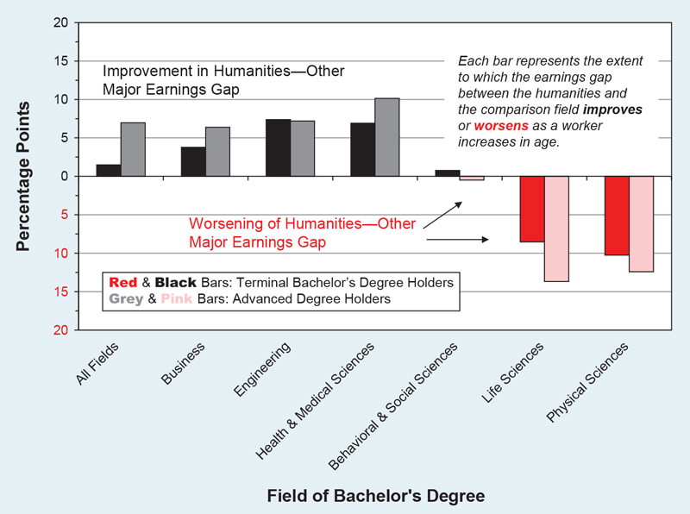
The Effect of Work Experience on the Relative Earnings of Humanities Graduates: Comparing the Earnings Gap for Younger Workers with That for Older Workers, 2015
Notes:
The gap in earnings between humanities majors and several of the higher-earning majors is less pronounced for older workers. The figure above indicates how the gap for workers ages 24 to 34 compares with that found among workers ages 35 to 54. For example, the earnings gap between humanities and business majors is two percentage points smaller for older workers with terminal bachelor’s degrees than younger workers with the same level of education. The gap is almost six-and-a-half percentage points narrower among advanced degree holders. The earnings differential between the humanities and the natural science fields, however, is larger among older workers, particularly for advanced degree holders.

Slide 6
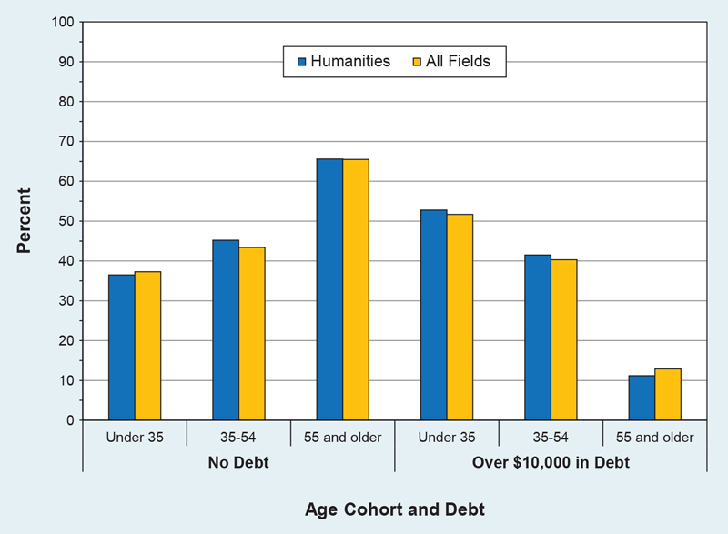
Amount Borrowed by Bachelor’s Degree Holders7 to Finance Undergraduate
Education, by Age and Field of Bachelor’s Degree, 2015
Notes:
Another financial concern raised about humanities degrees, one closely related to the issue of earnings, is the burden of student debt acquired during college study. A comparison of debt levels among college graduates in 2015, however, shows only negligible differences between humanities and non-humanities graduates across all age cohorts. In the humanities, as is true for the larger college graduate population, graduates tend to have either no debt or a considerable amount early in life. Even among those age 55 and older, almost 6% of graduates reported they still carried more than $10,000 in debt from their undergraduate studies (as compared to 66% without debt). Here again, there was no difference between humanities graduates and graduates generally.

Slide 7
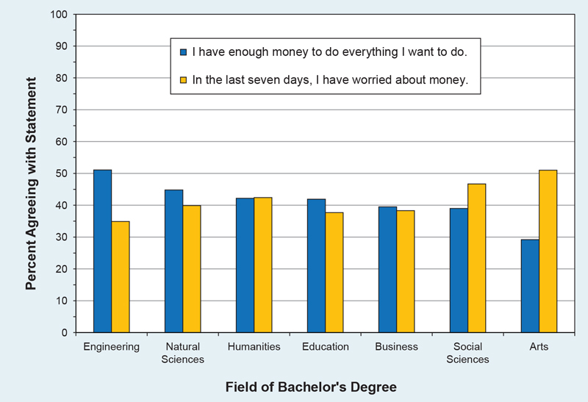
Bachelor’s Degree Holders’ Financial Satisfaction,
by Field of Bachelor’s Degree, 2014
Notes:
Despite the variations in earnings between the fields, there was considerable similarity in graduates’ perceptions of their personal financial situation, as college graduates from most fields appeared to have similar levels of comfort (and discomfort). Even among workers holding bachelor’s degrees in the highly paid field of engineering, only a bare majority (51%) said they had enough money to “do everything I want to do.” In comparison, 45% of graduates in the natural sciences and 42% of respondents in the humanities indicated they had enough money. Conversely, more than half of arts graduates (51%) reported they had worried about money in the past seven days, and 47% of the graduates from the social sciences shared that concern. The share of humanities graduates who had recently worried about money (42.4%) was close to the shares of graduates from the natural sciences, education, and business.

Slide 8
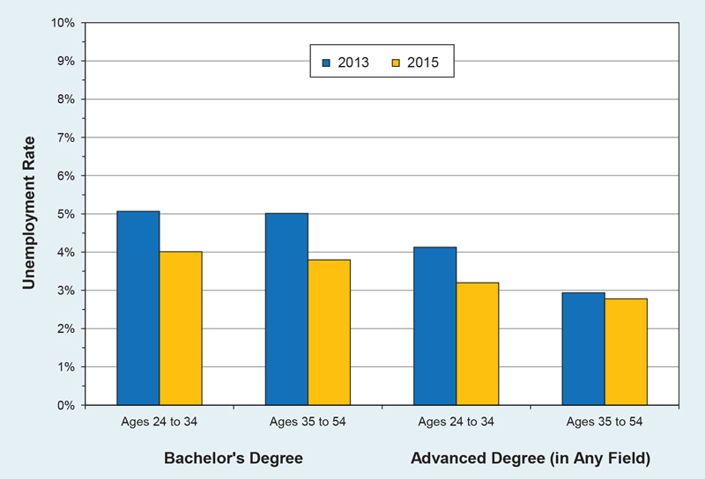
Unemployment among Humanities Bachelor’s Degree Holders,
by Highest Degree and Age, 2013 and 2015
Notes:
Relative unemployment rates can also play an important part in the overall financial picture for humanities graduates. Like graduates from every other field, holders of bachelor’s degrees in the humanities experienced a sharp increase in unemployment during the Great Recession. Using data for the 2009–2010 time period, Georgetown University’s Center for Education and the Workforce put the unemployment rate for college graduates with degrees in the humanities at 9.4%. The unemployment rate has fallen sharply from that point, with unemployment now at or below 4% among those in their prime working years (ages 24 to 55). Among humanities graduates with only a bachelor’s degree, the unemployment rate fell a full percentage point from 2013 to 2015.

Slide 9
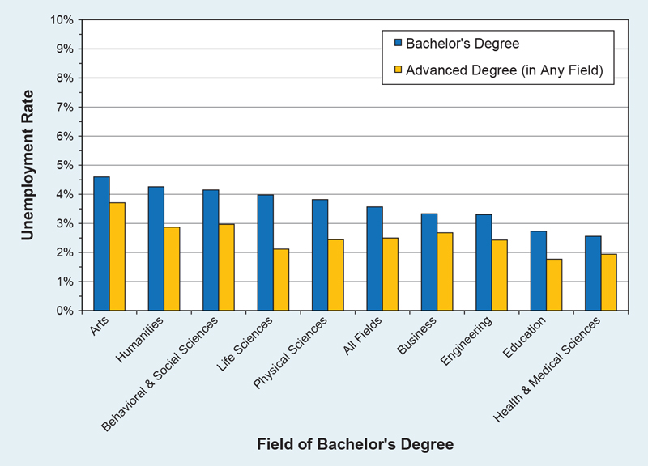
Unemployment among Bachelor’s Degree Holders,
by Highest Degree and Field of Bachelor’s, 2015
Notes:
While their unemployment rate has declined since the Great Recession, humanities graduates had a level of unemployment in 2015 that was modestly higher than the rate for the bachelor’s-holding population as a whole. The 4.3% unemployment rate among terminal bachelor’s degree holders in humanities compares to 3.6% among graduates from all fields combined.
The lowest levels of unemployment (below 3%) were found among bachelor’s degree holders in education and the health and medical sciences.

Slide 10
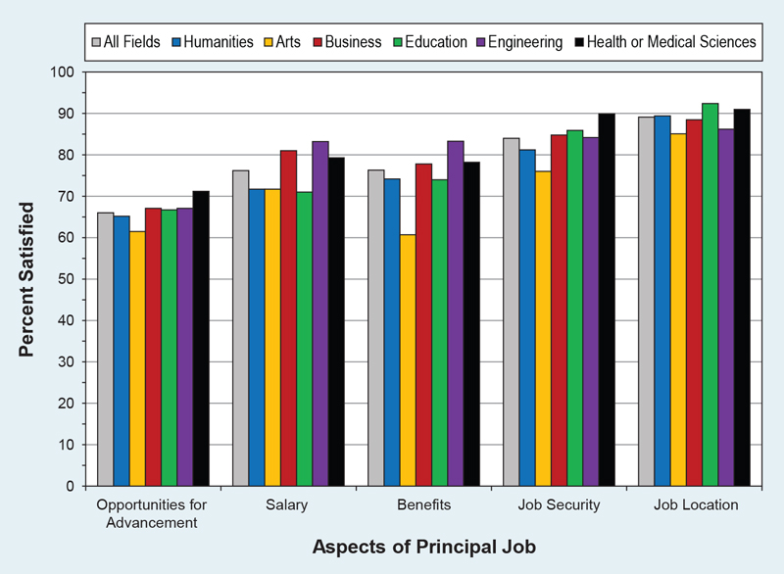
Bachelor’s Degree Holders’ Satisfaction with Aspects
of Their Principal Job, 2015
Notes:
Despite disparities in median earnings and smaller differences in unemployment rates, when college graduates were asked about their satisfaction with particular financial aspects of their job in 2015, humanities majors’ responses were generally similar to their peers. The figure above highlights only a few of the fields against which the humanities is often compared. On every measure, the share of humanities majors reporting satisfaction was within five percentage points. On the salary question specifically, 71.7% of humanities graduates expressed satisfaction with that aspect of their job, as compared to 76.2% among all college graduates.

Slide 11
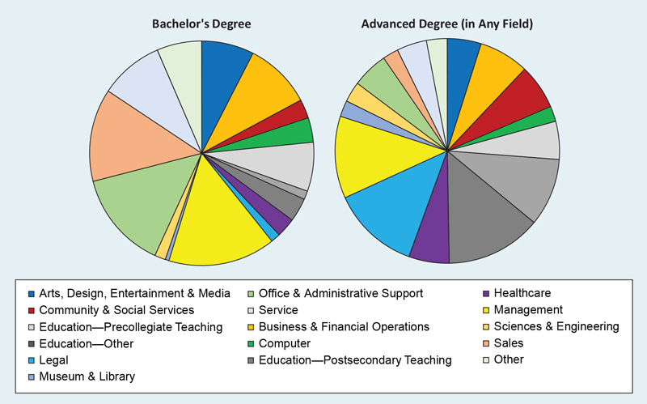
Occupational Distribution of Humanities Bachelor’s Degree Holders,
by Highest Degree, 2015
Notes:
The distribution of occupations of humanities bachelor’s degree holders who went on to earn an advanced degree differs substantially from that of their counterparts with terminal degrees. Among those whose highest degree is a bachelor’s (59% of humanities graduates as of 2015), almost a third were employed in office, sales, and service jobs, as compared to 10% of those with advanced degrees.
Among humanities graduates with terminal bachelor’s degrees, 14% were employed in management positions. In contrast, among those who had gone on to advanced degrees (in any field), almost a third were employed in education (with the largest share in postsecondary education), with another 13% employed in the legal profession and 11% in management positions.

Slide 12
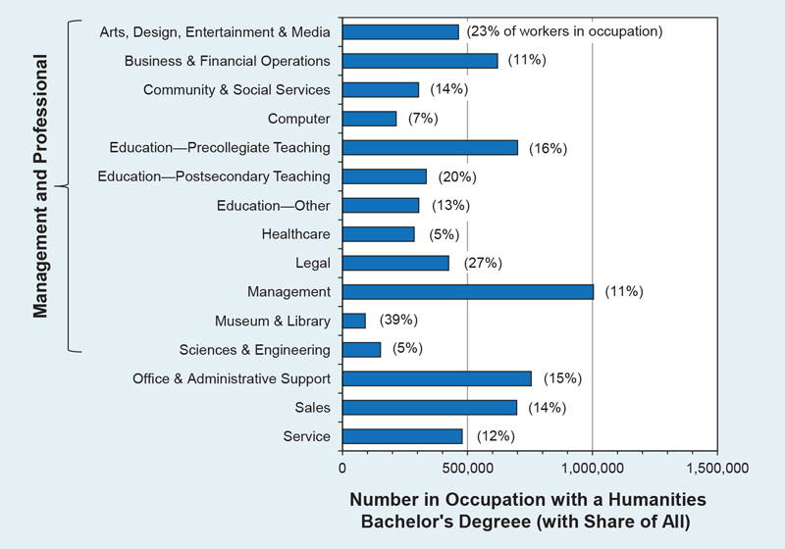
Percentage and Number of Workers with a Humanities Bachelor’s Degree,
by Occupation, 2015
Notes:
Approximately five million people employed in management and professional jobs in 2015 had bachelor’s degrees in the humanities. More than a million humanities graduates were employed as managers, and 1.3 million graduates from the field were employed in education positions (at the secondary and postsecondary level). The next largest areas of employment for holders of humanities bachelor’s degrees were office and administrative support positions (with 754,000 employees) and sales (with 696,000).
The numbers do not fully account for the role humanities majors play in each field, however, as they account for more than 10% of the people employed in every occupational category except those that are specifically STEM-related (where they account for almost 5% of employees in science, engineering, and healthcare, and 7% of employees in the computer occupations).

Slide 13
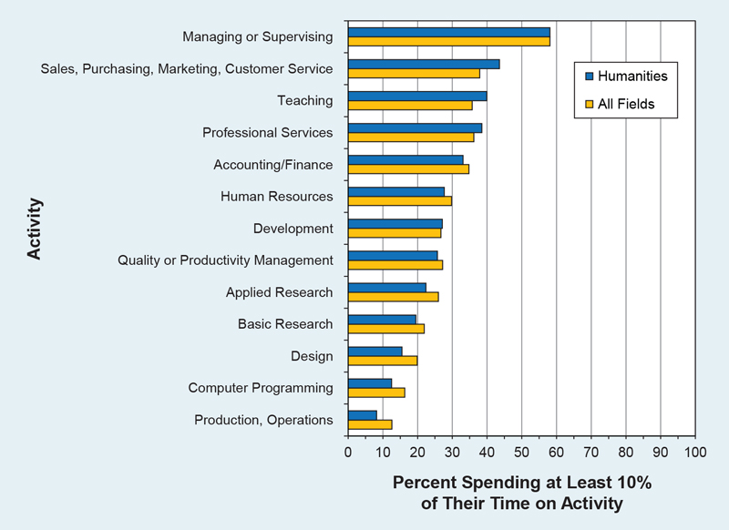
Activities Engaged in as Part of Principal Job by Humanities Bachelor’s Degree
Holders (as Compared to All Bachelor’s Degree Holders), 2015
Notes:
Humanities graduates are similar to the entire population of bachelor’s degree holders with respect to the likelihood that they engage in key work activities. The share of humanities majors who reported spending more than 10% of their time on managerial and supervisory activities was identical to the share among all fields (58%). Humanities majors were somewhat more likely to be engaged in teaching as well as sales and marketing work and somewhat less likely to be doing STEM-related activities (basic and applied research, design, computer programming, and production), though the share of humanities majors engaged in each of those activities was close to the percentage for all graduates.

Slide 14
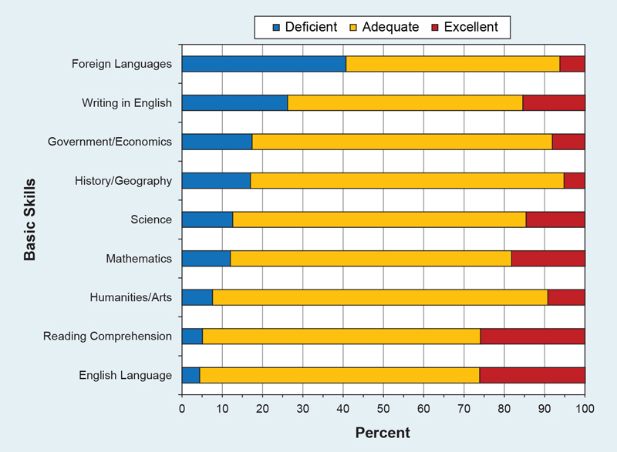
Employer Ratings of Four-Year College Graduates Entering Workforce
on Readiness in Certain “Basic” Skills, 2006
Notes:
Given the range of occupations and activities performed by college graduates, further research is needed about how humanities study connects to their subsequent work lives. Existing research on the skills that potential employers find desirable is generally imperfect given the range of possible employers and differing job characteristics. The surveys that do exist, however, tend to highlight the value of a range of humanities skills. For instance, although not nationally representative, a 2006 Conference Board survey of 431 employers noted substantial perceived deficiencies in college-educated employees’ skills in key areas of humanities learning. These “basic skills” included foreign languages, writing in English, and reading comprehension. The responding employers identified the latter two skills as particularly important for successful job performance.

Slide 15
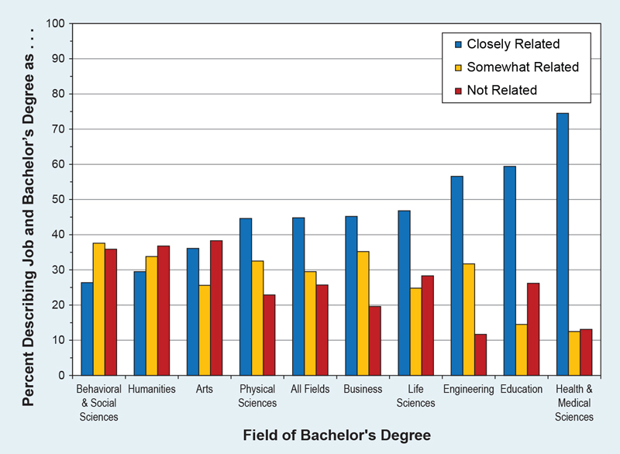
Bachelor’s Degree Holders’ Perception of Relationship between Job and Degree, 2015
Notes:
Regardless of the specific skills employers are seeking, there appears to be a wide gap between humanities majors and graduates from certain professional and STEM fields in their perceptions of the relationship between job and degree (graduates from the arts and the behavioral and social sciences were similar to humanities graduates in this regard). More than a third of bachelor’s degree holders from the humanities saw no relationship between their job and their degree, as compared to less than 15% of graduates from engineering and the health and medical sciences. Among humanities graduates who were dissatisfied with their job, a majority felt there was no relationship to their degree.

Slide 16
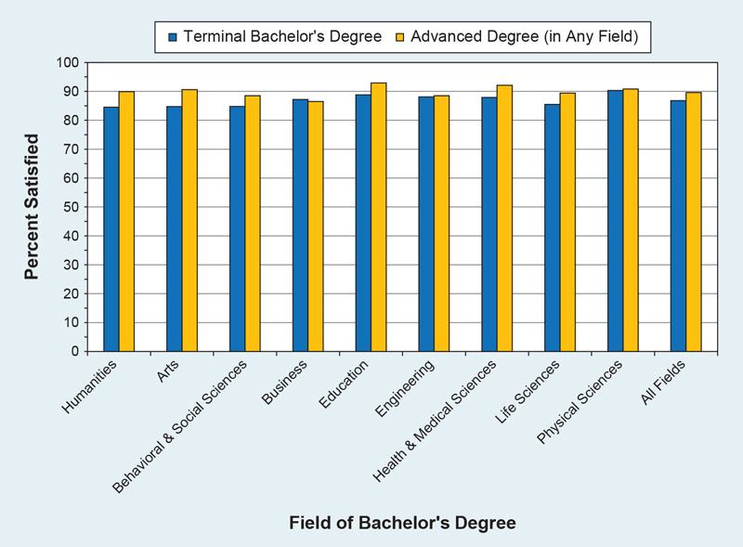
Bachelor’s Degree Holders Indicating They Are “Very” or “Somewhat” Satisfied
with Their Job, by Highest Degree and Field of Bachelor’s, 2015
Notes:
Despite the uncertainty about the connection between their degree and their job, humanities graduates reported job satisfaction at levels comparable to graduates from almost every other field. Almost 87% of all workers with a bachelor’s degree in the humanities reported they were satisfied with their job in 2015.
Earning an advanced degree made a slight difference in overall job satisfaction for bachelor’s degree recipients. Among graduates from every field, the overall level of job satisfaction was three to five percentage points higher among those who had gone on to earn an advanced degree.

Slide 17
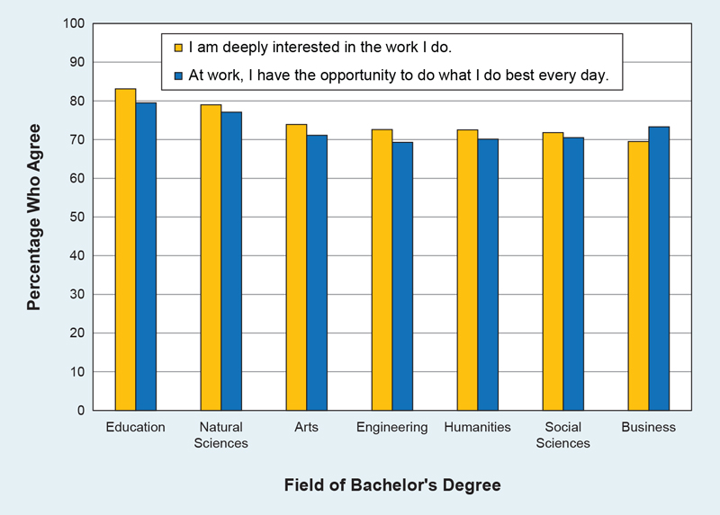
Number of Online Job Postings in Massachusetts Seeking Bilingual Candidates,
2010 and 2015
Notes:
A handful of recent studies about state and local job markets has highlighted the need for employees with language skills. A study in Massachusetts found a sharp increase in online job postings seeking a candidate who could speak a language other than English: from 5,612 openings in 2010 to 14,561 in 2015. A similar study found that one in five job postings from some of New Jersey’s largest employers (including Bank of America, H&R Block, State Farm Insurance Companies, and Crossmark, Inc.) sought bilingual employees. A separate study from the Northern Illinois University Center for Governmental Studies found “half of all employers in northern Illinois plan to hire more bilingual or multilingual college graduates within five years.”

Slide 18
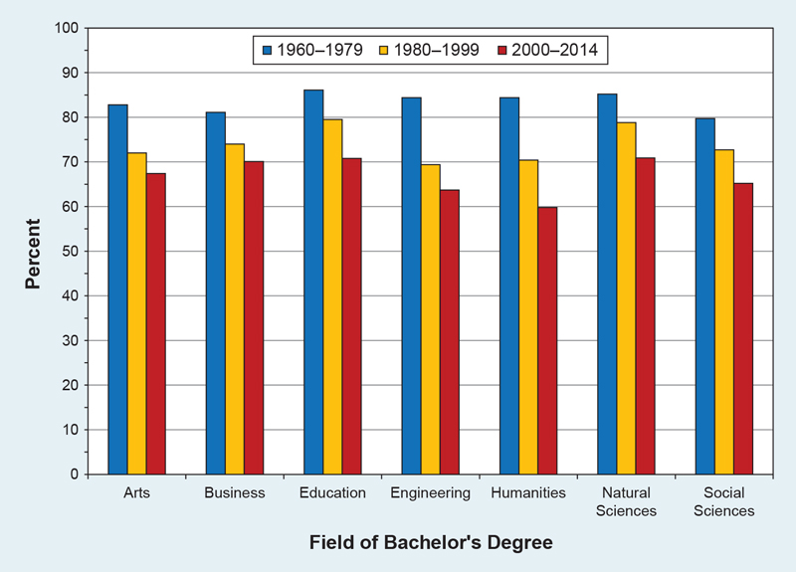
Bachelor’s Degree Holders Who Agree That “At Work, I Have the Opportunity to Do What I Do Best Every Day,” by Graduation Cohort and Field of Bachelor’s Degree, 2014
Notes:
Experience in the workforce appeared to play an important role in measures of satisfaction with the work humanities graduates perform. There were substantial differences among graduation cohorts in response to the prompt, “At work, I have the opportunity to do what I do best every day.” The humanities was not alone in showing a difference between young and old on this question, but it did have the widest gap. While 60% of those who earned humanities degrees from 2000 to 2014 expressed satisfaction about the opportunity to best use their talents and skills at work, 84% of graduates in the oldest cohort (1960 to 1979) reported similar satisfaction.
In the oldest cohort, humanities graduates were near the highest levels of reported satisfaction on this measure.

Slide 19
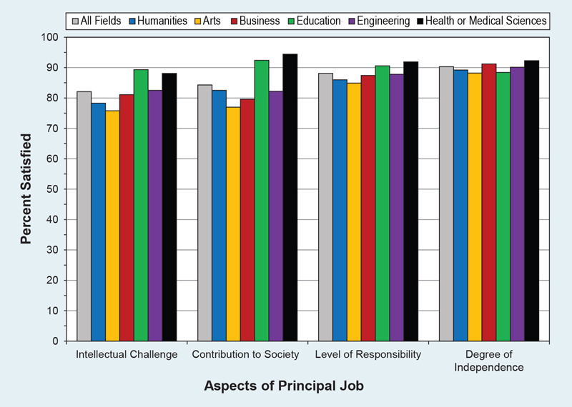
Bachelor’s Degree Holders’ Satisfaction with Intangible Aspects of Their Principal Job,
by Field of Bachelor’s Degree, 2015
Notes:
Humanities graduates’ satisfaction with a range of intangible aspects of their job was similar to the share for all fields on most measures. The shares of graduates with bachelor’s degrees in the humanities who expressed satisfaction about their contribution to society, their degree of independence, and their level of responsibility in their job were similar to the shares among graduates with degrees in business and engineering. Graduates from education and the health and medical sciences tended to have the highest levels of satisfaction on these aspects of their job.

Slide 20
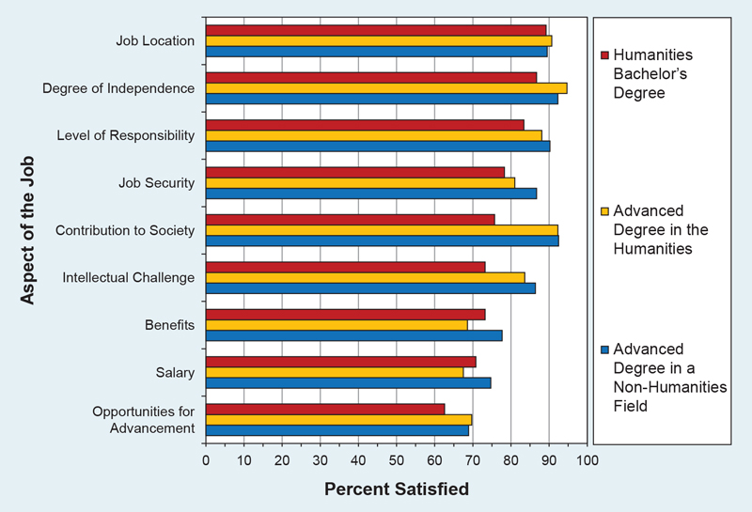
Satisfaction of Humanities Bachelor’s Degree Holders with Aspects of Their
Principal Job, by Highest Degree, 2015
Notes:
Those who had earned both their bachelor’s and higher degree in the humanities had the highest percentage of satisfaction with their degree of independence but the lowest percentage of satisfaction with their salary and benefits. Graduates with an advanced degree in another field were the most likely to be satisfied with their salary and job security. When it came to satisfaction with various aspects of their job, earning an advanced degree appeared to make only a modest difference for holders of humanities bachelor’s degrees, and the disparities were less pronounced than the differences in earnings.

Slide 21
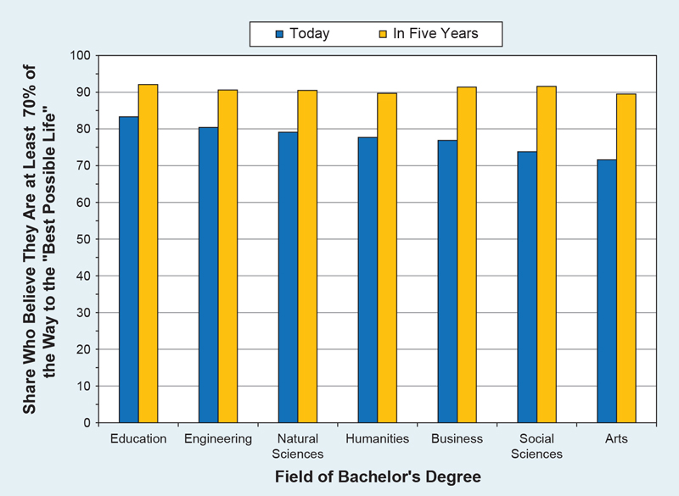
Satisfaction of Humanities Bachelor’s Degree Holders with Aspects of Their
Principal Job, by Highest Degree, 2015
Notes:
Work life is but one aspect of well-being. When asked to reflect on their lives generally, a 2014 Gallup survey found modest differences among majors with respect to the share who believed that they had or soon would realize their “best possible” life. At the time of the survey, over three-quarters of humanities graduates saw themselves at least 70% of the way to this goal, which was similar to the shares of engineering and natural science graduates who believed this. Education majors were the most likely to feel they were close to attaining such a life.
In every field, an even larger share of respondents expected to be well on their way to their best life or to have attained that life in five years. Ninety percent of humanities majors reported believing this, alongside similarly large shares of graduates from every other field.

Slide 22
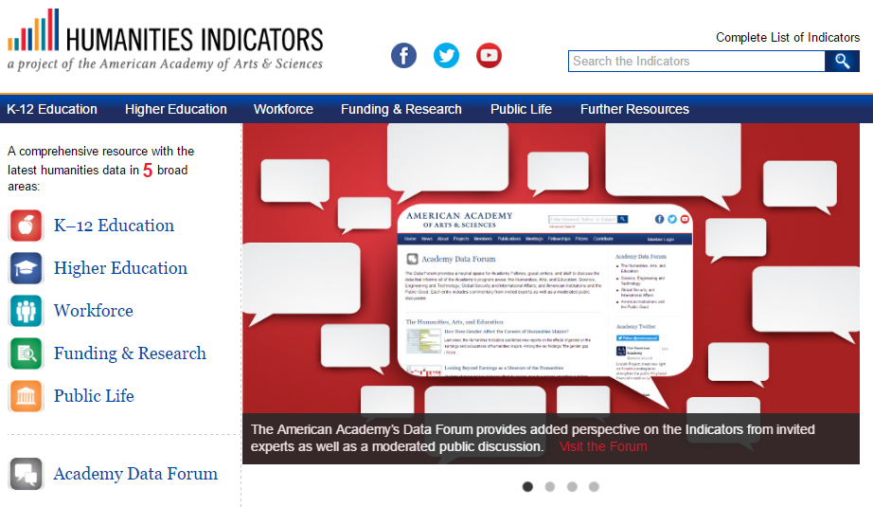
Visit us at www.HumanitiesIndicators.org
          Contact us with specific questions at rtownsend@amacad.org and cfuqua@amacad.org or on Twitter @rbthisted and @humedk12
And sign up for email updates at http://bit.ly/IndicatorsUpdates

