Slide 1
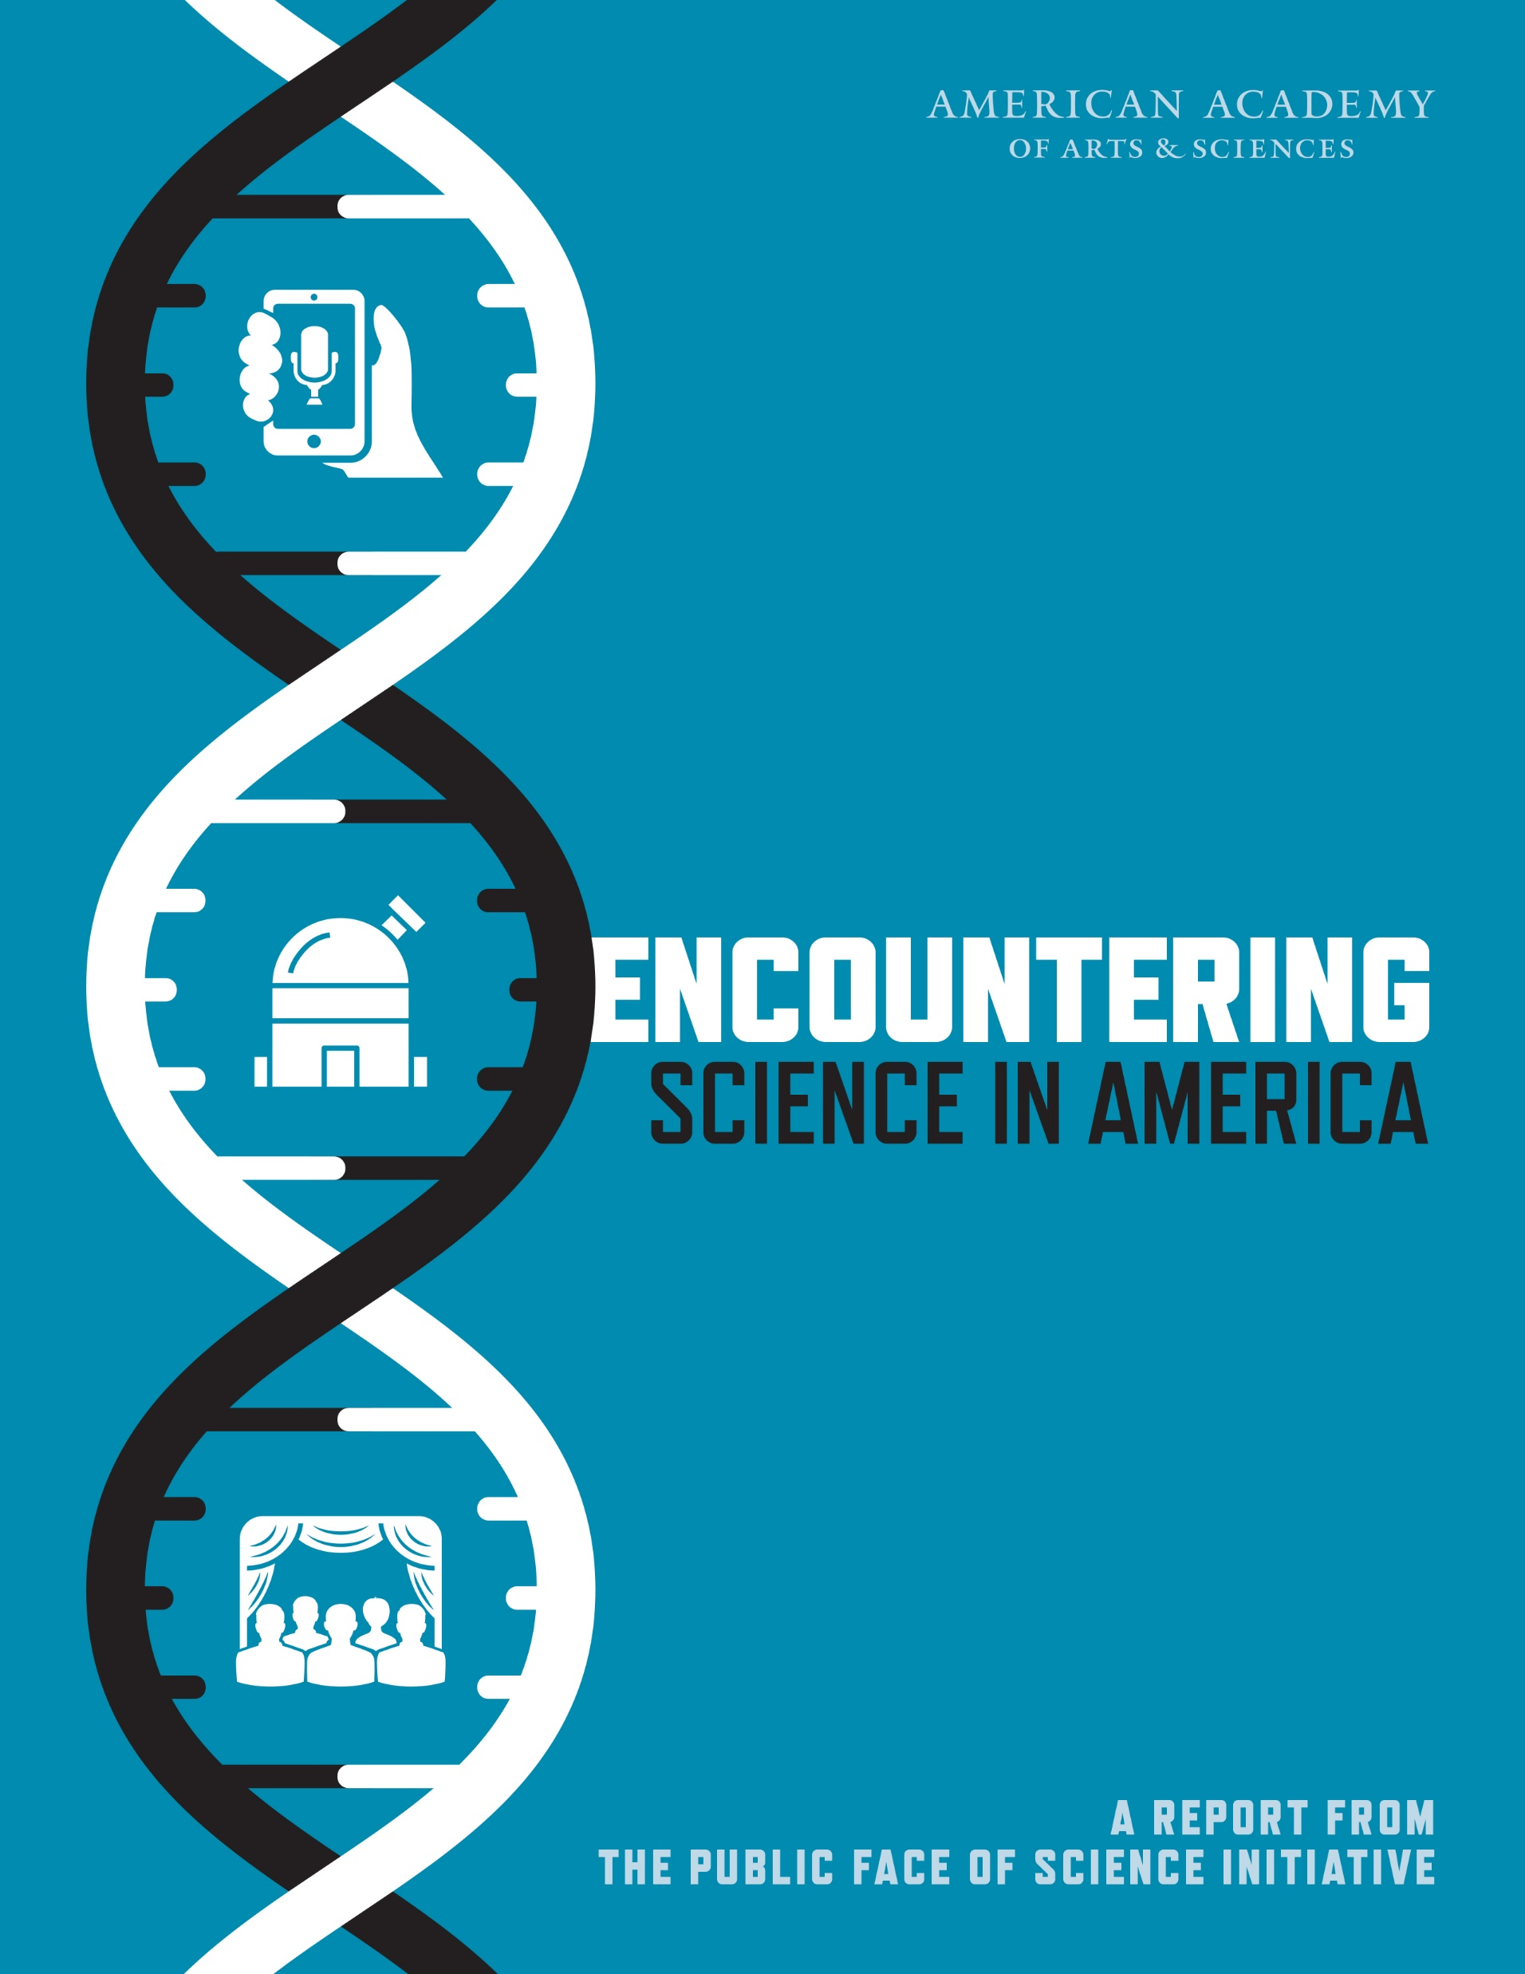
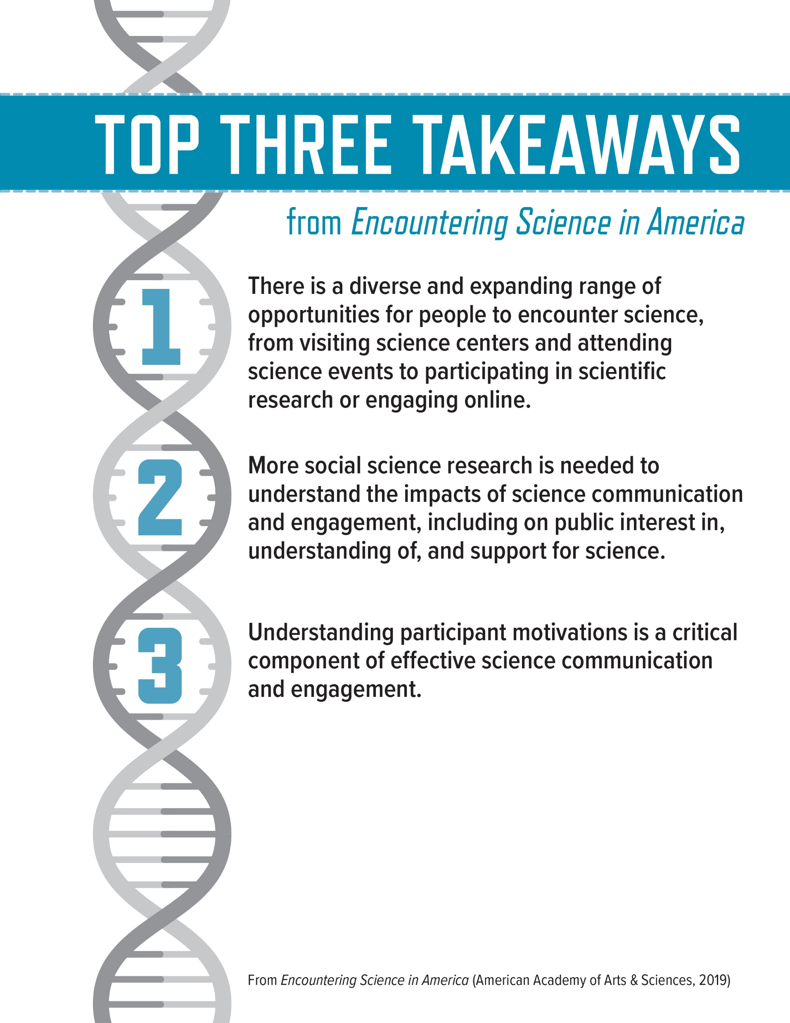

Slide 2
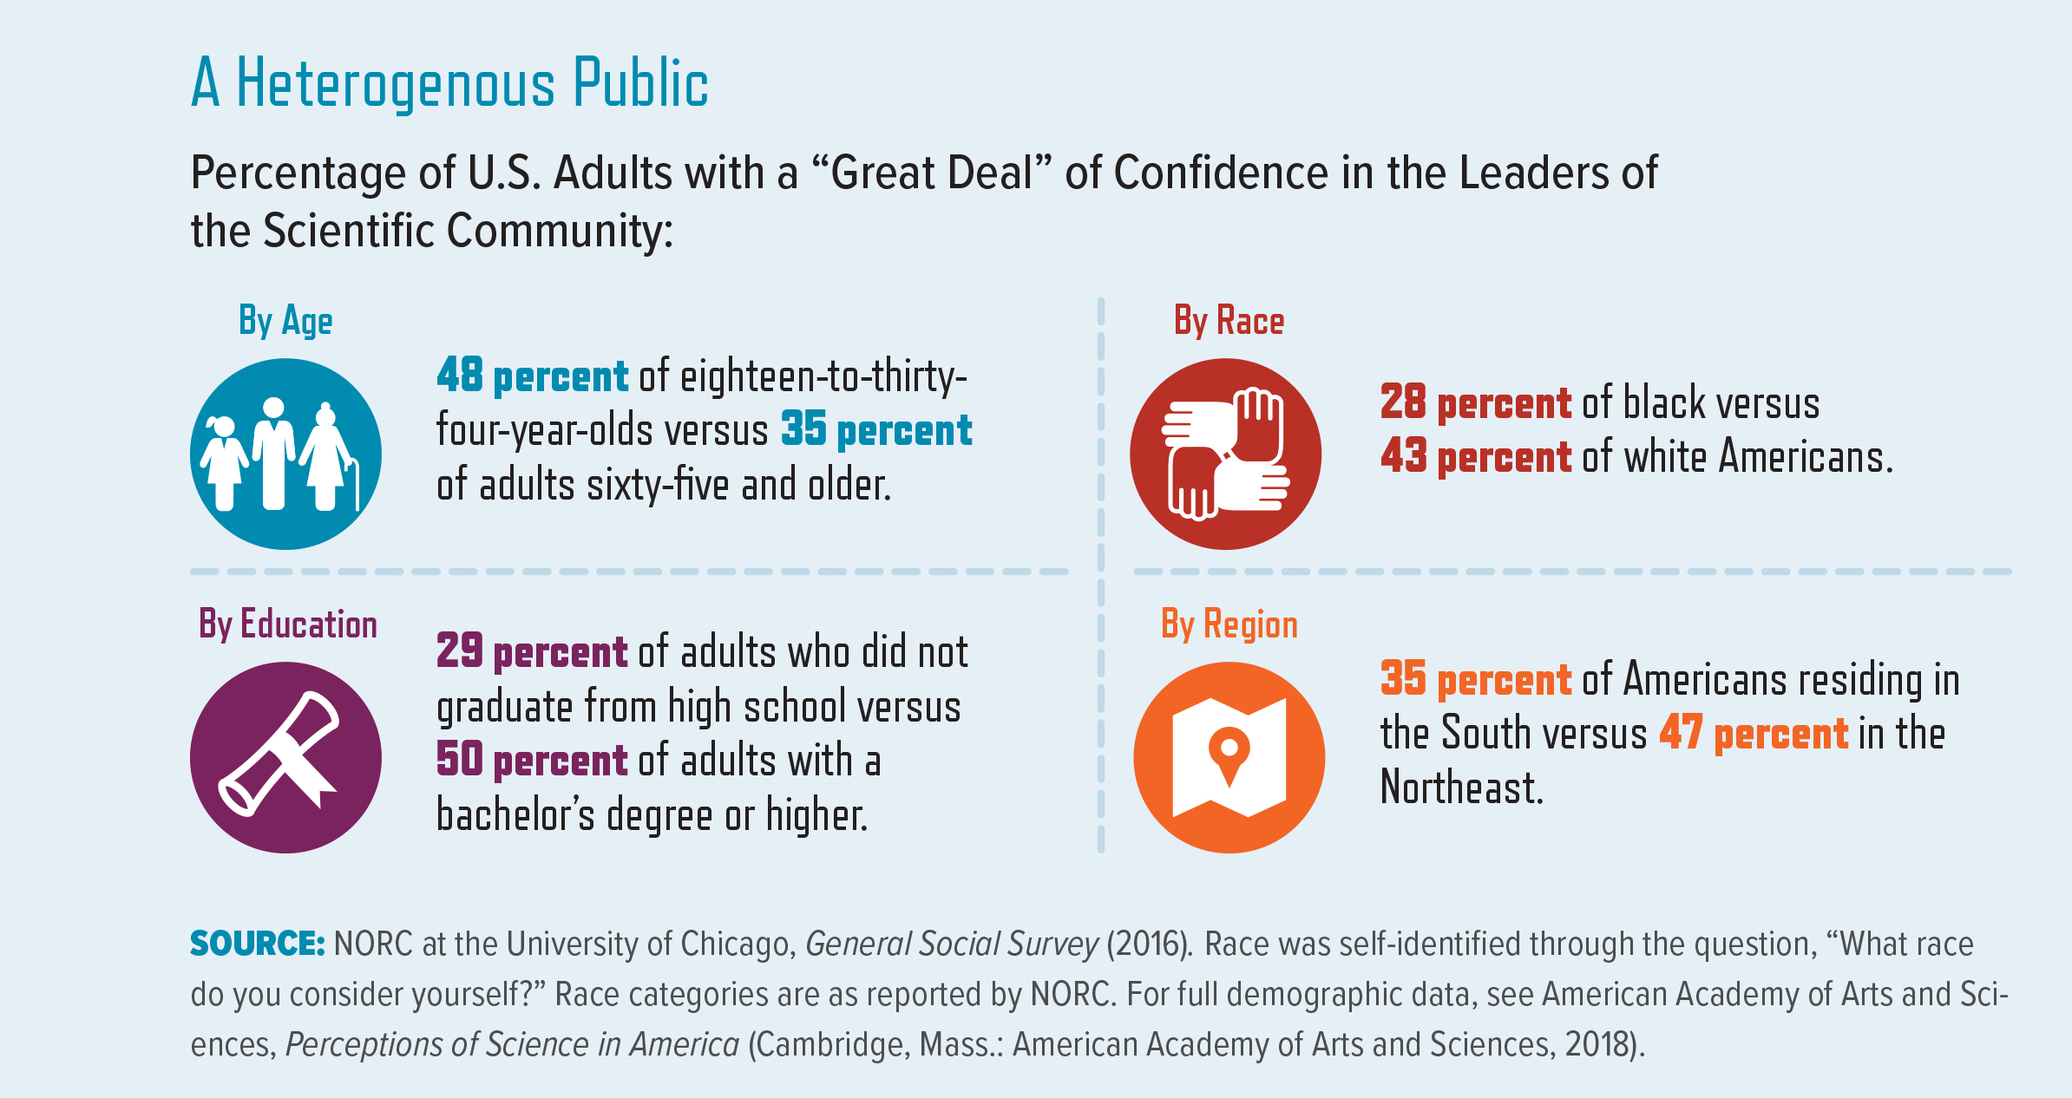
Notes:
In February 2018, the American Academy of Arts and Sciences released the first report from its Public Face of Science Initiative. Titled Perceptions of Science in America, the report presents data showing that confidence in scientific leaders has remained generally stable over the last thirty years, but that attitudes toward science vary based on age, race, educational attainment, region, political ideology, and other factors. Taken together, these data support the notion of a heterogeneous public whose perceptions depend on context and values.

Slide 3
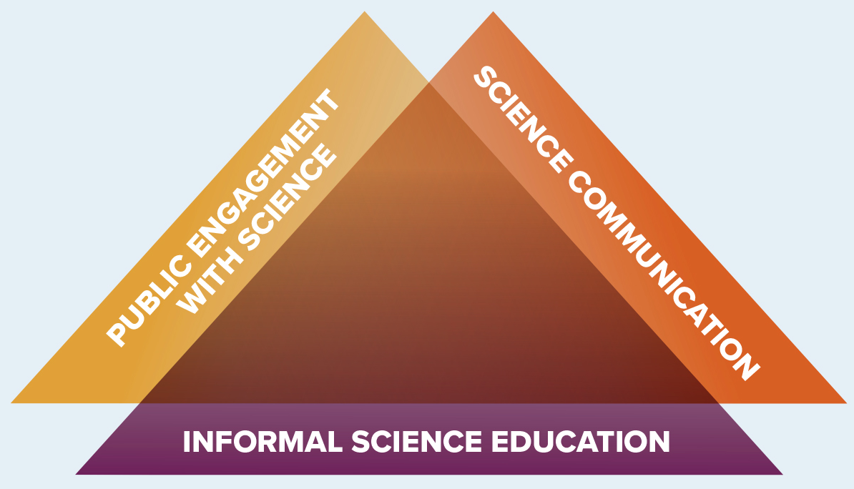
Notes:
While science communication, public engagement, and informal science education have much in common, they can be viewed as distinct fields that share similar goals and practices.4 Each of these fields may seek to influence the accuracy and accessibility of scientific information, the quality of science-based experiences, and opportunities for direct engagement with content experts. However, informal science education focuses on outcomes associated with learning and public engagement activities whose designs and settings take audiences’ interests, prior learning, and culture (or identity) into account. The distinction between science communication, engagement, and education is particularly evident among the practitioners and those who study the practices. The science of science communication—a specialized subfield that studies “how science can best be communicated in different social settings” and the effectiveness of these methods—is one specific example.5 The rise of this interdisciplinary research has helped advance the practice of science communication and engagement.
PUBLIC ENGAGEMENT WITH SCIENCE The American Association for the Advancement of Science (AAAS) defines “public engagement with science” as “intentional, meaningful interactions that provide opportunities for mutual learning between scientists and members of the public.”6
SCIENCE COMMUNICATION A National Academies of Sciences, Engineering, and Medicine (NASEM) report on communicating science effectively defines science communication as “the exchange of information and viewpoints about science to achieve a goal or objective such as fostering greater understanding of science and scientific methods or gaining greater insight into diverse public views and concerns about the science related to a contentious issue.”7
INFORMAL SCIENCE EDUCATION The Center for Advancement of Informal Science Education (CAISE) describes the field of informal science education as pursuing opportunities for “lifelong learning in science, technology, engineering, and math (STEM) that takes place across a multitude of designed settings and experiences outside of the formal classroom.”8

Slide 4
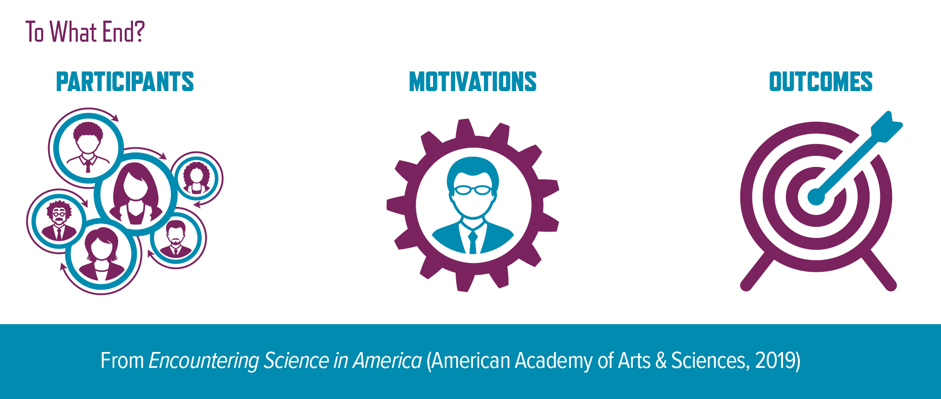
Notes:
This section examines three core elements of science communication and engagement: 1) the diverse categories of participants; 2) the range of motivations that lead each of these groups to participate; and 3) the resulting outcomes, including but not limited to the acquisition of new skills, knowledge, attitudes, or behaviors. The following pages focus on the motivations of, and outcomes for, participants from the public and scientific communities. Despite the heterogeneity within these groups (particularly the public; see next page), there are nevertheless common themes regarding the nuances of their motivations and outcomes. It is necessary to understand these considerations in order to develop effective approaches to science communication

Slide 5
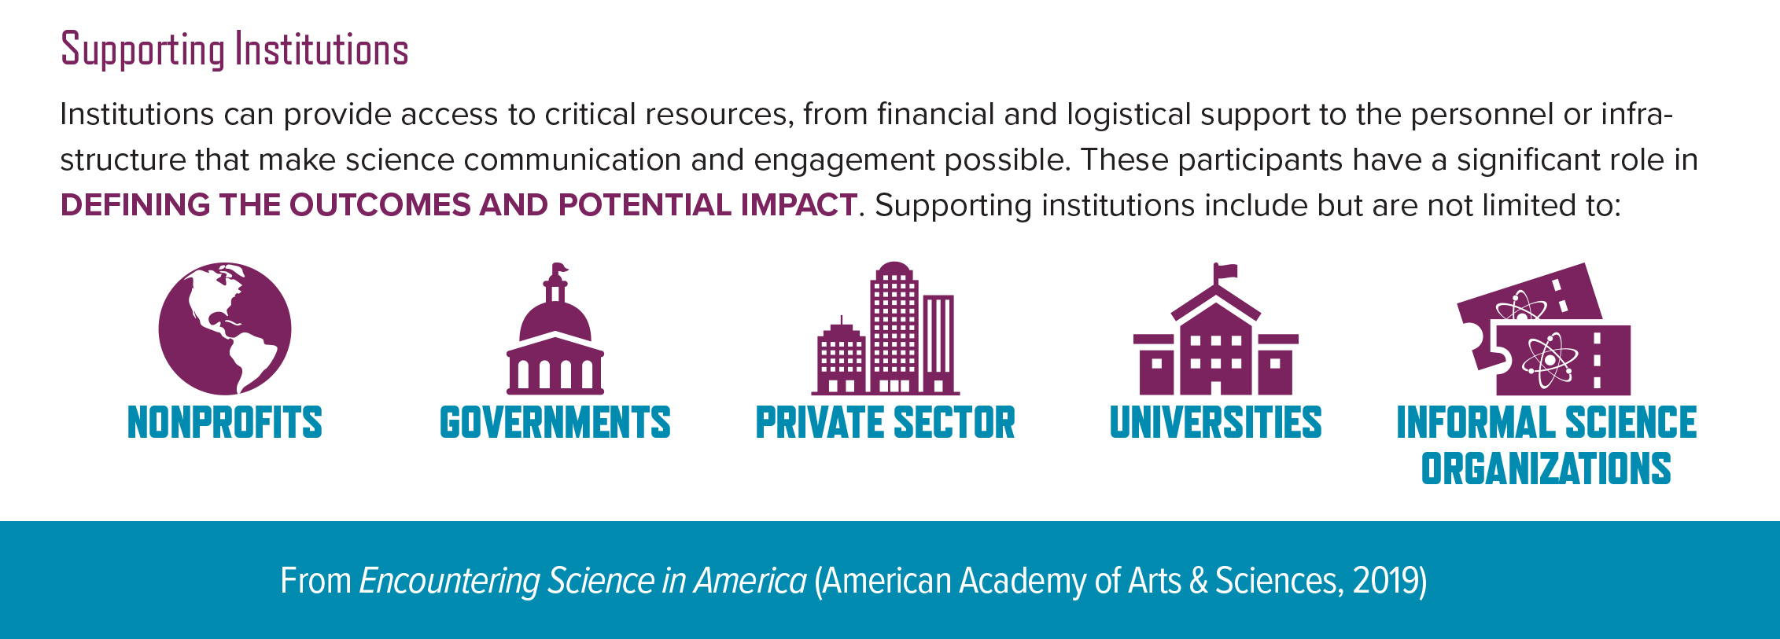

Slide 6
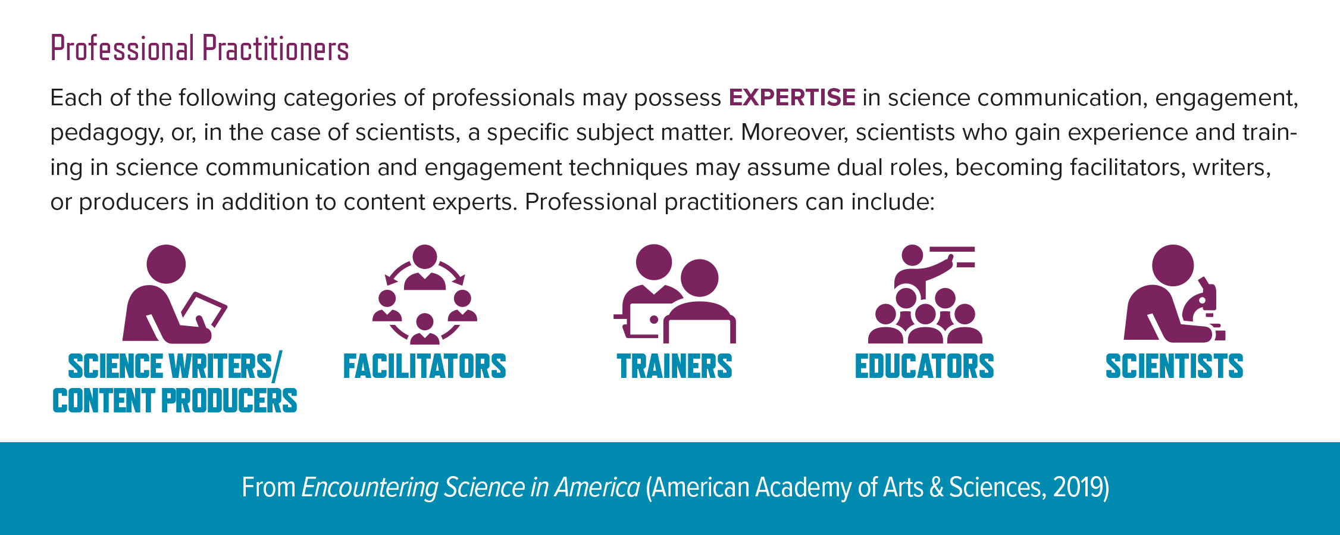

Slide 7
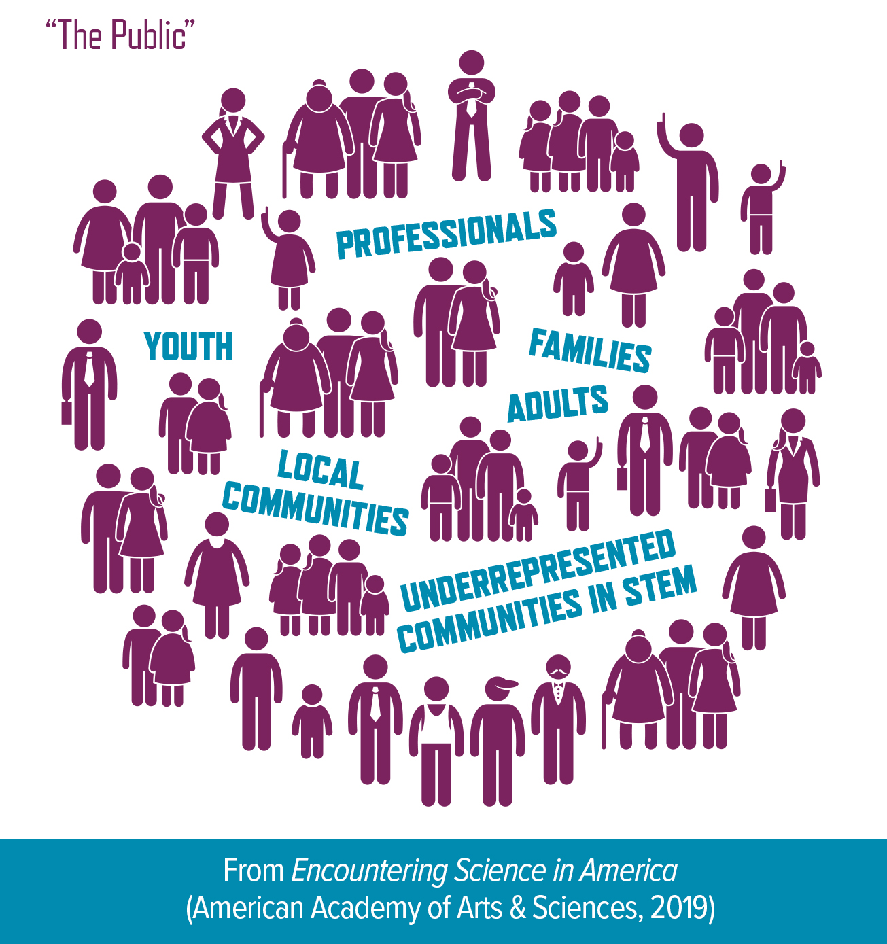
Notes:
There is no singular “public,” but rather many publics whose diverse backgrounds, expertise, and experiences can influence the efficacy of science communication and engagement (see Takeaways about the “Public” below).* The term public is used here to differentiate general science communication and engagement from more-specialized activities such as communicating about science-based policy, or the day-to-day teaching of science in classrooms. Insights into which members of the public are likely to participate in a given activity can be gained through published research and surveys on participation in similar activities. In addition, science communication and engagement efforts may be designed to reach particular categories of the public

Slide 8
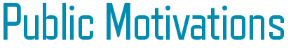
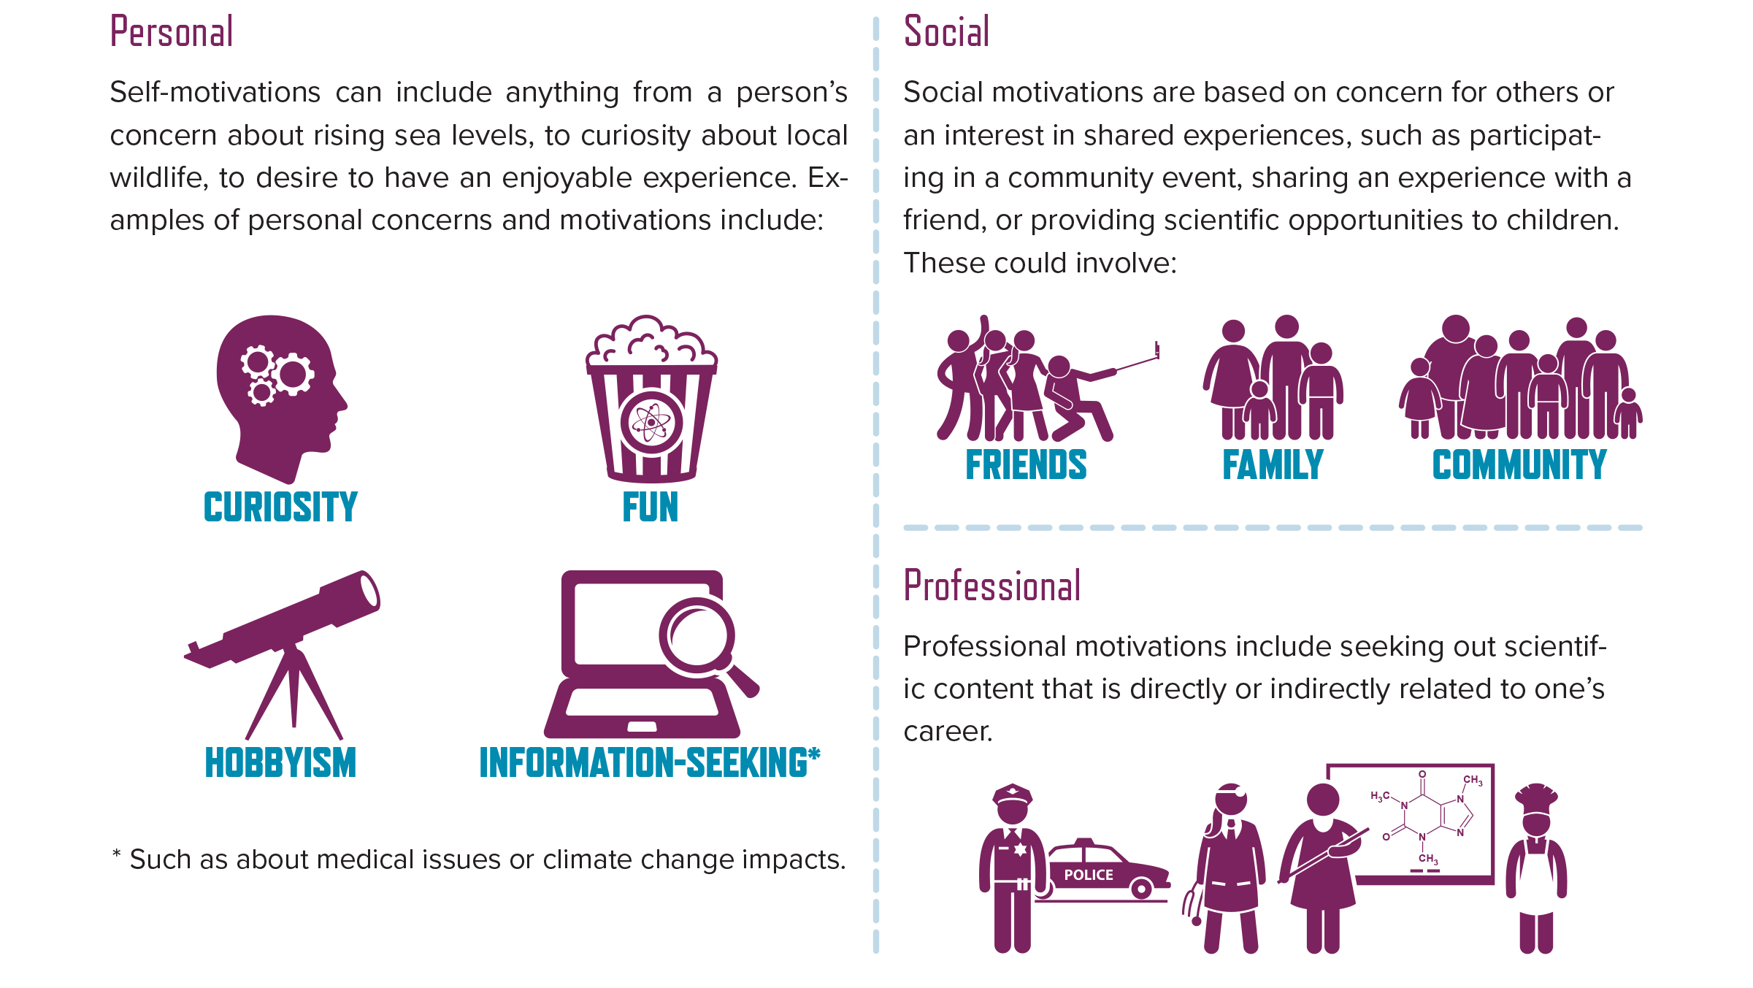

Slide 9
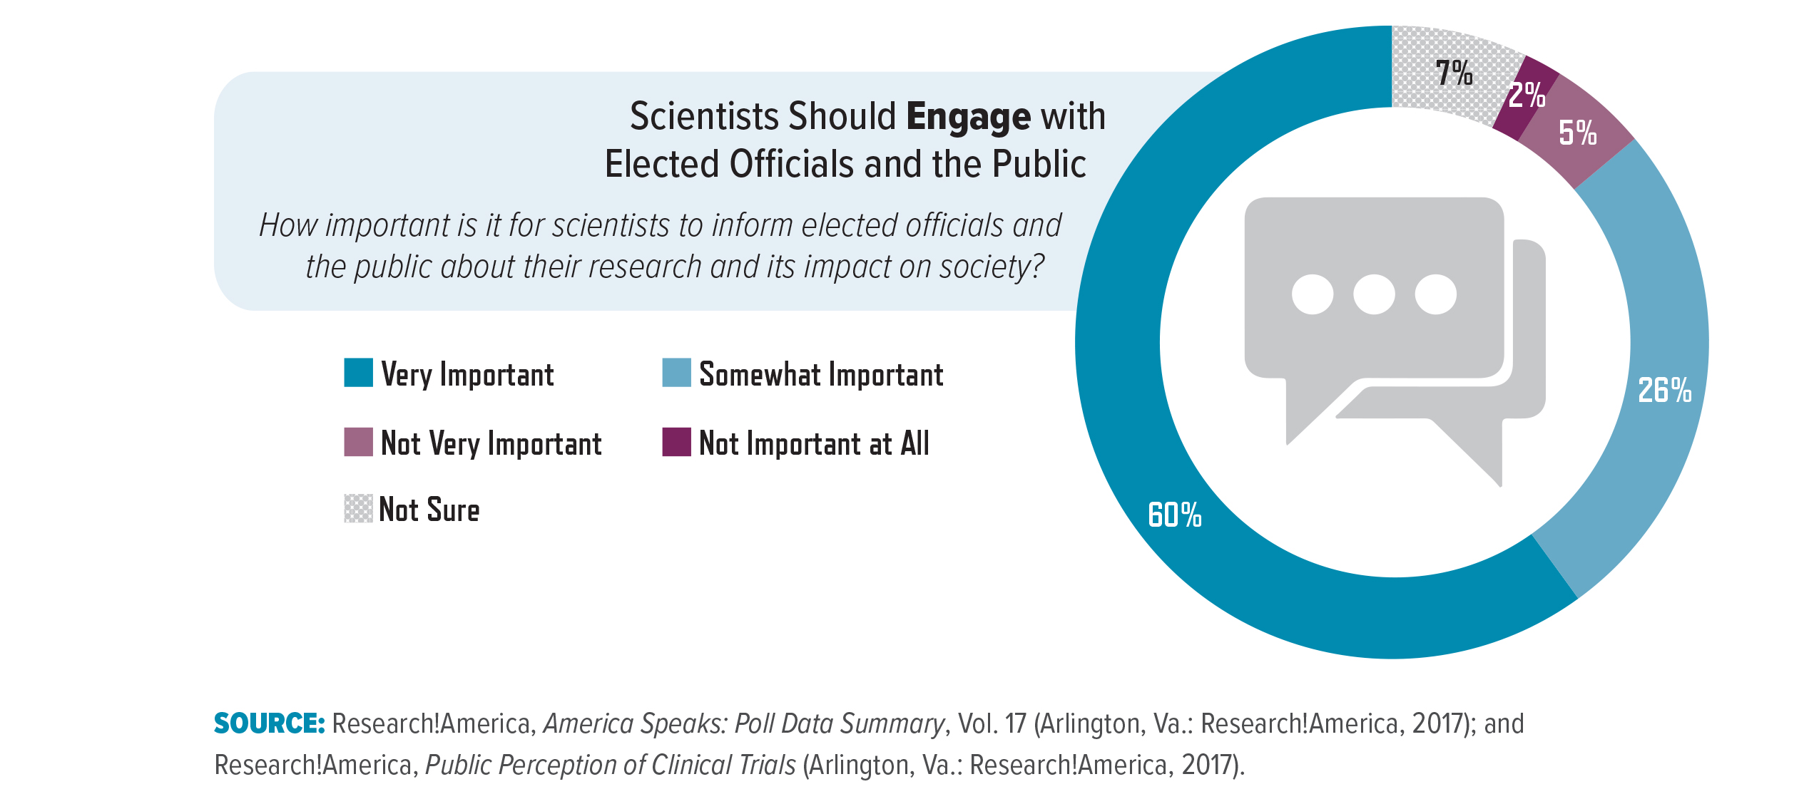
Notes:
Scientists Have a Variety of Personal and Professional Motivations
A 2013 survey of Ph.D.-level university scientists in the United States found that “defending science” and “informing the public about science” were high priorities for online public engagement.13 Other personal motivations included the desire to improve science literacy, the desire to strengthen the perception of science, and personal enjoyment.14 Participation in communication and engagement activities may also be motivated by funding or job requirements or the desire to increase the visibility of one’s personal research. Public demand supports these motivations: a 2017 Research!America survey found that 86 percent of people agreed it was “very” or “somewhat” important for scientists to inform elected officials

Slide 10
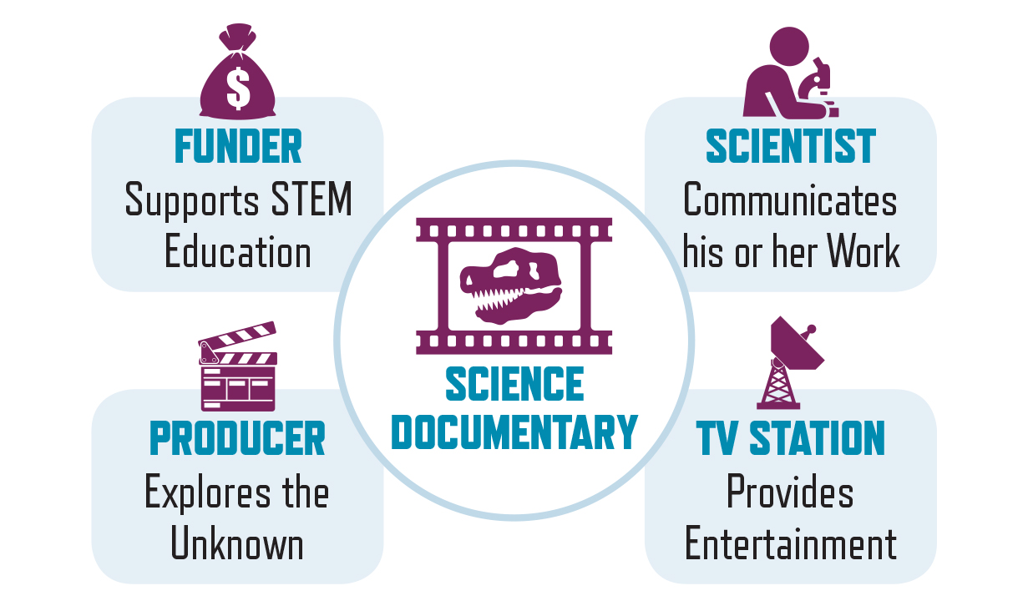
Notes:
The experts and institutions who organize, facilitate, host, fund, and/or contribute to science communication and engagement activities have diverse and sometimes conflicting motivations. The following example demonstrates how the motivations of funders, producers, scientists, and disseminators can converge as part of a shared activity. In this example, all the participants share the goal of developing a science documentary series, but have distinct motivations for their involvement and seek different outcomes.

Slide 11
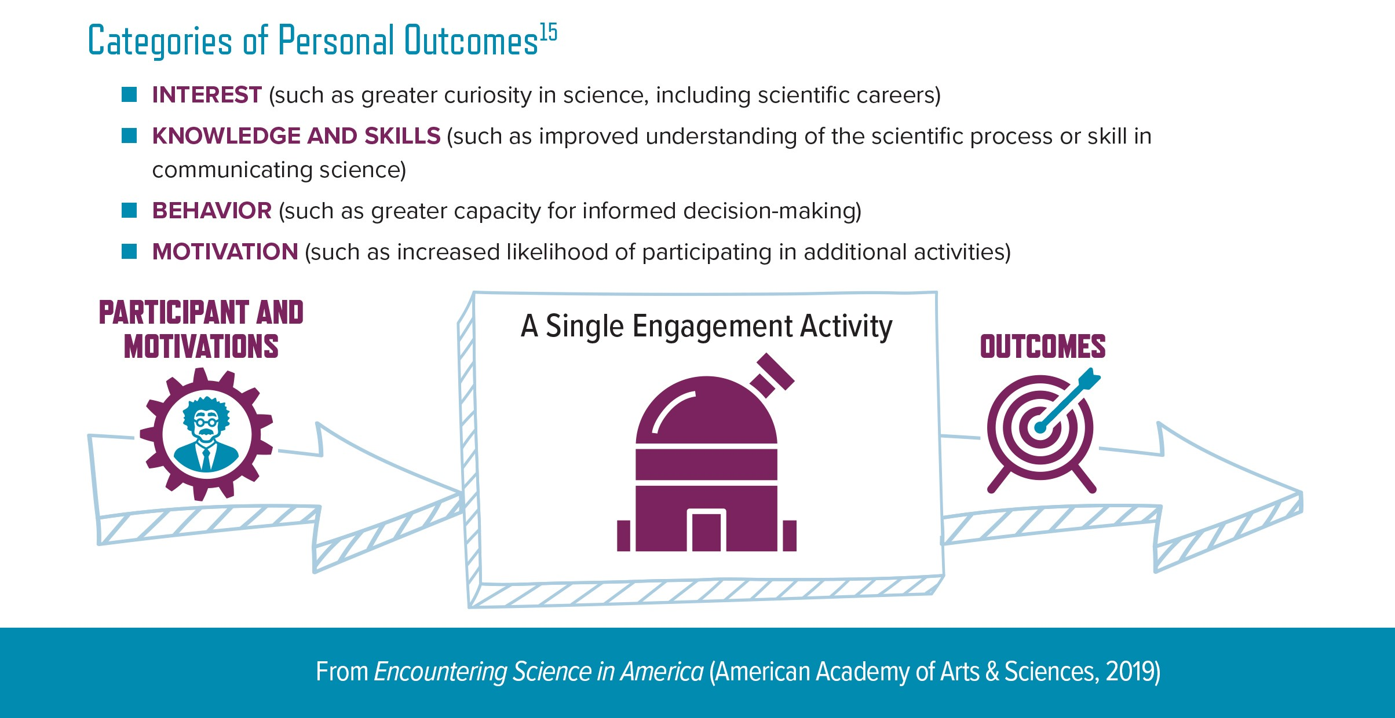
Notes:
Communication and engagement activities can have different outcomes for each of the involved participants. Potential outcomes range from changes in attitude, knowledge, or skills, to a greater curiosity and excitement about science, to better institutional relationships with the local community. For example, a scientist who participates in a science café may develop a greater understanding of the local community’s perspective on his or her work, whereas an attendee may become more motivated to click on a news article or watch a YouTube video on that scientific topic. Such outcomes can be immediate and carry direct personal benefits. (For examples of broader societal benefits, see Section 3: Designing Engagement for Specific Impact.)

Slide 12
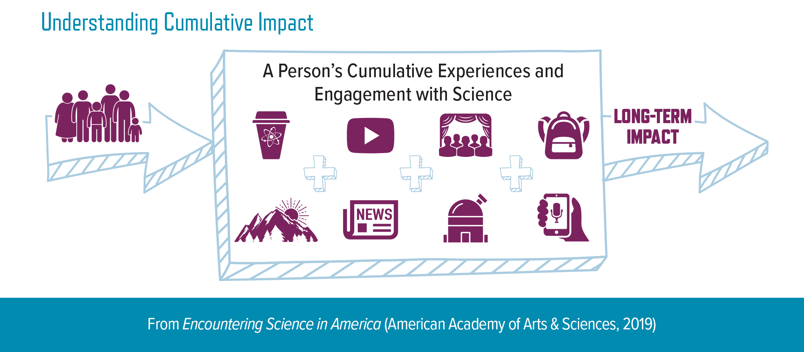
Notes:
Understanding Cumulative Impact
An individual’s underlying attitudes toward science are the result of the interaction between an unknown number of experiences with science and prior knowledge about science.18 The long-term, cumulative impacts of experiences and engagement with science are challenging to assess because these experiences do not occur as isolated events and there is limited data on an individual’s movement between activities. Further, differences in metrics and methodologies limit researchers’ ability to compare existing evaluation data.

Slide 13
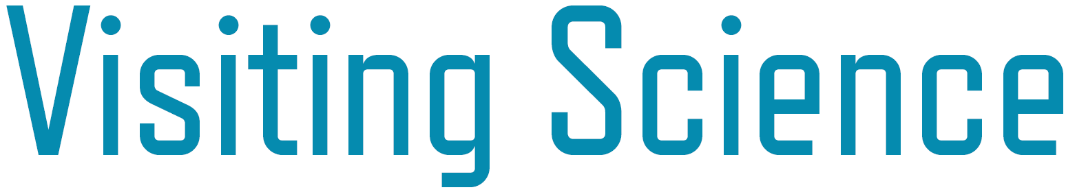
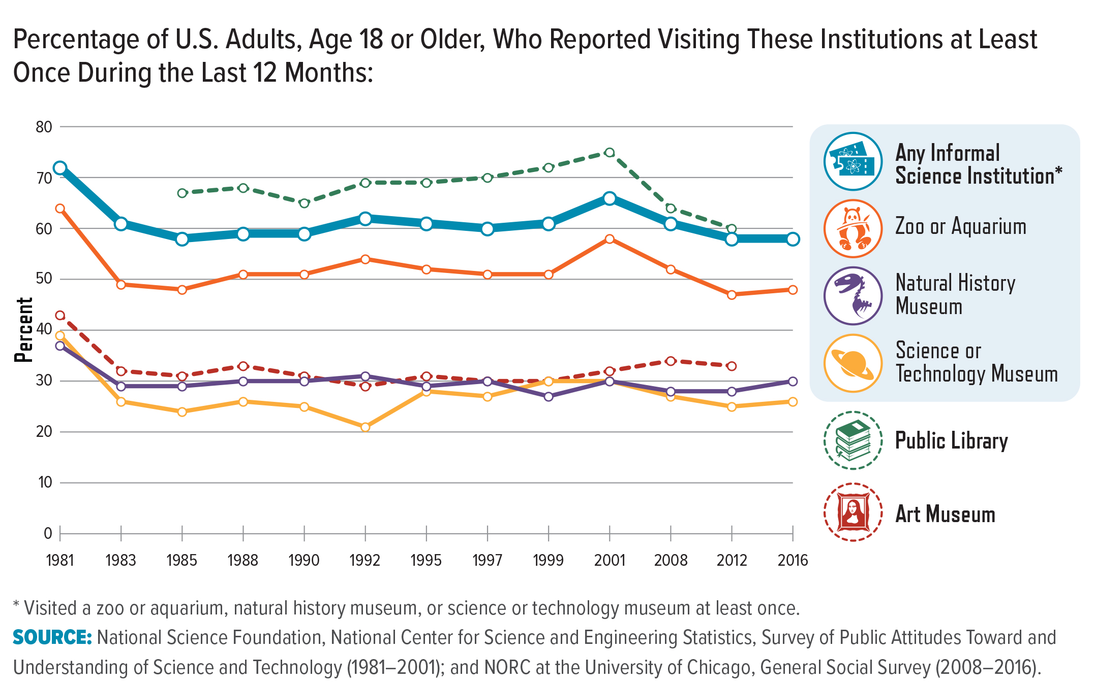
Notes:
Informal science education refers to experiences that take place outside of a formal classroom setting, including at museums, zoos, aquariums, planetariums, national parks, and botanical gardens.29 These institutions are visited by millions of people each year, including nearly 60 percent of U.S. adults—comparable to public library attendance (see graph below). While not all national parks and botanical gardens feature science, scientific programming can be incorporated into the experience, such as through location-based climate change programming.30 As described in the previous section, visitors interpret the knowledge gained through these experiences differently depending on their background, previous knowledge, and past experience.

Slide 14
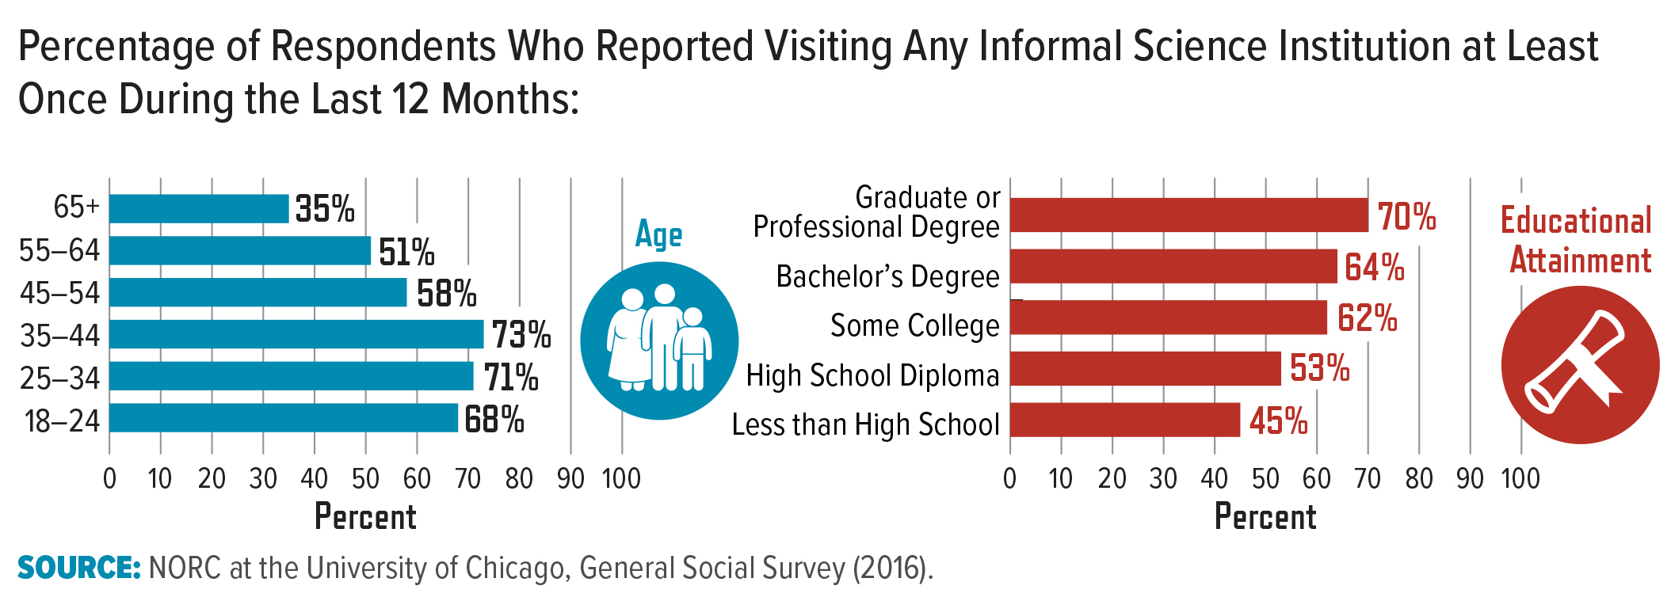
Notes:
In addition to designing programming to appeal to a demographically diverse audience, informal science centers also must consider the wide range of motivations that draw people to attend. Individuals do not necessarily visit science centers with the sole intention of learning about science. Indeed, for many people, the desire for social experiences and entertainment may be the primary reason for attending. When assessing the needs of the audience for exhibits and programs, therefore, it is crucial that curators, facilitators, and other practitioners start with an understanding of visitors’ motivations, as well as their demographic profiles.

Slide 15

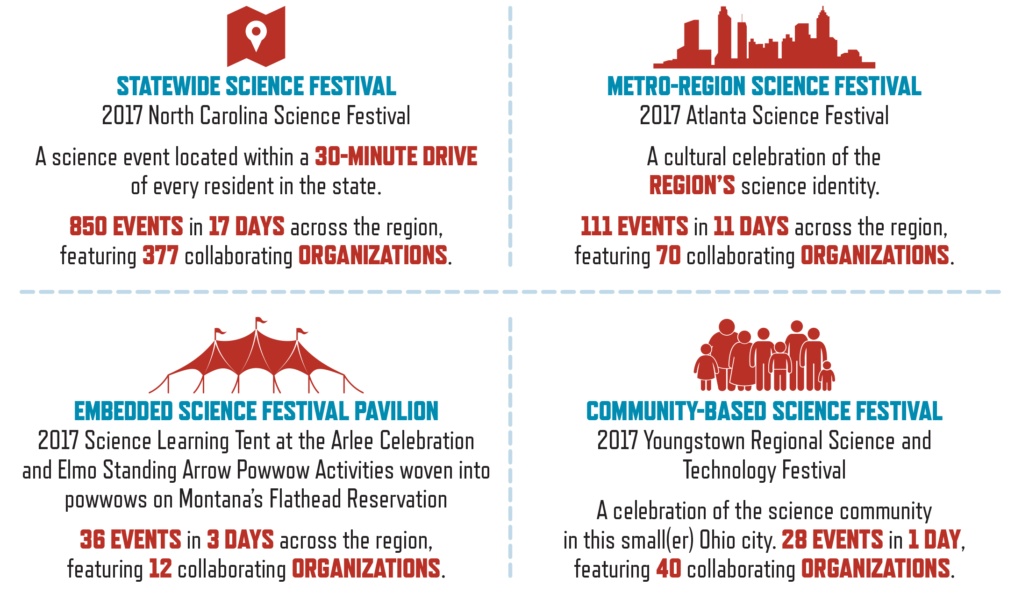
Notes:
Science festivals are collaborative annual or biennial event series that celebrate and engage local communities in STEM. The Science Festival Alliance (SFA) formed to establish and sustain such events. In 2017 alone, an estimated 19,892 STEM practitioners at forty-seven SFA festivals, representing a total of 4,671 events, hosted more than two million people across the United States.38 The four 2017 science festivals highlighted below demonstrate the wide variability in format and scope of science festivals:

Slide 16
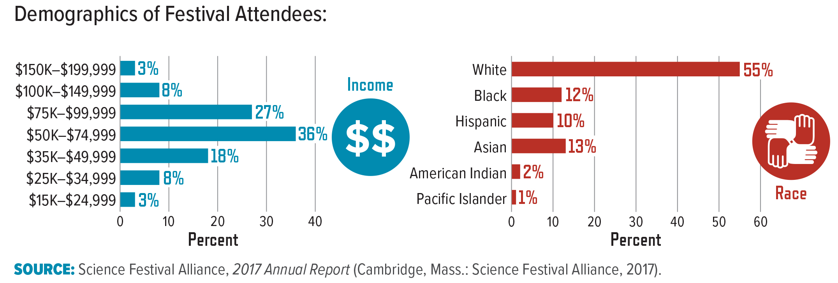
Notes:
EvalFest is an nsf-funded community of practice that develops evaluation approaches for understanding and explaining the impact of science festivals.39 Evalfest data from 2017 show that while many festival attendees came with their families, 33 percent of participants did not attend with children. Although the demographics of the attendees vary among festivals, on a national scale these data reveal a demographically diverse audience. Evalfest notes that these data were collected primarily at family friendly expos and may not be representative of the entirety of festival activity.

Slide 17
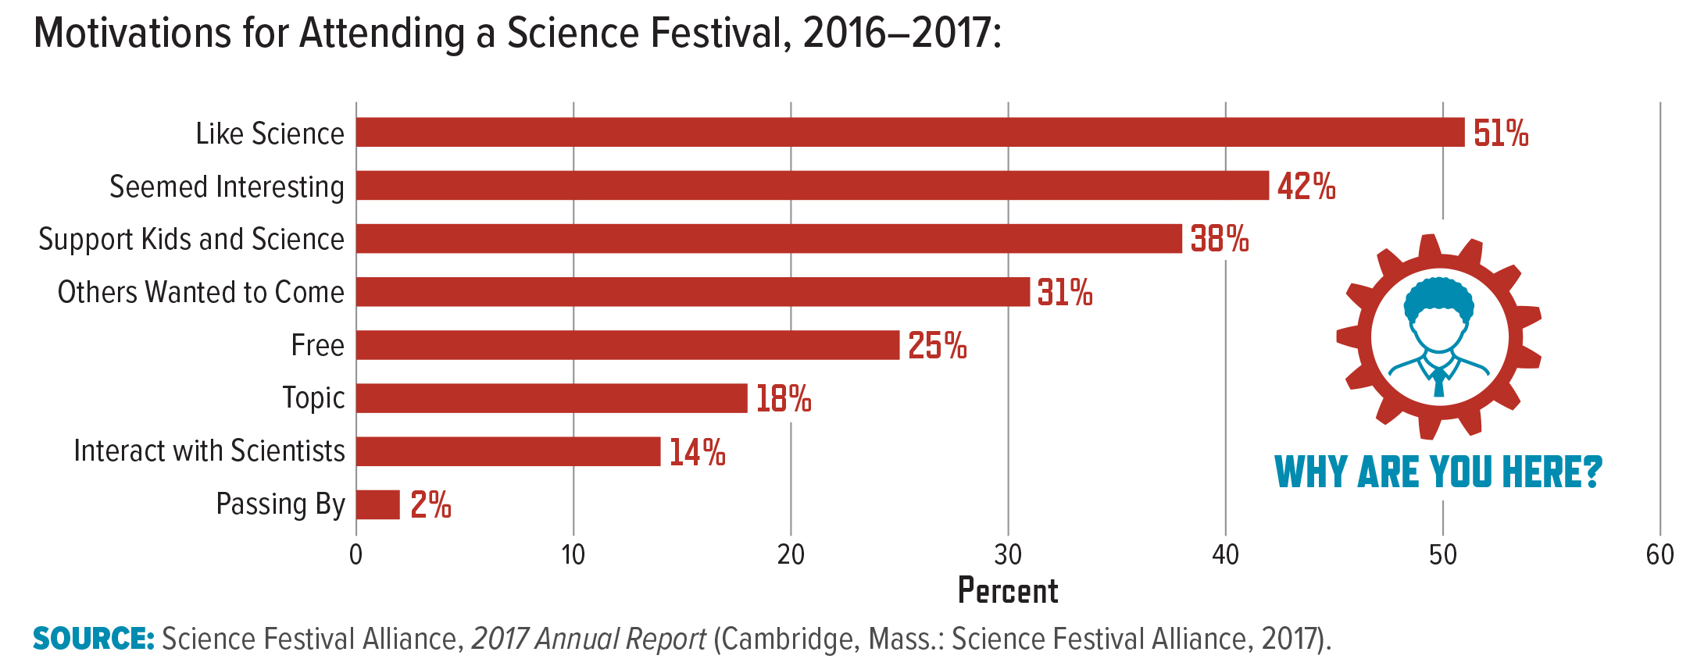
Notes:
Common motivations for attending science festivals cited by EvalFest survey respondents included liking science and interest in science. Data also suggest that festivals have positive effects on respondents’ perceptions of stem in their communities: 75 percent of attendees reported that a festival had “quite a bit” or a “great deal” of impact on their understanding of the advances their region or state was making in stem (data not shown).

Slide 18
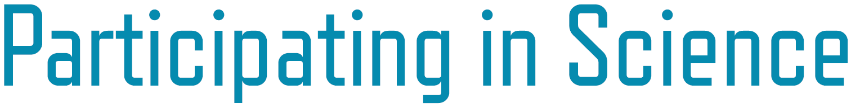
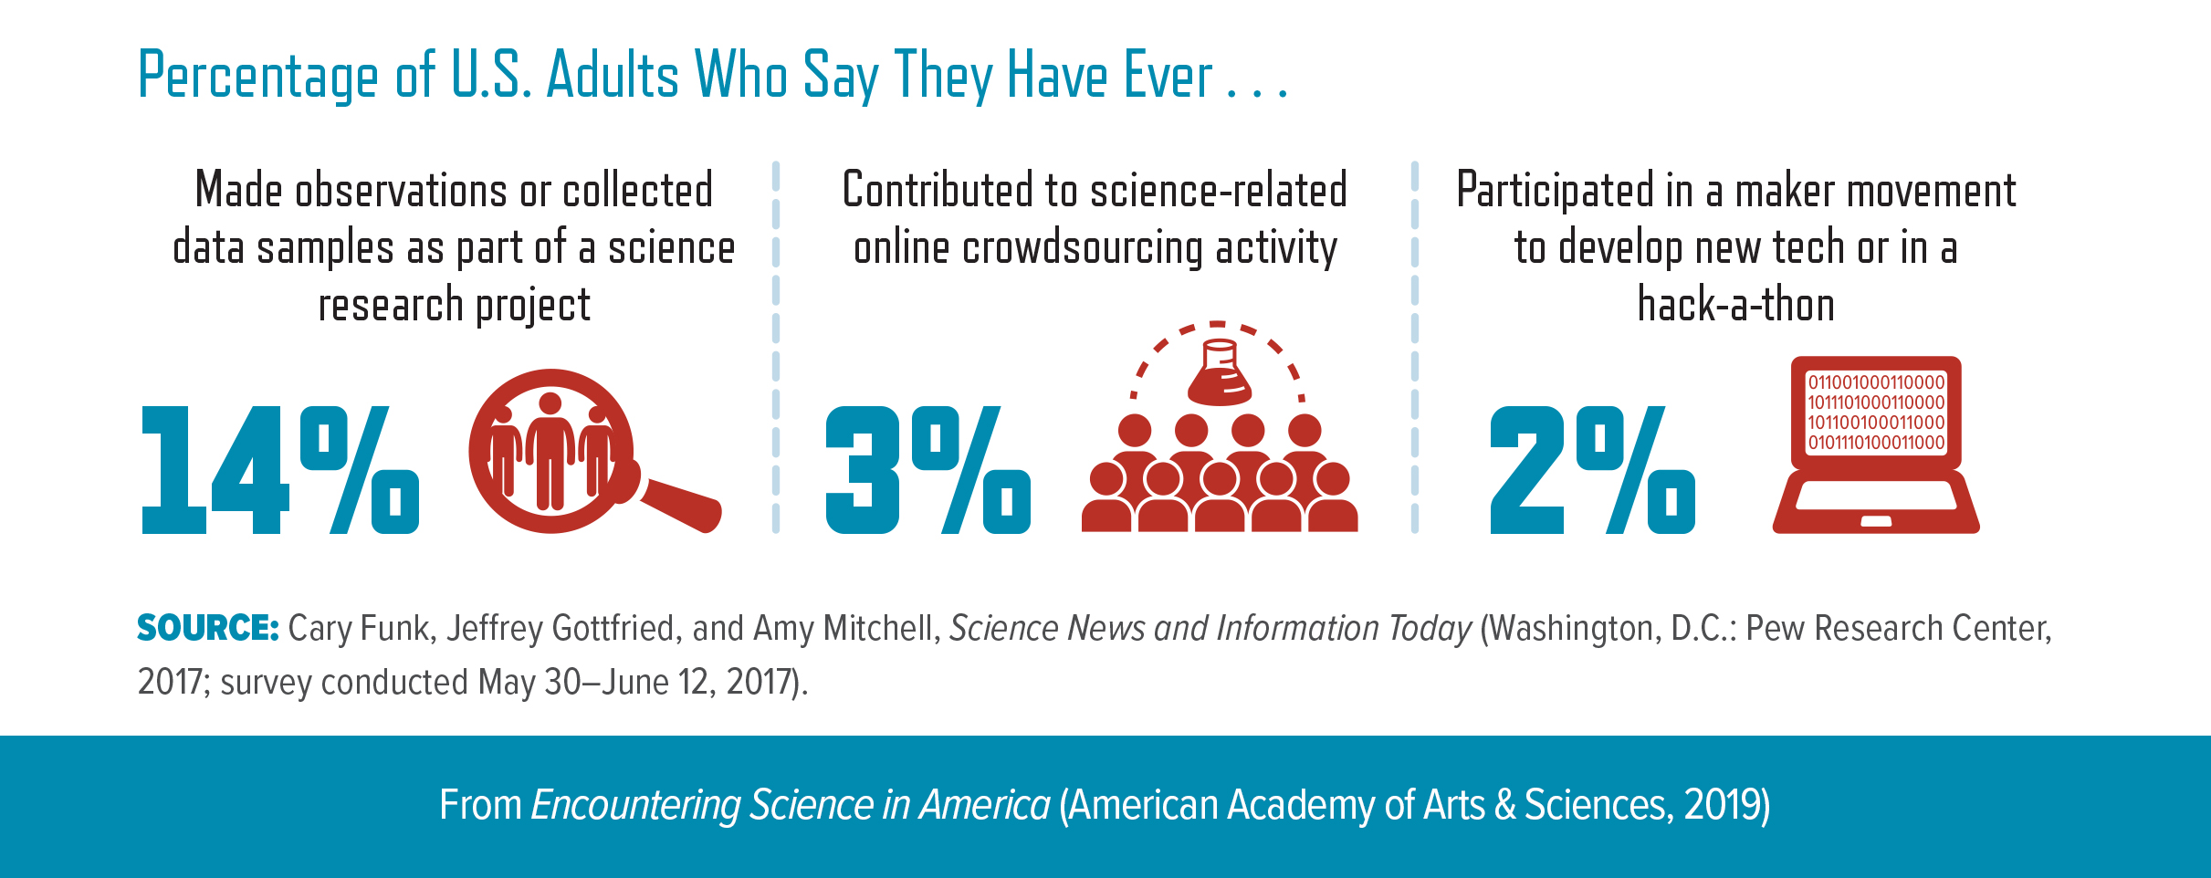
Notes:
Citizen science is an example of public participation in stem research. Citizen science generally refers to public (individual or community) contributions to large-scale scientific research projects, either in person and/or online. In addition to furthering scientific investigation, citizen science projects support educational and social objectives for the participants. These projects are commonly discussed on social media using the hashtags #CitizenScience and #CitizenScientists. Maker-spaces and online platforms can support citizen science projects by providing centralized locations for sharing ideas, equipment, and other resources.

Slide 19
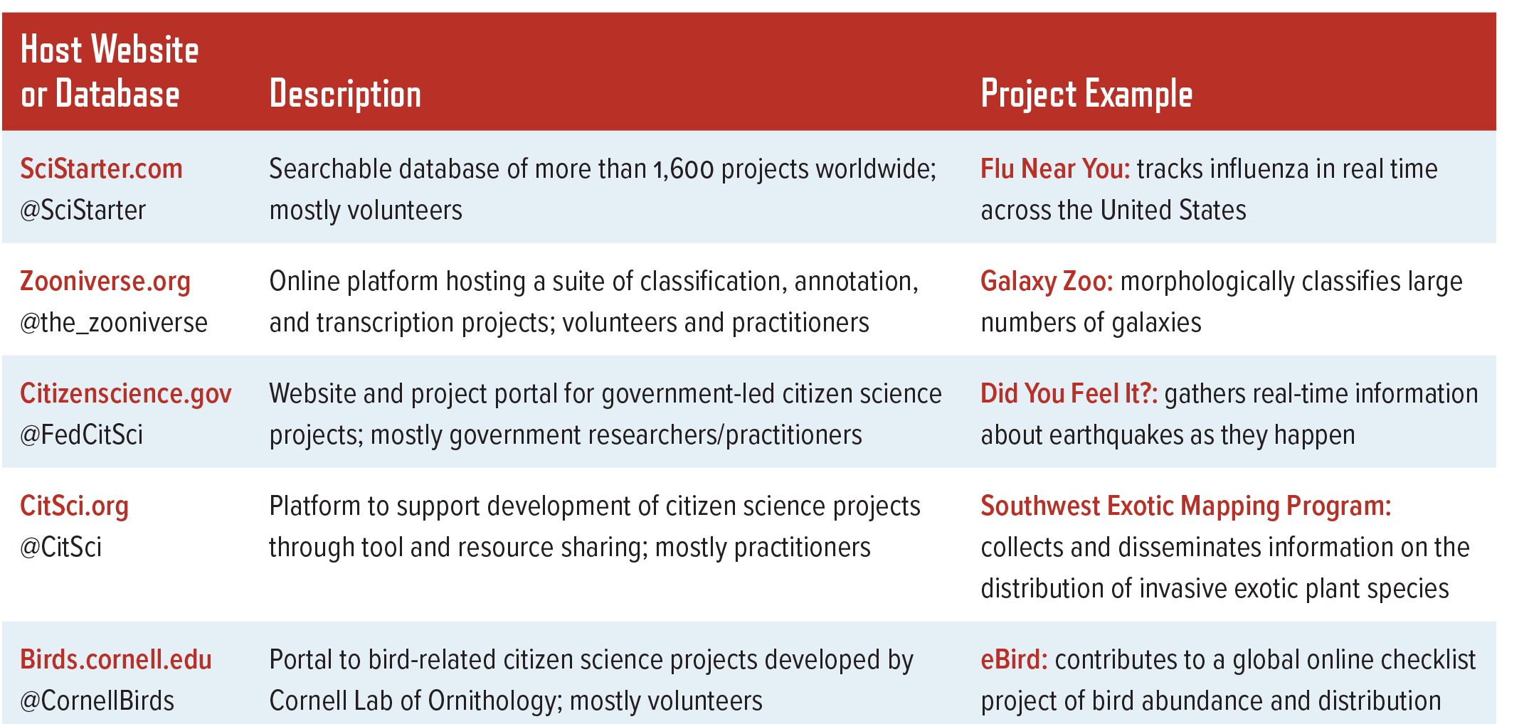

Slide 20
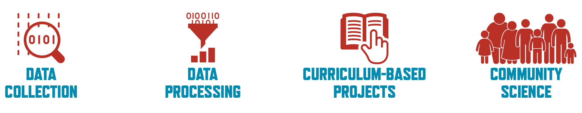
Notes:
Citizen scientists are motivated by everything from curiosity to general interest in science to the desire to contribute to research.40 According to a 2018 National Academies report, for citizen science activities, “science learning outcomes are strongly related to the motivations, interests, and identities of learners.”41 The outcomes of citizen science activities also vary with the project setting and nature of the activity. A majority of the topics in recently published articles mentioning citizen science are drawn from the biological sciences, astronomy, and environmental science (see data below). Some citizen science projects have been shown to raise awareness of new research, promote greater understanding of science, encourage continued participation in engagement activities, and increase monitoring of local issues.42

Slide 21
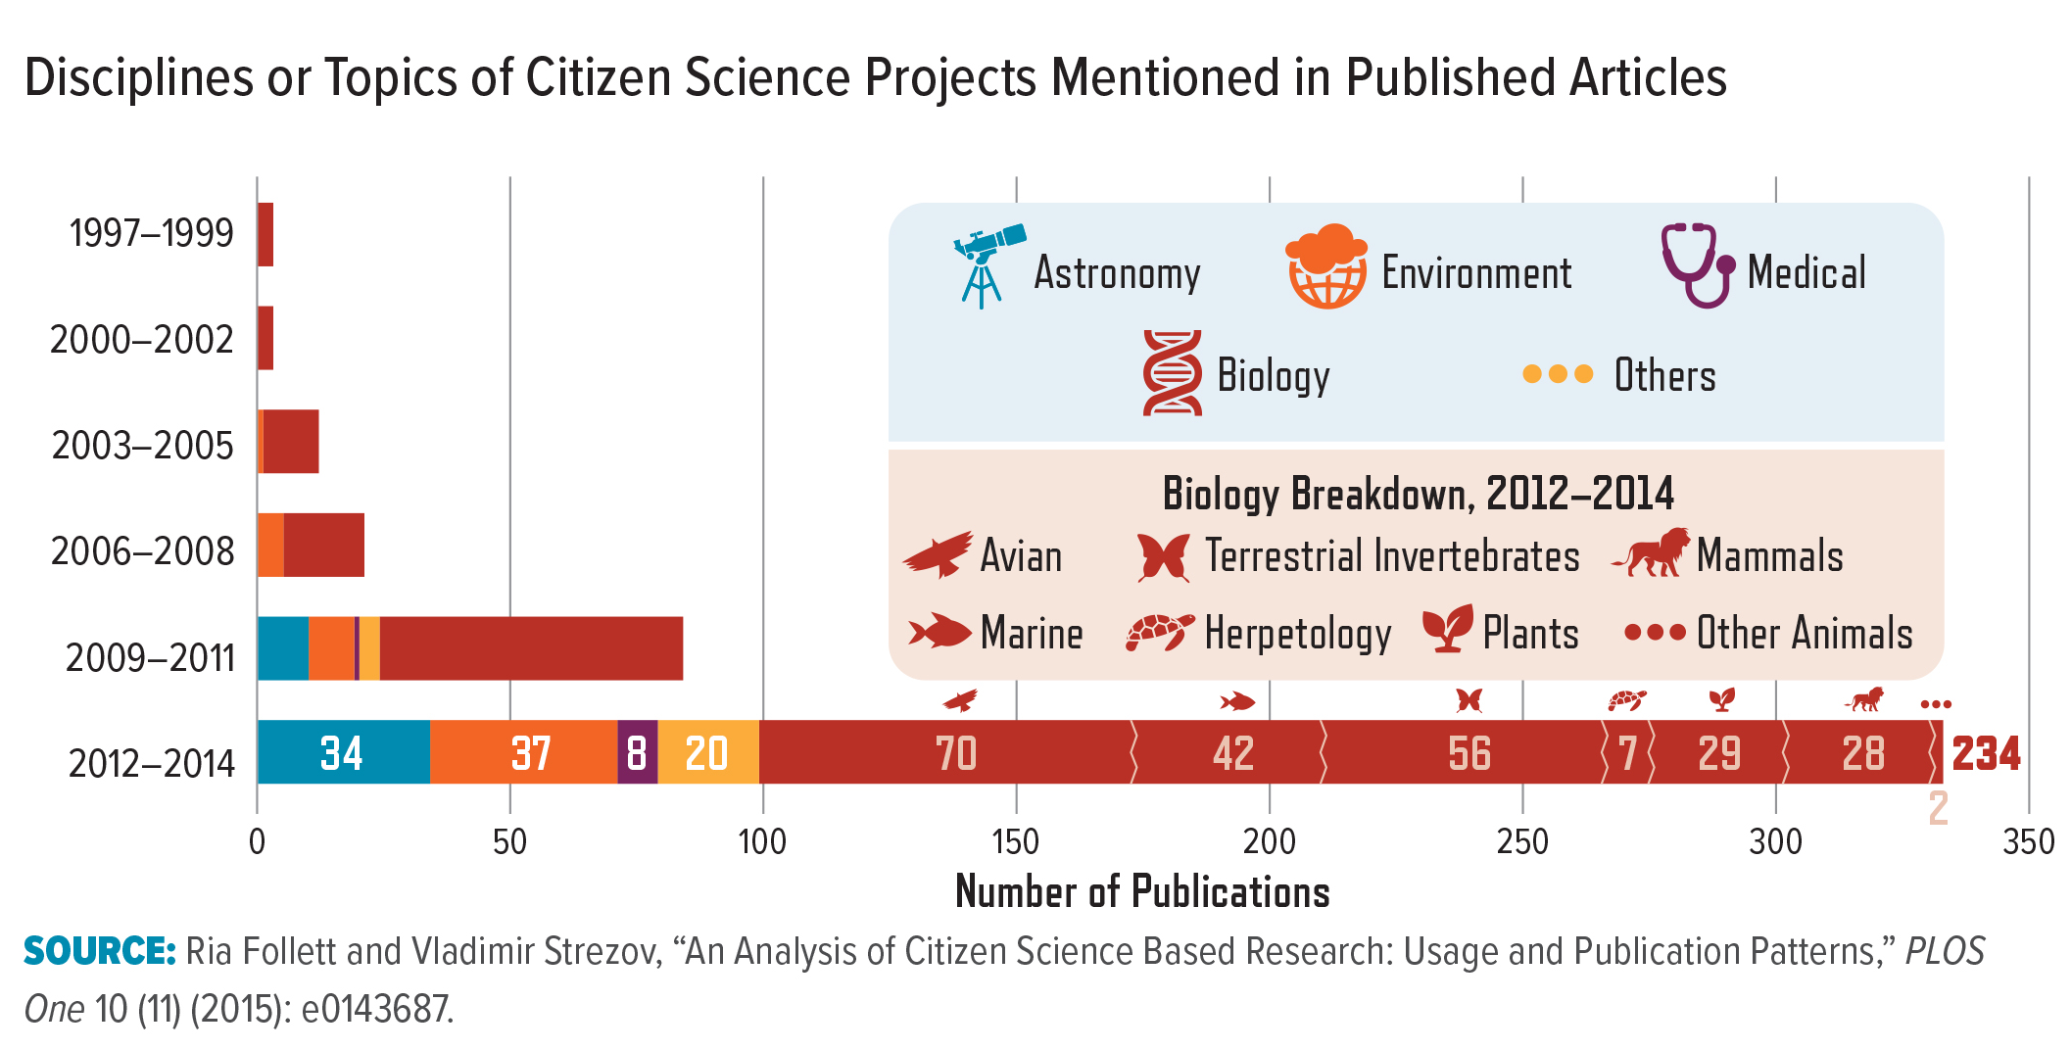
Notes:
Citizen scientists are motivated by everything from curiosity to general interest in science to the desire to contribute to research.40 According to a 2018 National Academies report, for citizen science activities, “science learning outcomes are strongly related to the motivations, interests, and identities of learners.”41 The outcomes of citizen science activities also vary with the project setting and nature of the activity. A majority of the topics in recently published articles mentioning citizen science are drawn from the biological sciences, astronomy, and environmental science (see data below). Some citizen science projects have been shown to raise awareness of new research, promote greater understanding of science, encourage continued participation in engagement activities, and increase monitoring of local issues.42

Slide 22
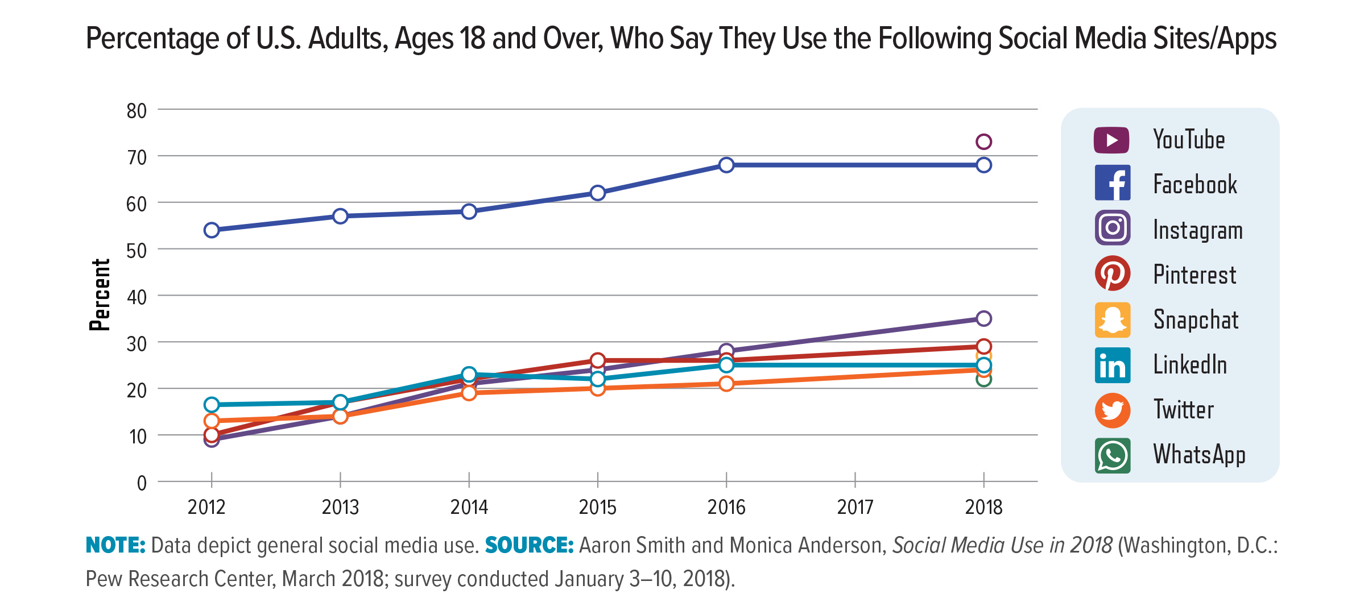
Notes:
Social Media
Social media platforms such as YouTube, Facebook, Instagram, Twitter, and Snapchat provide opportunities for science communication and engagement. Over the last five years, social media use has been dynamic (see graph below). Moreover, use of these platforms varies significantly based on the age of the user. Majorities of adults use Facebook and YouTube.44 Instagram and Snapchat are more popular among eighteen-to-twenty-four-year-olds than they are among older adults.45 Well-known institutions and media outlets are more likely to have a larger presence on social media. For example, at the time of the study in June 2017, National Geographic, Discovery, and Animal Planet had 44, 39, and 20 million Facebook followers, respectively.46 Other Facebook pages, such as iflscience, have become popular (25.6 million followers in June 2017) without any institutional affiliation.

Slide 23


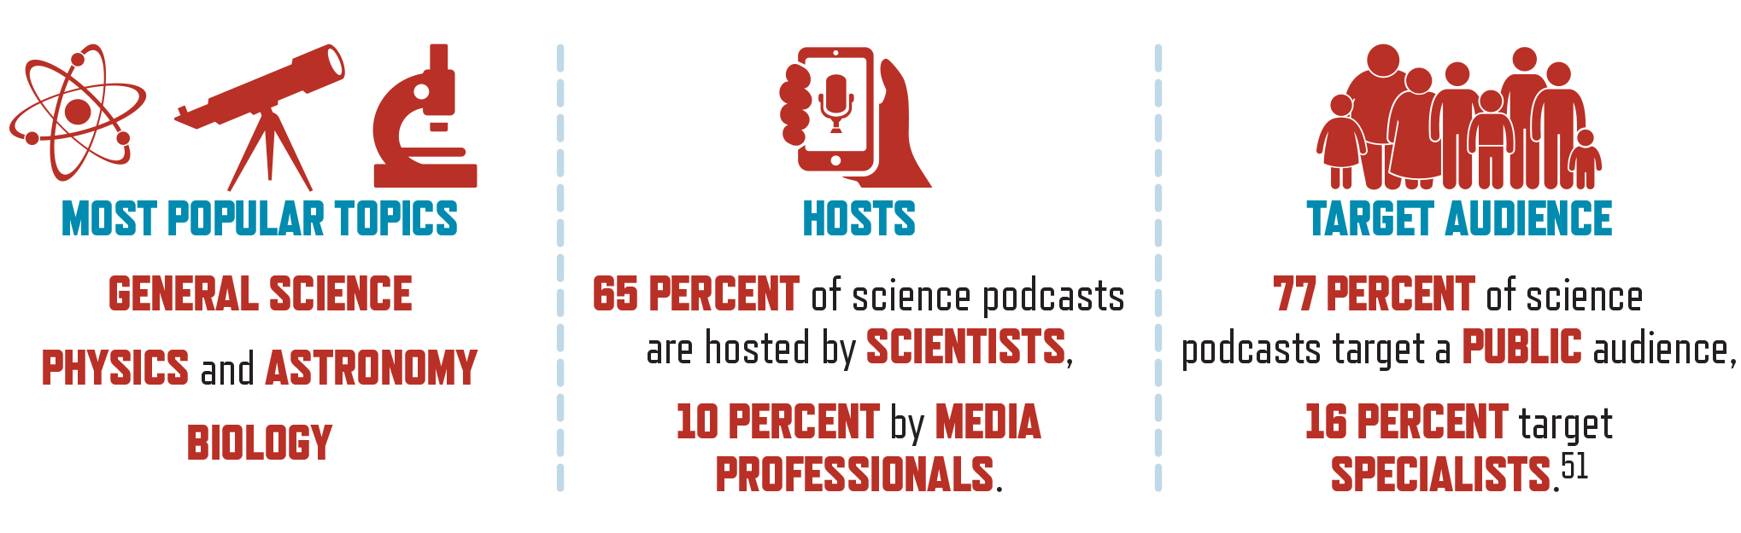
Notes:
Podcasts use a downloadable audio format to provide an informal, on-demand source of information and entertainment. Storytelling is a common science communication strategy used on podcasts such as Radiolab and Story Collider. According to a recent study, the number of science podcasts increased at an exponential rate from 2010 to 2018.50

Slide 24
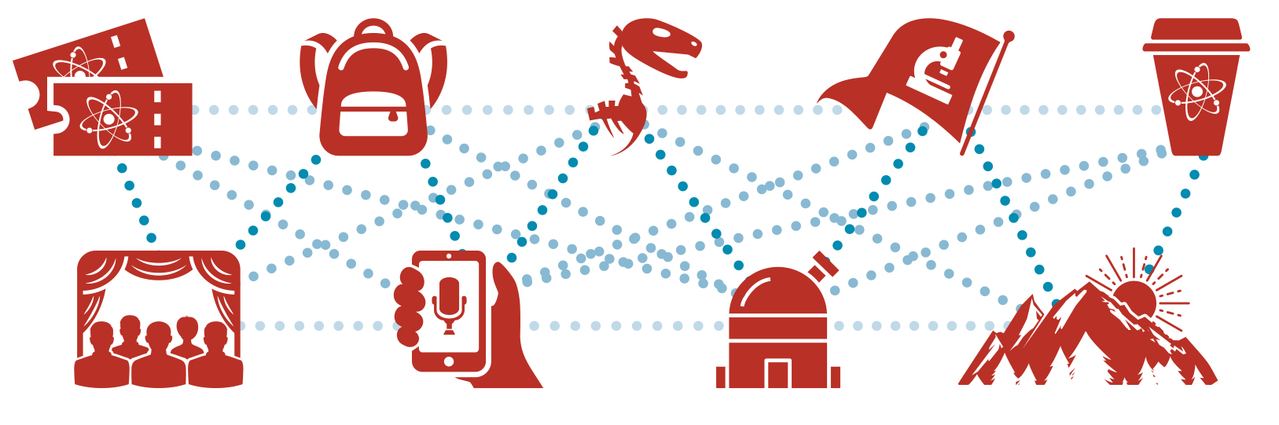
Notes:
Whether it is an interest in local conservation efforts that leads a high school student to become a citizen scientist, or a desire to stay current that causes a researcher to follow a science blog, or a shared interest in stem that brings a group of friends to a science festival, understanding audience motivations for participating in particular activities is necessary for identifying the potential outcomes of engagement. Approaches to science communication and engagement that build connections to previous experiences with science and provide opportunities for continued engagement have the potential for long-term effects, such as a higher curiosity about science, different perceptions of science, or behavioral changes based on scientific information.

Slide 25
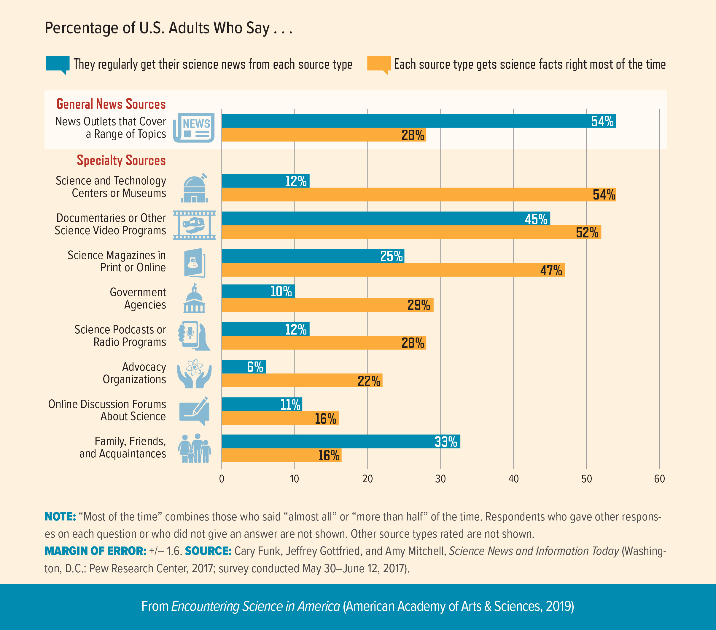

Slide 26
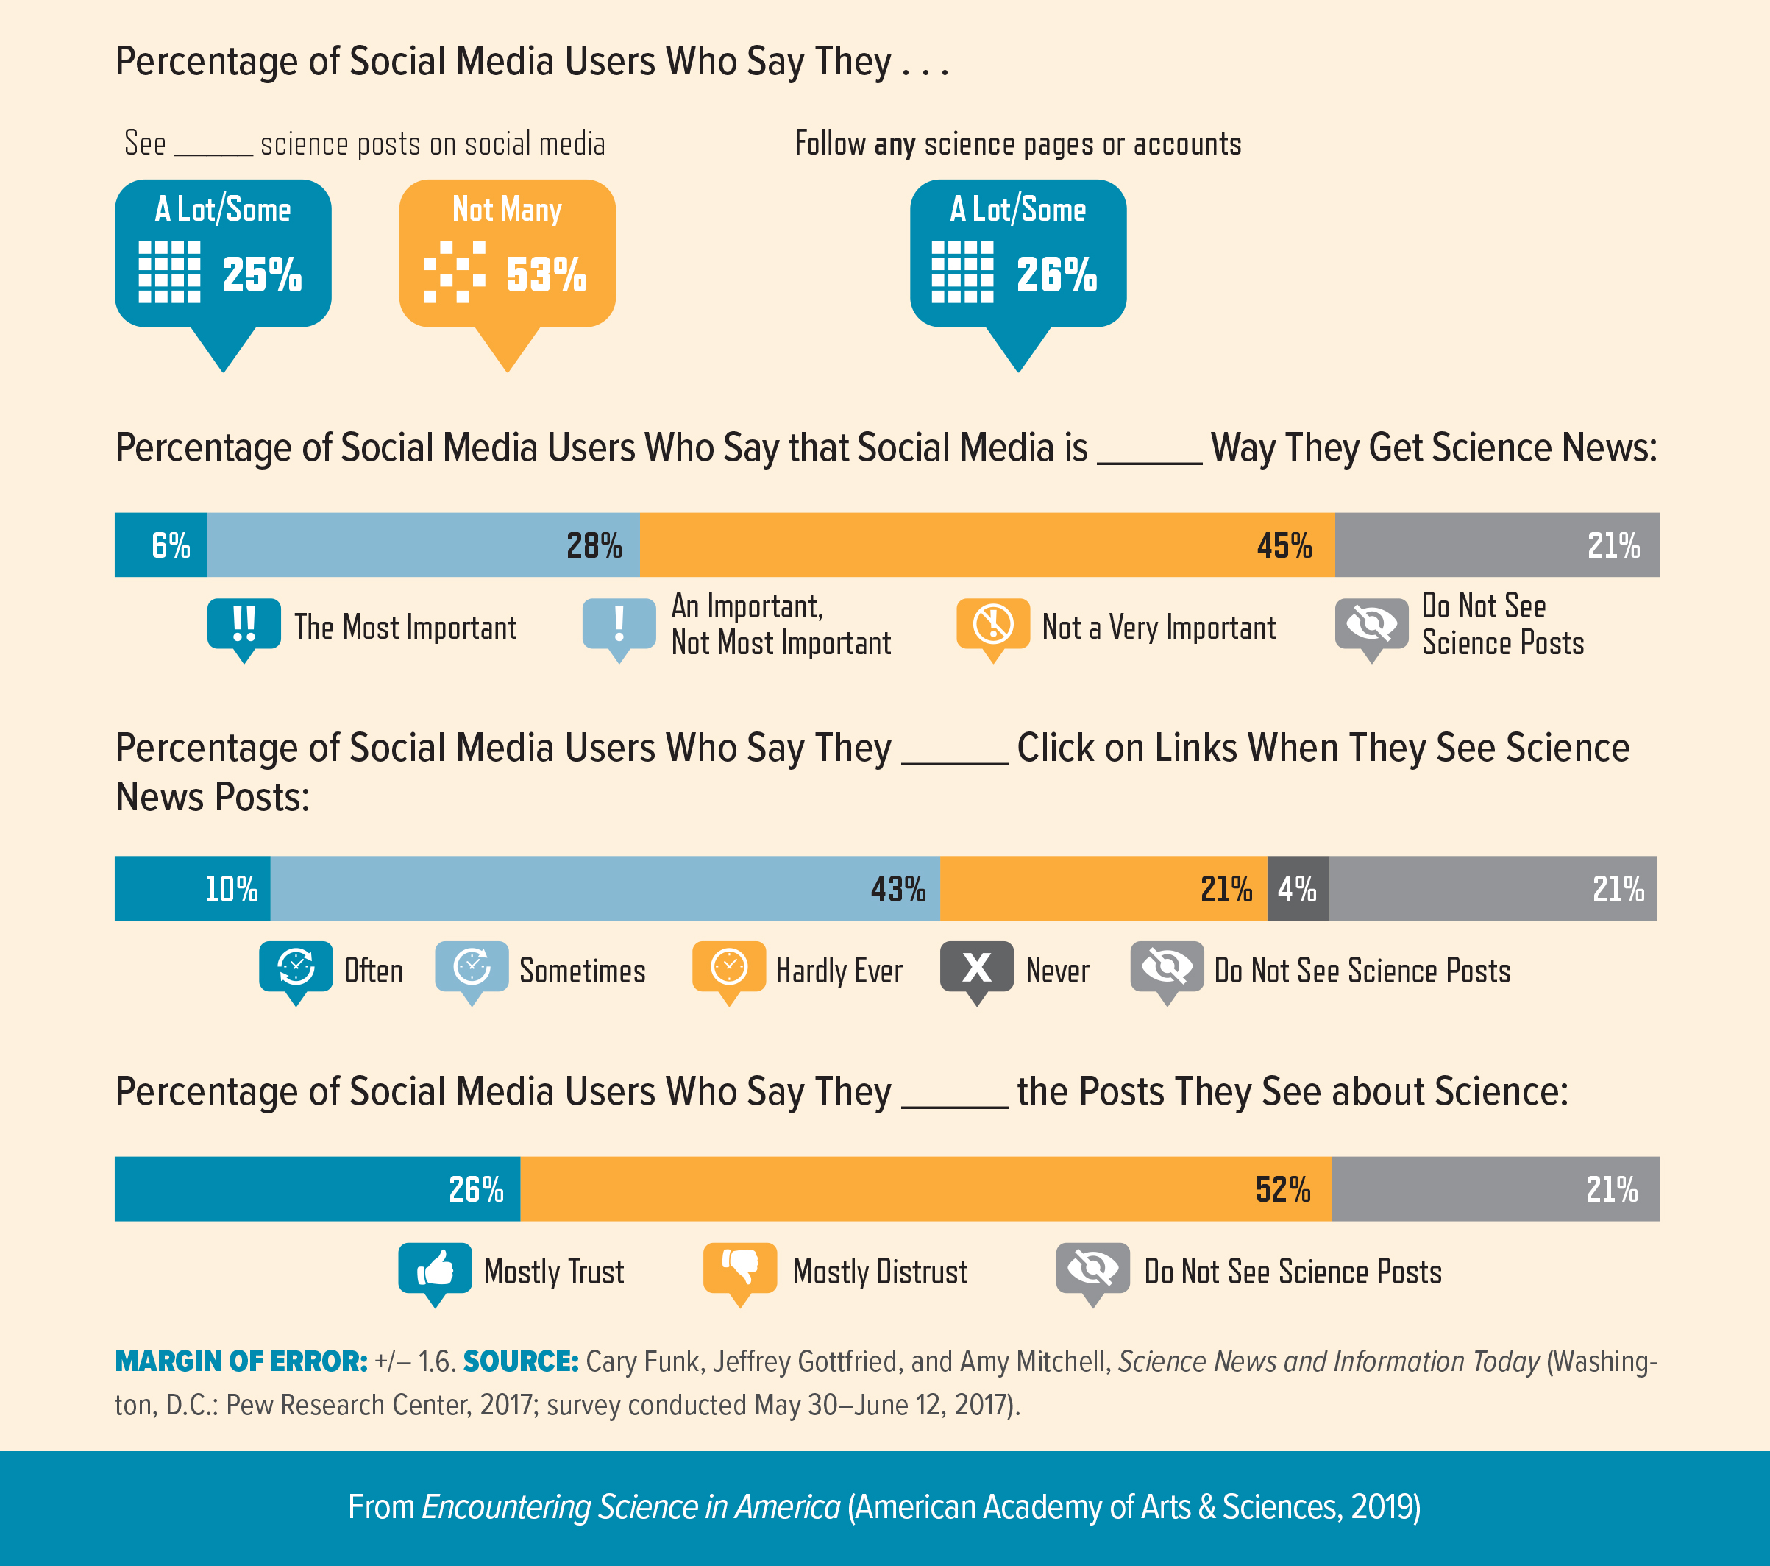

Slide 27
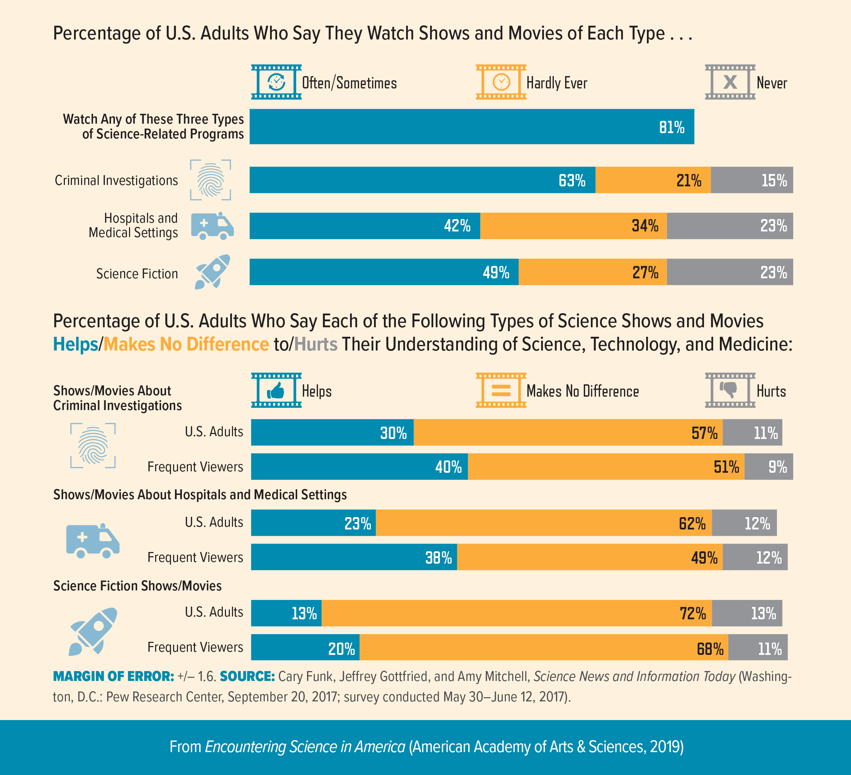

Slide 28
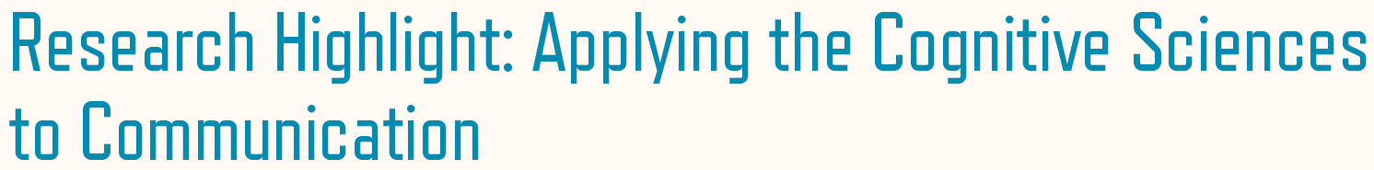
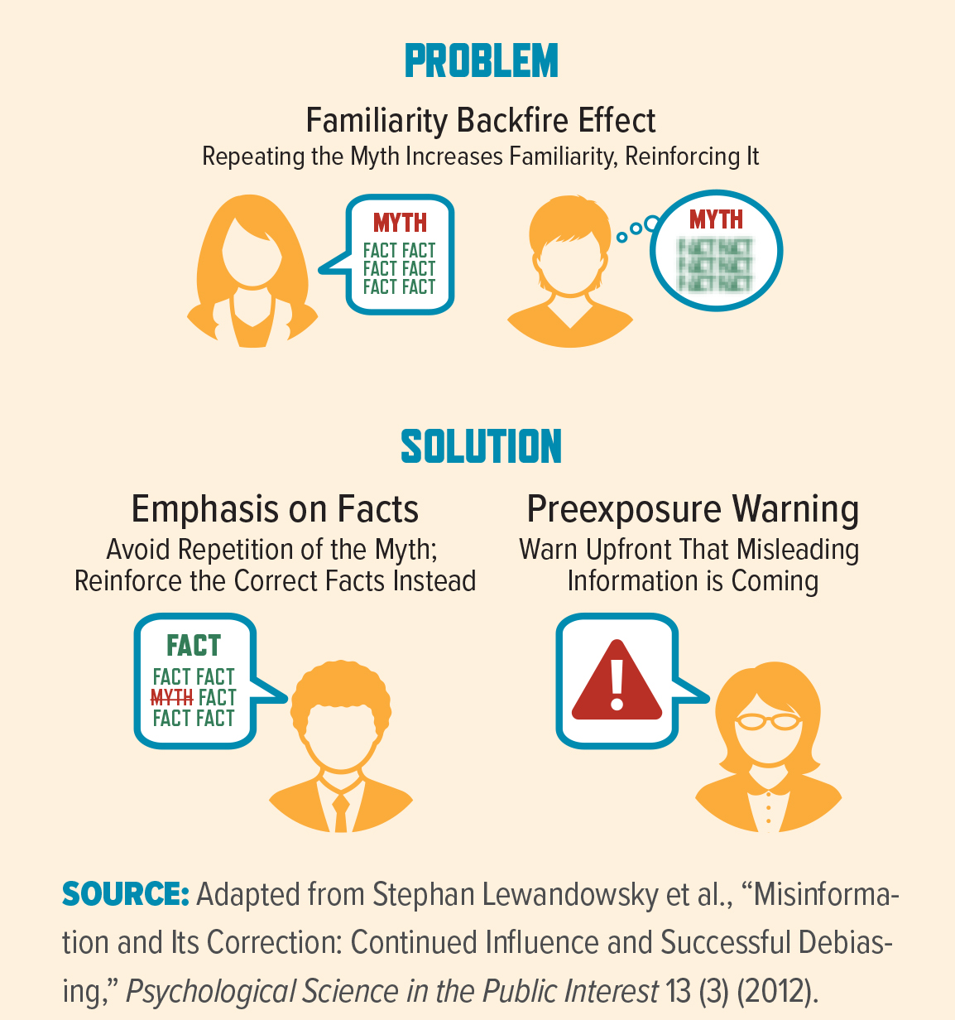
Notes:
Research Highlight: Applying the Cognitive Sciences to Communication
The field of cognitive sciences can provide insight into effective visual and verbal communication by studying how information is processed or spread within society. For example, data visualization studies can reveal areas of misunderstanding in particular presentations of quantitative information such as a connected scatter plot or dual-axis line graph.61 Of particular importance to the scientific community are recommendations into correcting misinformation on topics such as vaccines, climate change, and genetically modified organisms, on which the scientific consensus has been rejected by different populations of the public.62

