Slide 1
Notes:
The views expressed in this report are those held by the authors and are not necessarily those of the Officers and Members of the American Academy of Arts and Sciences. The Academy gratefully acknowledges the financial support of The Andrew W. Mellon Foundation, which funded this study and the other work of the Humanities Indicators.

Slide 2
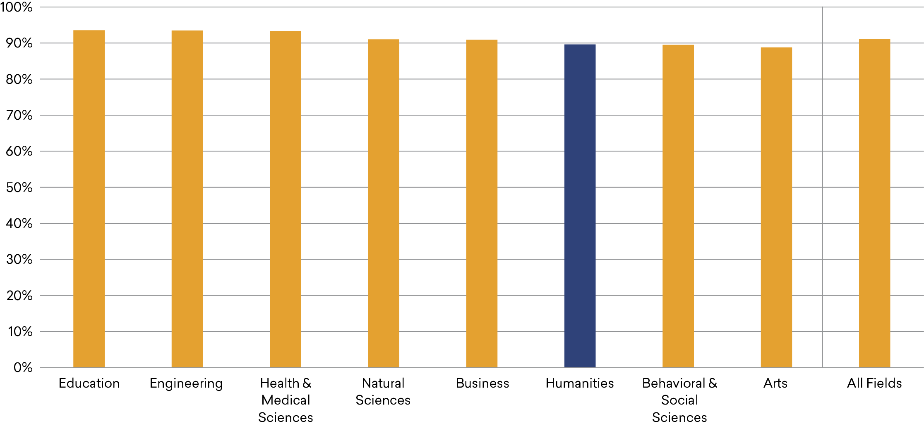
Share of College Graduates Who Are Satisfied with Their Life, by Field of Bachelor’s Degree, 2019
Source: Gallup Alumni Survey, 2019
Notes:
ASK A COLLEGE GRADUATE whether they are satisfied or dissatisfied with their life, and they are highly likely to report that they are satisfied—regardless of their field of degree. Approximately 90% of college graduates from each of the major fields indicated as much. So why, one might ask, is there a perception that graduates from some fields—most notably the humanities—end up worse off after earning their degree? This report unpacks that assumption, presenting what high-quality national data reveal about differences among fields in the career and other life outcomes of their graduates. Identifying the sources of these differences—understanding the “why” behind the “what” presented in these pages—will require further research.

Slide 3
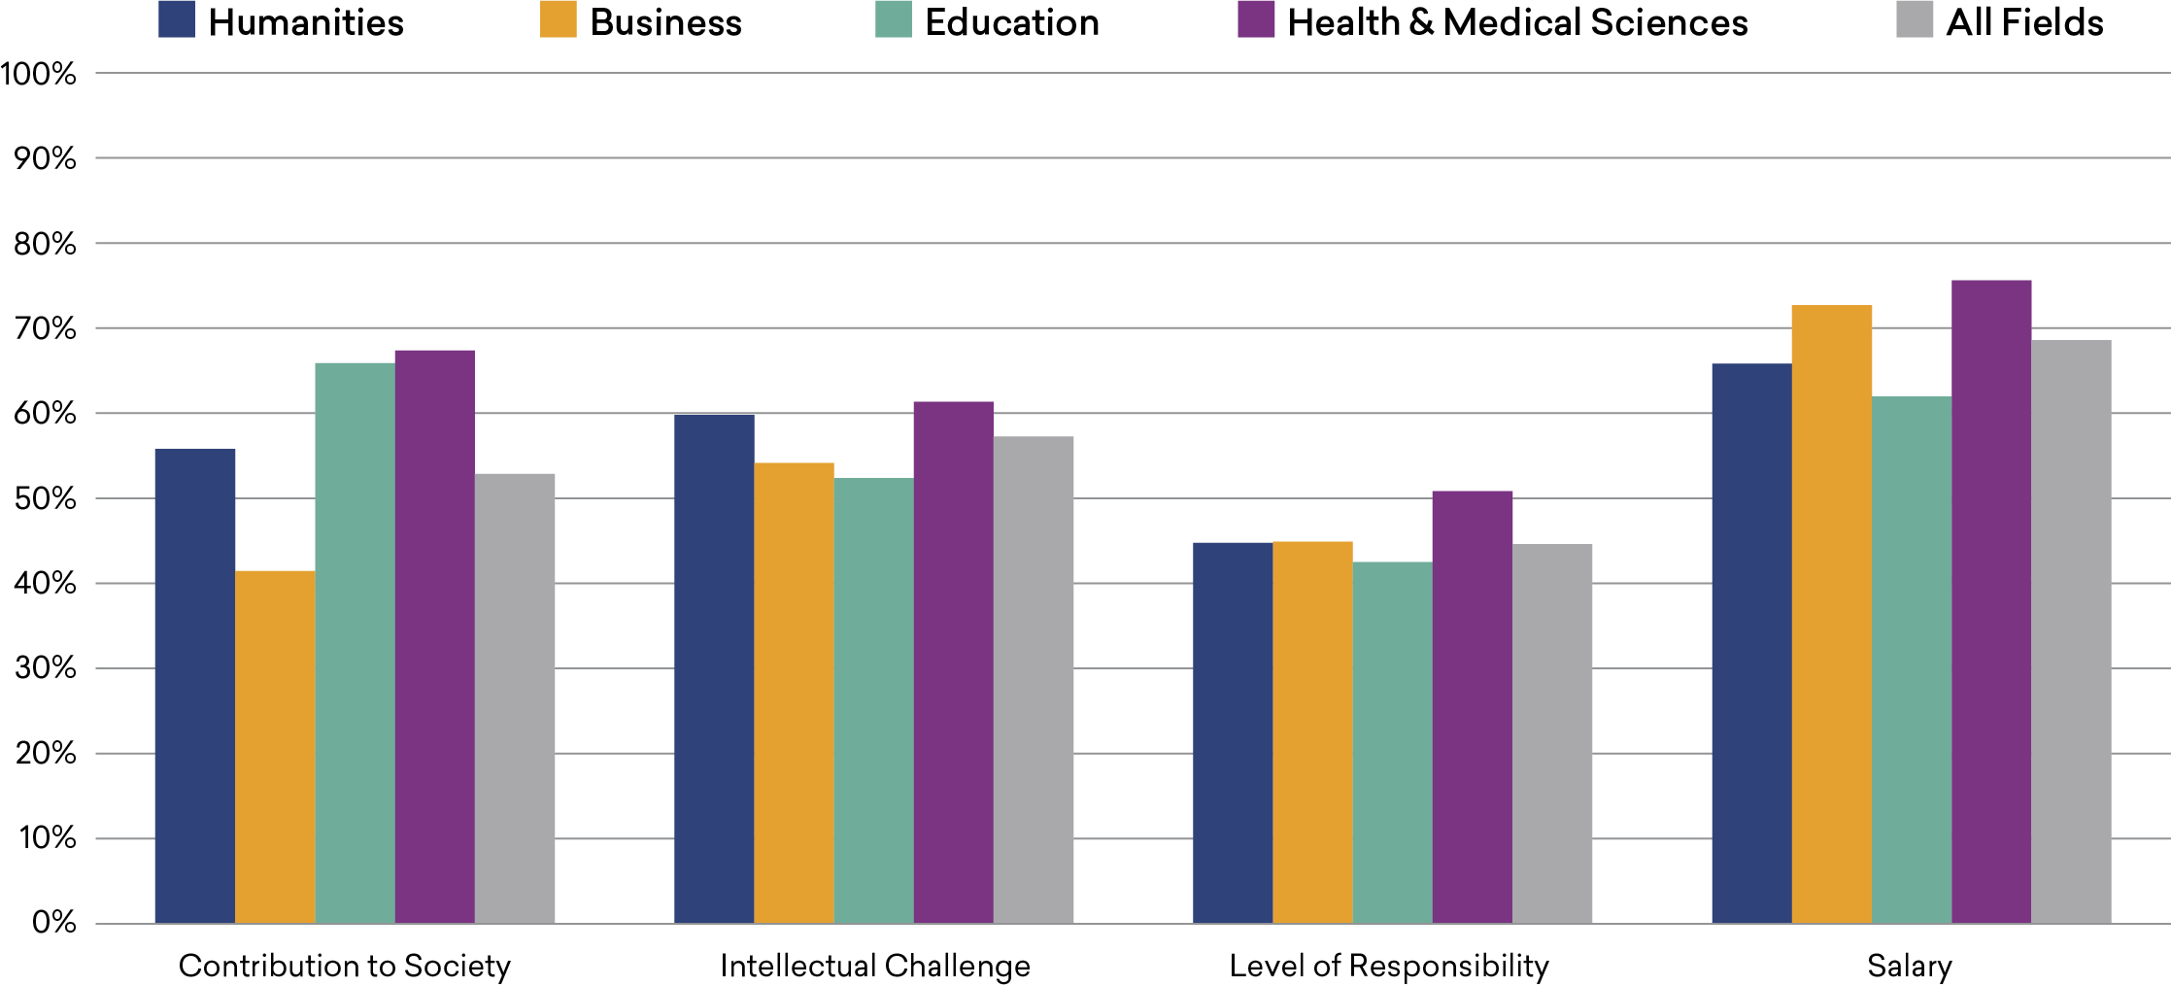
Share of College Graduates Who Consider Aspects of Work “Very Important,” by Field of Bachelor’s Degree, 2019
Source: National Survey of College Graduates, 2019
Notes:
AN EXAMINATION of what college graduates are looking for in a job provides helpful context for a discussion of their employment outcomes. For instance, the data reveal that humanities graduates are similar to college graduates gener ally in whether they consider key aspects of work important.
Humanities majors, however, were less likely than business or health/medical sciences graduates to consider salary “very important.” And humanities graduates were less likely than their counterparts in education or health/medical sciences to consider making a contribution to society very important, but they were substantially more likely than business majors to value it. (Information for other fields can be found on the report website.)

Slide 4
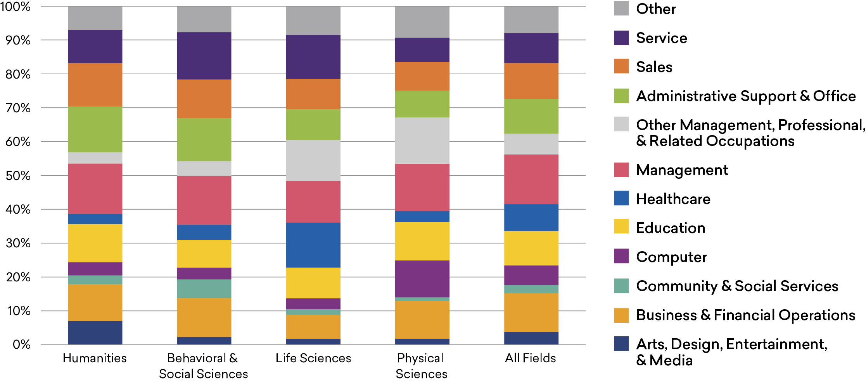
Occupational Distribution of Terminal Bachelor’s Degree Holders, by Field of Degree, 2018
Source: 2018 American Community Survey
Notes:
ALSO SHAPING PERCEPTIONS about the value of humanities degrees is the sense that graduates from the field are less likely than other graduates to be prepared for a variety of occupations, a belief encapsulated in the stereotype of humanities majors as baristas and reflected in pressure on college provosts “to focus on academic programs that have a clear orientation toward careers.” Contrary to the
stereotype, humanities graduates—even those without advanced degrees—are widely distributed across occupational categories, similar to college graduates generally and those from the science disciplines.7 This report will offer a closer look at where humanities graduates find work, as well as their satisfaction with those jobs.

Slide 5
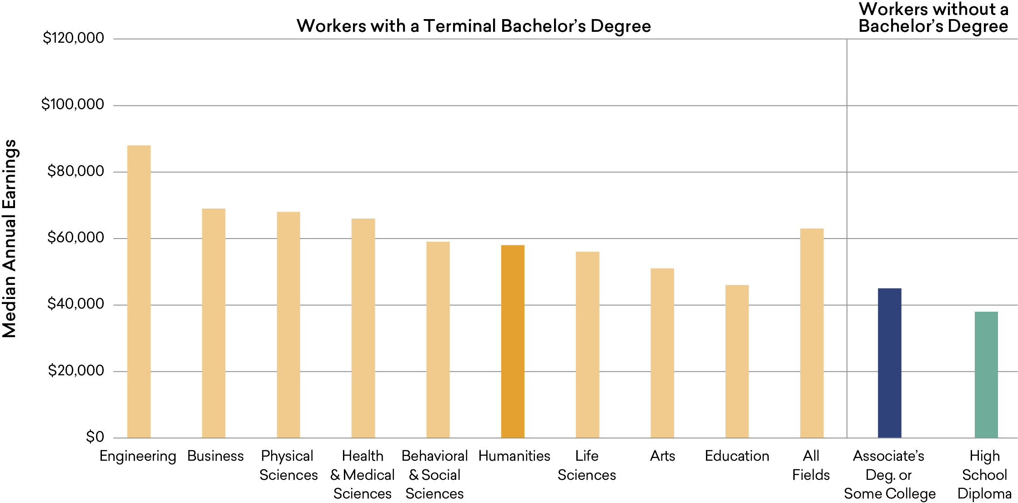
Earnings Comparison: Workers with a Terminal Bachelor’s Degree
(by Field of Degree) versus Those without a Four-Year Degree, 2018
Source: 2018 American Community Survey
Notes:
EARNINGS TEND TO BE THE FOCUS of conversations about the value of college degrees, in part because they are relatively easy to measure. Median annual earnings for workers with a terminal bachelor’s degree in the humanities stood at $58,000 in 2018, which was somewhat below the median for all college graduates ($63,000) but similar to the earnings for graduates from the behavioral/social and life sciences and considerably higher than those with a baccalaureate degree in education ($46,000). The relatively low median earnings of education majors are notable given their high levels of job and life satisfaction (discussed elsewhere in this publication).
While humanities graduates’ earnings were lower than those for engineering, business, and some science graduates, they were much higher than those of workers who lack a bachelor’s degree—both those with an associate’s degree or some college ($45,000) and those with only a high school diploma ($38,000).

Slide 6
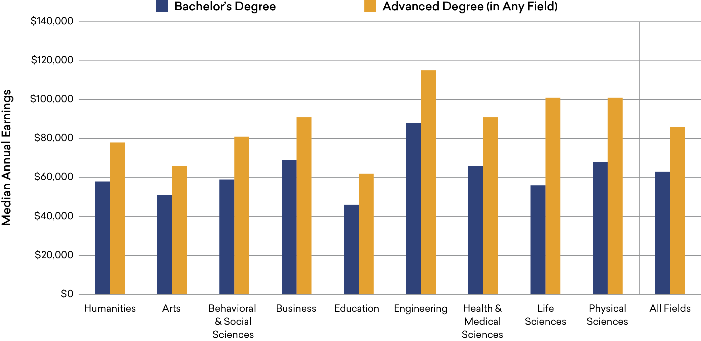
Earnings of College Graduates, by Field of Bachelor’s and Highest Degree, 2018
Source: 2018 American Community Survey
Notes:
AS OF 2018, approximately 41% of humanities graduates held an advanced degree (similar to the share of all college graduates who had earned such a degree).10 As with other college graduates, obtaining an advanced degree made a substantial difference in the earnings of humanities majors. The median earnings of humanities majors who went on to earn an advanced degree (which may be in another field) were 34% higher than those of workers with only a bachelor’s de gree ($78,000 as compared to $58,000). Among college grad uates generally, advanced degree holders earned 37% more than terminal bachelor’s degree holders, with the largest increase found among graduates from the life sciences (80%).

Slide 7
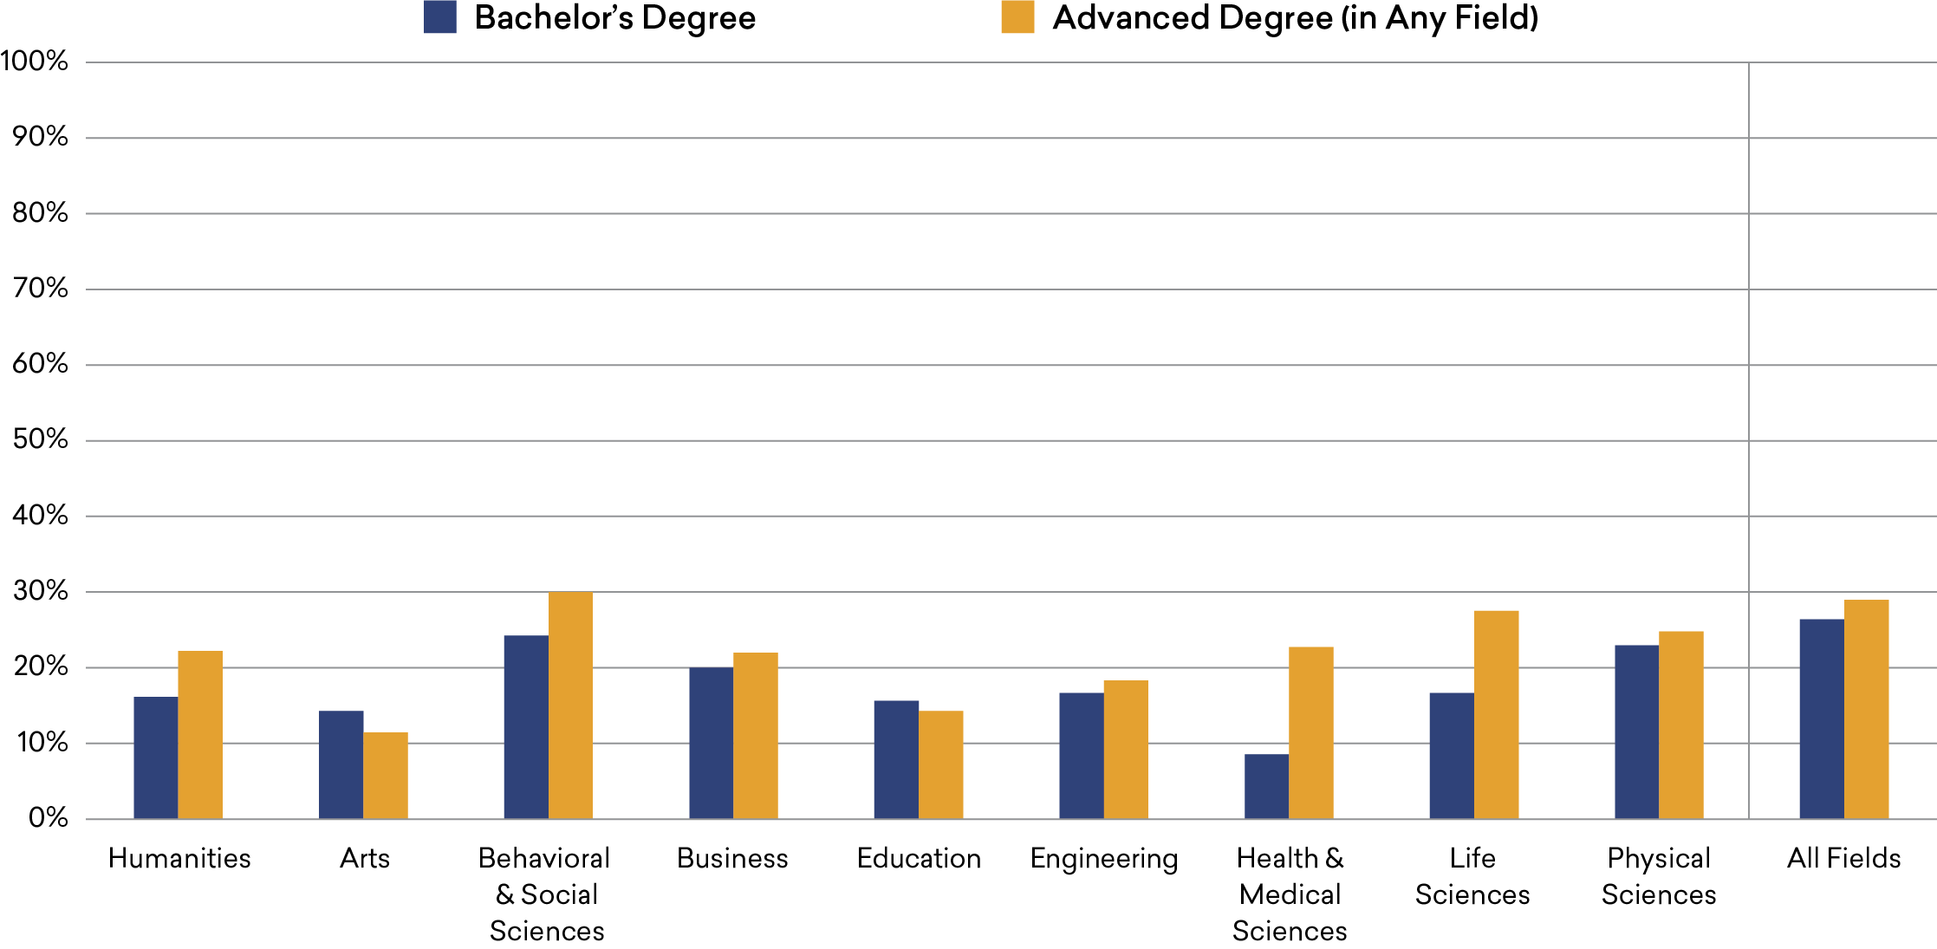
Gender Earnings Gap among College Graduates, by Field of Bachelor’s and Highest Degree, 2018
Source: 2018 American Community Survey
Notes:
GENDER ALSO MAKES A DIFFERENCE in graduates’ earnings. Among college graduates generally, women earned substantially less than their male counterparts, though the 16% gender gap in earnings among holders of terminal bachelor’s degrees in the humanities was smaller than the gap among graduates from business, the physical sciences, or the behavioral/social sciences.
For most fields, including the humanities, the gap in earnings between men and women was larger for those who had earned advanced degrees. But the difference between humanities graduates with only a bachelor’s and those who had gone on to earn an advanced degree was modest compared to that found among life or health/medical science graduates.

Slide 8
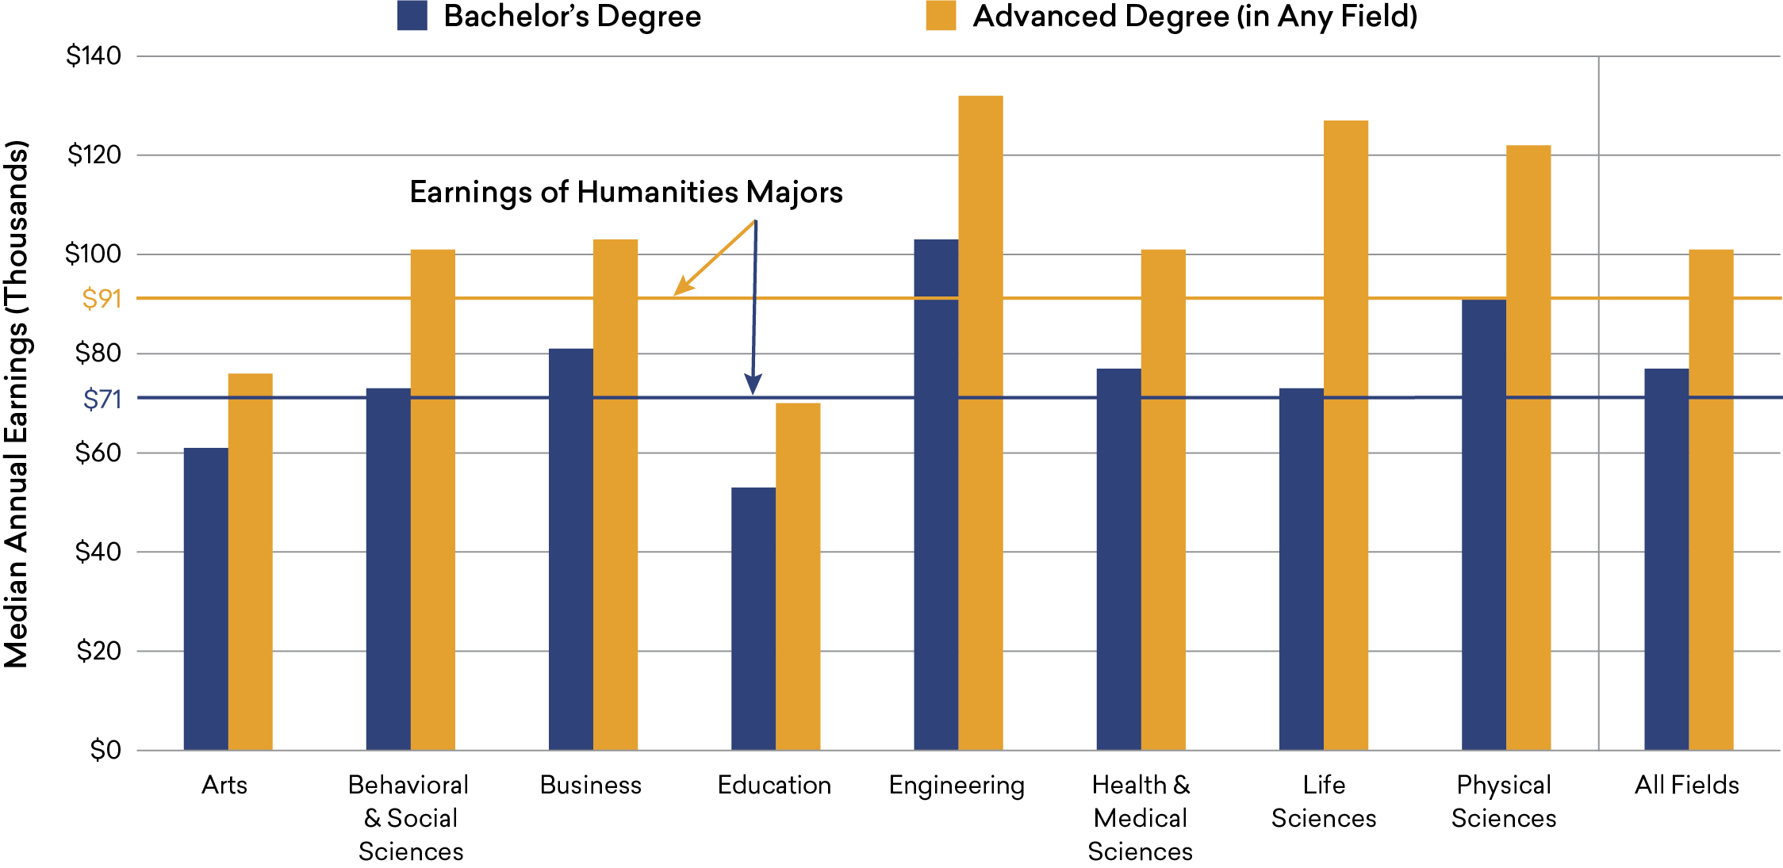
Earnings of College Graduates, by Field of Bachelor’s and Highest Degree, 2018
Source: 2018 American Community Survey
Notes:
WHILE HUMANITIES GRADUATES have substantial median earnings in their peak earnings years (from their late 40s into their 50s), they earned less than graduates from business and several STEM fields. The median earnings of terminal bachelor’s degree holders generally were 8.5% higher than those of humanities graduates whose highest degree was a bachelor’s.
The differential between every higher-earning field and the humanities was almost as large if not larger when the focus shifts to workers with an advanced degree. A particularly dramatic example is the life sciences, whose advanced degree holders earned 40% more than their counterparts in the humanities, even though median earnings of the two fields’ graduates were almost identical for those with just a bachelor’s degree. Advanced degree holders generally earned 11% more than humanities graduates with the same level of education.14

Slide 9
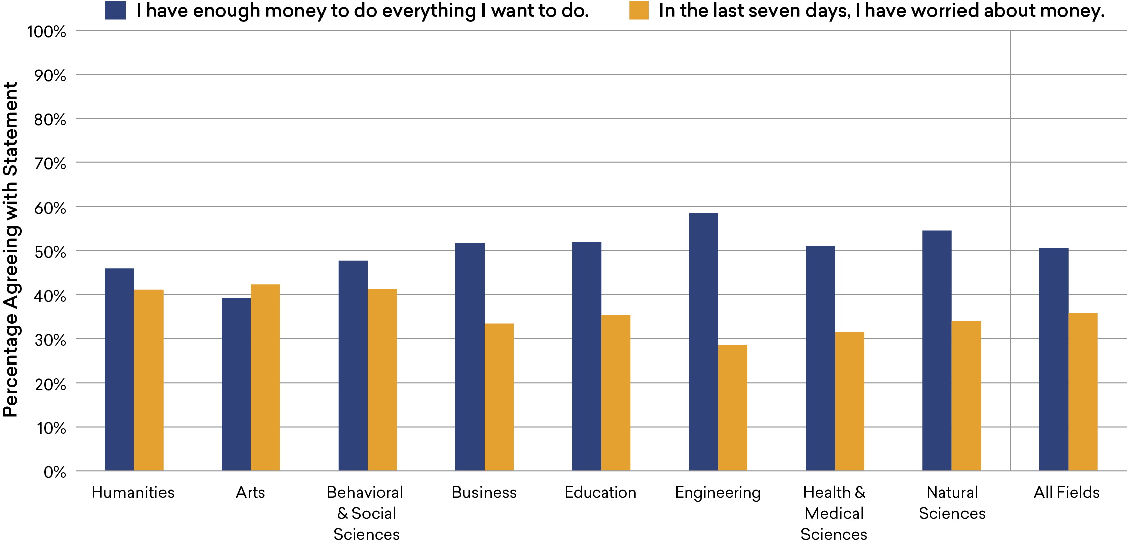
College Graduates’ Financial Satisfaction, by Field of Bachelor’s Degree, 2019
Source: Gallup Alumni Survey, 2019
Notes:
WITH THE EXCEPTION OF ENGINEERING on the high side and the arts on the low side, from 46% to 55% of each field’s graduates agreed they had “enough money to do everything I want to do.” Conversely, from 31% to 41% of the graduates from those “typical” fields reported they had worried about money in the past seven days.
Graduates from the humanities, arts, and behavioral/social sciences were similar in that less than half of graduates felt they had enough money, while slightly more than 40% had worried about money. Curiously, however, a majority of education graduates felt they had enough money—a share similar to that of several higher-earning fields—even though graduates from the field had the lowest median earnings.15

Slide 10
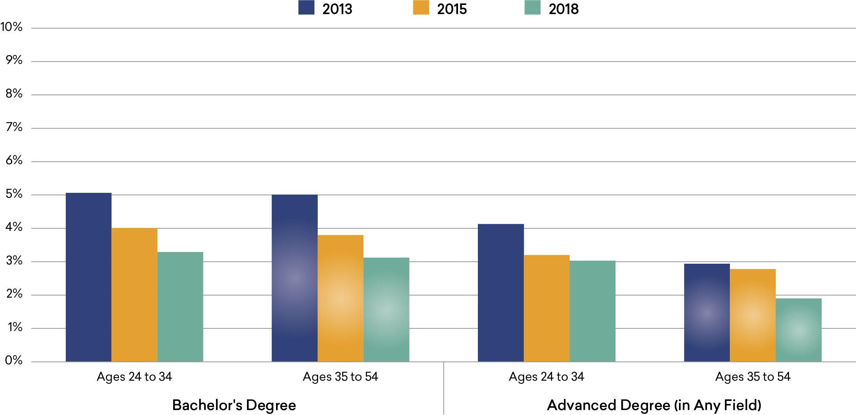
Unemployment among Humanities Bachelor’s Degree Holders, by Age and Highest Degree
Source: 2018 American Community Survey
Notes:
RELATIVE UNEMPLOYMENT RATES can also play an important part in perceptions of the postcollegiate outcomes of humanities graduates. Like graduates from every other field, holders of bachelor’s degrees in the humanities experienced a sharp drop in unemployment from the Great Recession to the COVID-19 pandemic. From 2013 to 2018, the rate fell to near 3% for those with just a bachelor’s degree, and to below 2% among older advanced degree holders. (In 2018, the unemployment rate among workers who completed high school but did not attend college was 7.3% for those ages 24–34, and 4.4% for those ages 35–54.)

Slide 11
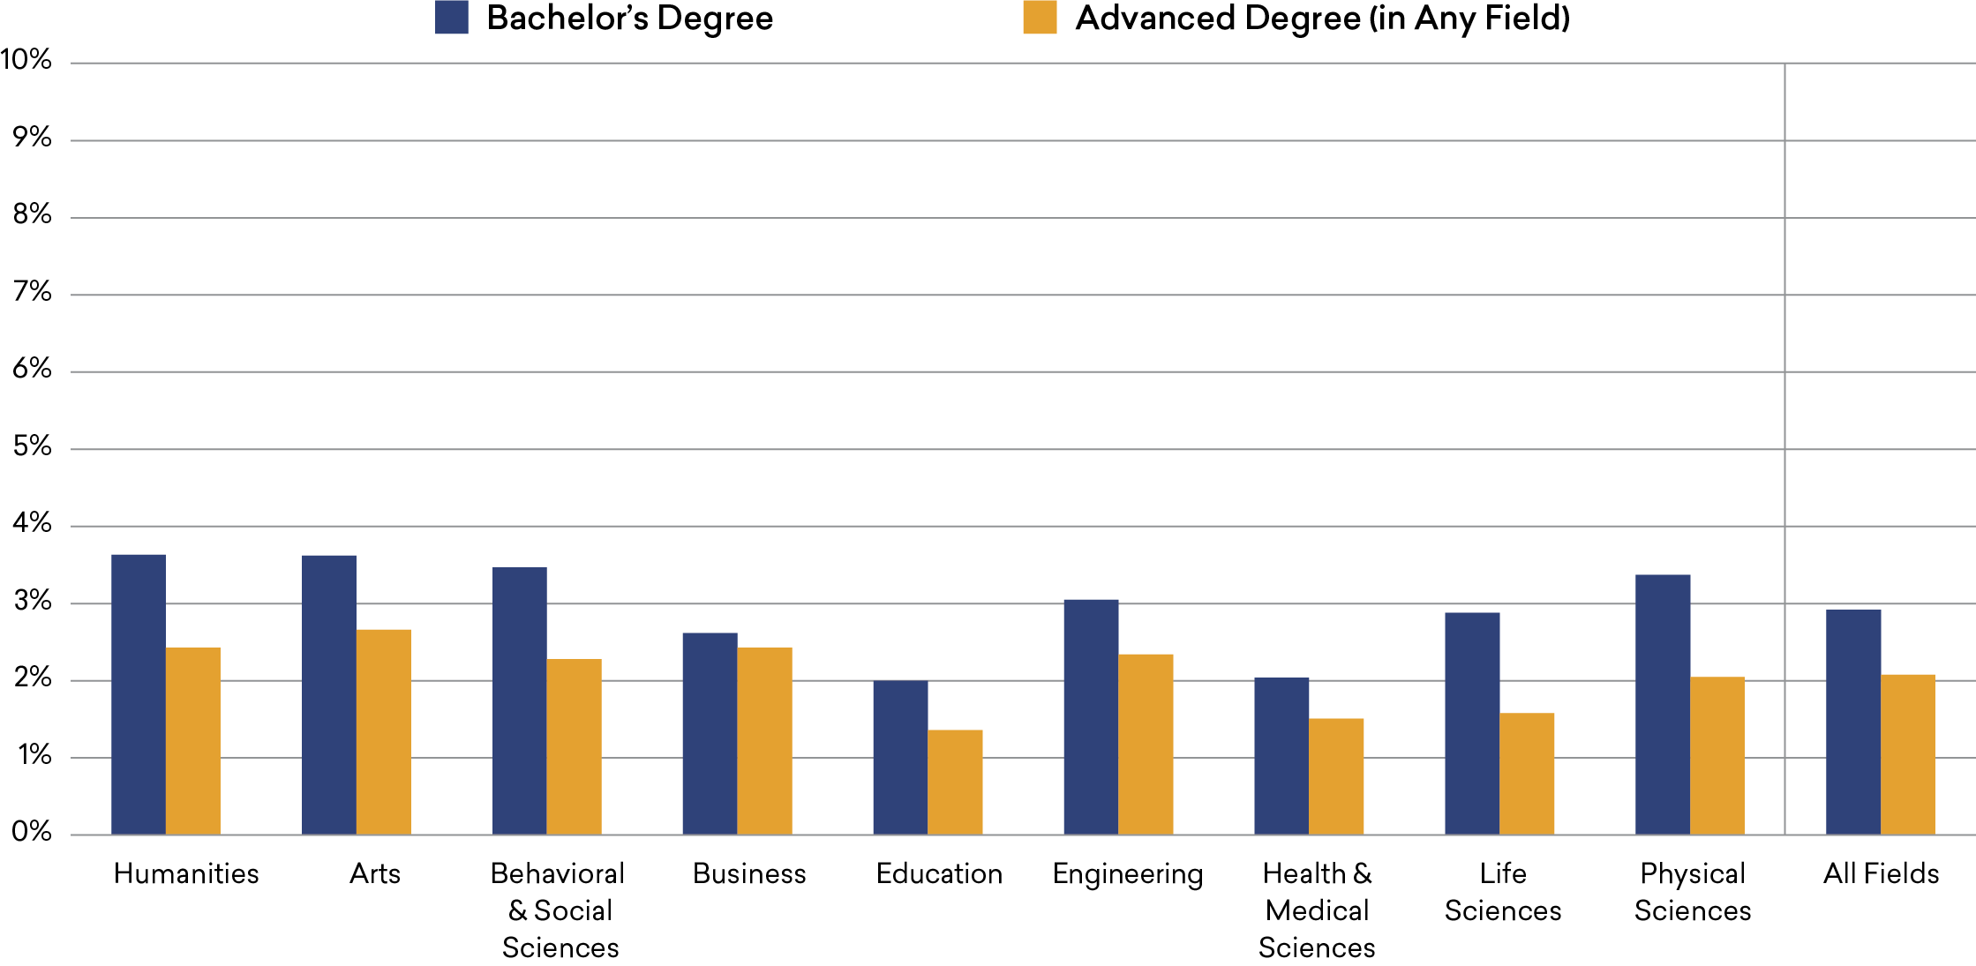
Unemployment among College Graduates, by Field of Bachelor’s and Highest Degree, 2018
Source: 2018 American Community Survey
Notes:
WHILE THEIR UNEMPLOYMENT RATE had declined since the Great Recession, humanities graduates in 2018 had a slightly higher level of unemployment than the bachelor’s-holding population as a whole. The 3.6% unemployment rate among terminal bachelor’s degree holders in the humanities compares to 2.9% among graduates from all fields combined. Education and health/medical sciences graduates had the lowest levels of unemployment among terminal bachelor’s degree holders (2.0%).
For every field, unemployment was lower among advanced degree holders than among those with just a bachelor’s degree. Among graduates with an advanced degree, the humanities’ rate (2.4%) was virtually identical to that of business and engineering. Education graduates had the lowest rate among advanced degree holders (1.4%).17

Slide 12
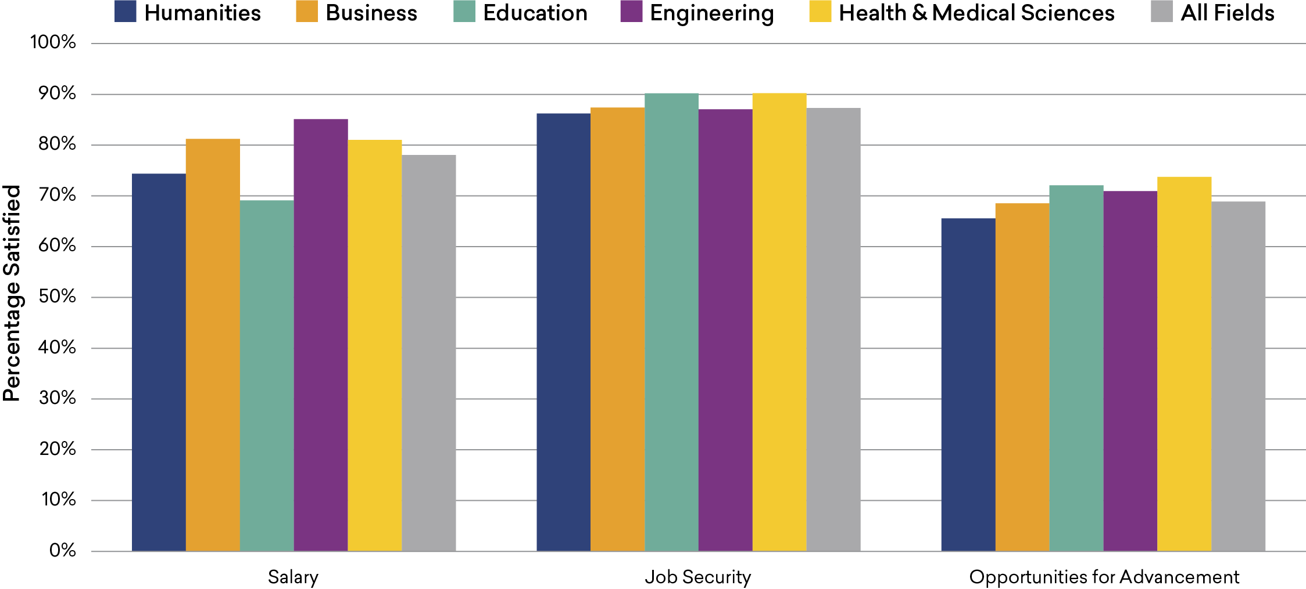
Satisfaction of College Graduates with Monetary Aspects of Their Job, by Field of Bachelor’s Degree, 2019
Source: National Survey of College Graduates, 2019
Notes:
DESPITE DISPARITIES AMONG FIELDS in graduates’ median earnings, when college graduates were asked about their satisfaction with various financial aspects of their job, humanities majors’ responses were similar to those of college graduates in general. The figure above highlights a few of the fields to which the humanities is often compared.
On salary, 74% of humanities graduates expressed satisfaction, a slightly smaller share than among college graduates generally (78%) but almost 11 percentage points smaller than for engineering graduates. Graduates from education, engineering, and health/medical sciences were somewhat more likely to express satisfaction about their opportunities for advancement than humanities majors. The share of humanities graduates expressing satisfaction with job security was very similar to the shares in the other fields examined here.

Slide 13
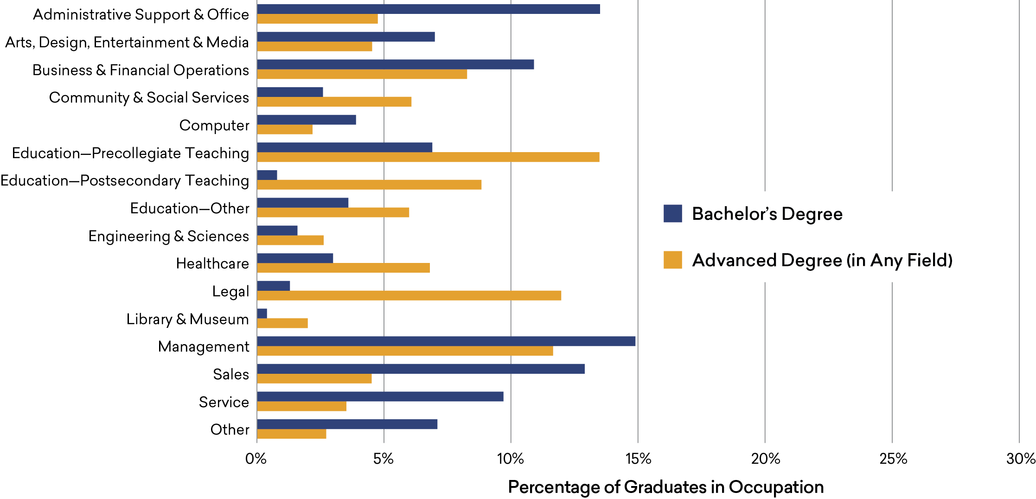
Occupational Distribution of Humanities Bachelor’s Degree Holders, by Highest Degree, 2018
Source: 2018 American Community Survey
Notes:
THE OCCUPATIONAL DISTRIBUTION of humanities majors who went on to earn an advanced degree differs substantially from that of their counterparts with a terminal bachelor’s degree. Among those whose highest degree was a bachelor’s, over a third were employed in office, sales, and service jobs, as compared to only 13% of those with advanced degrees. In contrast, those who had gone on to earn an advanced degree (in any field) were likeliest to work in education occupations, with 28% holding such jobs (the bulk of them in precollegiate teaching), with another 12% employed in legal occupations. The share in management jobs, however, was similar between terminal bachelor’s and advanced degree holders, accounting for 15% and 12% of each group, respectively.

Slide 14
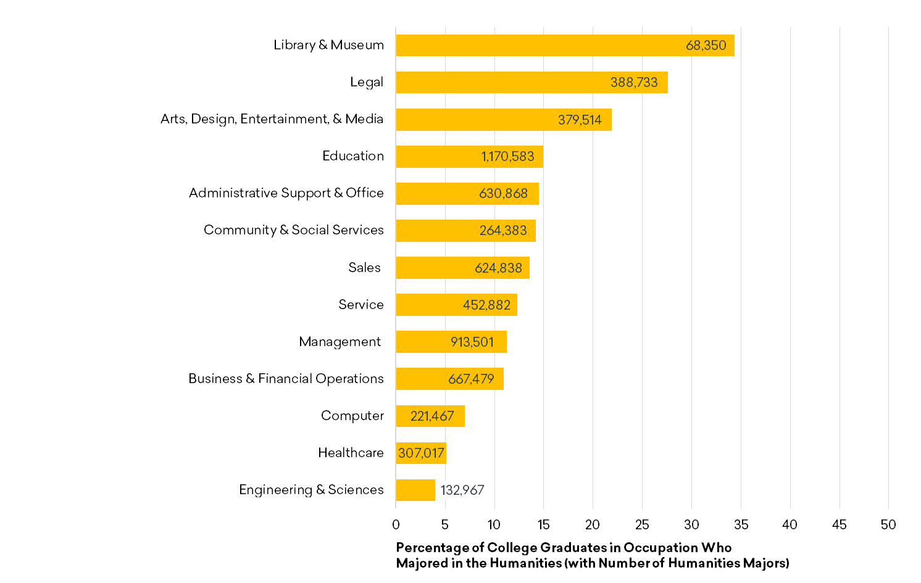
Share and Number of College Graduates in Various Occupations Who Hold a Bachelor’s Degree in the Humanities, 2018
Source: 2018 American Community Survey
Notes:
WHILE HUMANITIES GRADUATES can be found in every broad occupation category, they account for a widely varying share of each, ranging from more than a third of the college graduates in library/museum jobs to less than 5% of those in engineering/sciences positions. In addition to the sizable share of college-educated library/museum workers they represented, humanities graduates accounted for more than 20% of the college graduates employed in both legal and arts/media jobs.
Given the disparities in the size of each occupation, however, the largest number of employees with a bachelor’s degree in the humanities, over 1.1 million, was found in the education category. Over 900,000 humanities graduates were employed in management positions. Substantial numbers were also employed in administrative support/office, business/ financial, and sales occupations (with more than 600,000 humanities graduates in each of these categories).

Slide 15
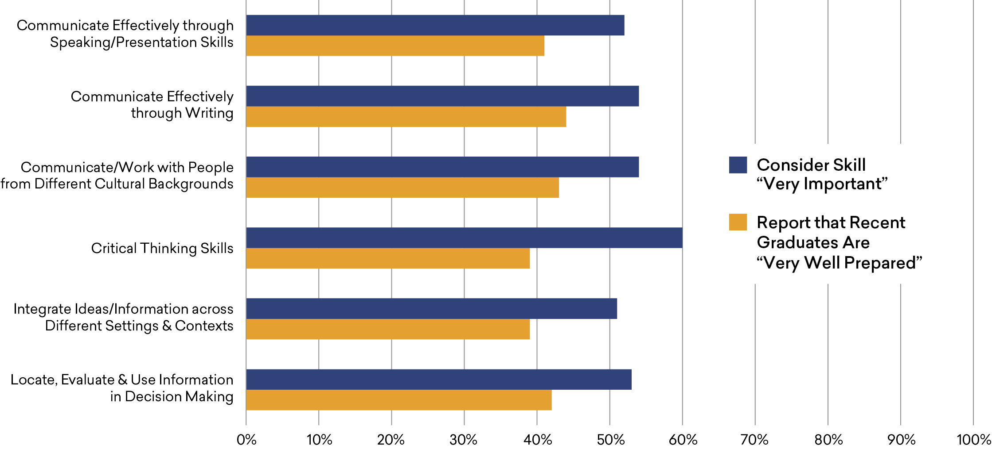
Employer Assessment of Importance of Humanities Skills and Recent
College Graduates’ Preparation, 2020
Source: 2020 AAC&U Employer Survey
Notes:
GIVEN THE VARIETY OF OCCUPATIONS performed
by humanities graduates, further study is needed to assess how their college coursework prepares them for employment. What research does exist highlights the value to employers of a range of skills thought to be developed in humanities courses. For instance, a recent survey of 500 employers commissioned by the Association of American Colleges & Universities found that a majority of employers considered several such skills—including writing, public speaking, and collaborating with people of different cultures—to be very important for their employees. For every skill, a smaller share of employers believed recent college graduates were “very well prepared” to use the skill in the workplace.23

Slide 16
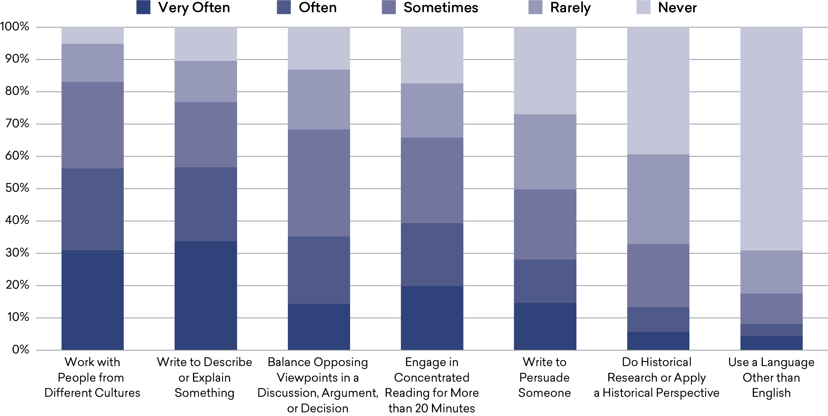
Adult Workers’ Use of Humanities-Related Skills on the Job (Self-Reported), 2019
Source: Humanities in American Life Survey
Notes:
THE EXTENT TO WHICH PEOPLE actually use such skills offers another measure of the value of a humanities education. A survey of American adults by the Humanities Indicators found that most workers used humanities-related skills on the job. Of the seven skill areas included in the survey, workers used an average of four at least sometimes, and 81% used at least one of these skills often or very often in their jobs. More than half of employed Americans worked with people from different cultures often or very often as part of their job, and approximately the same percentage engaged in descriptive writing; however, workers were far less likely to use other humanities-related skills that frequently.24

Slide 17
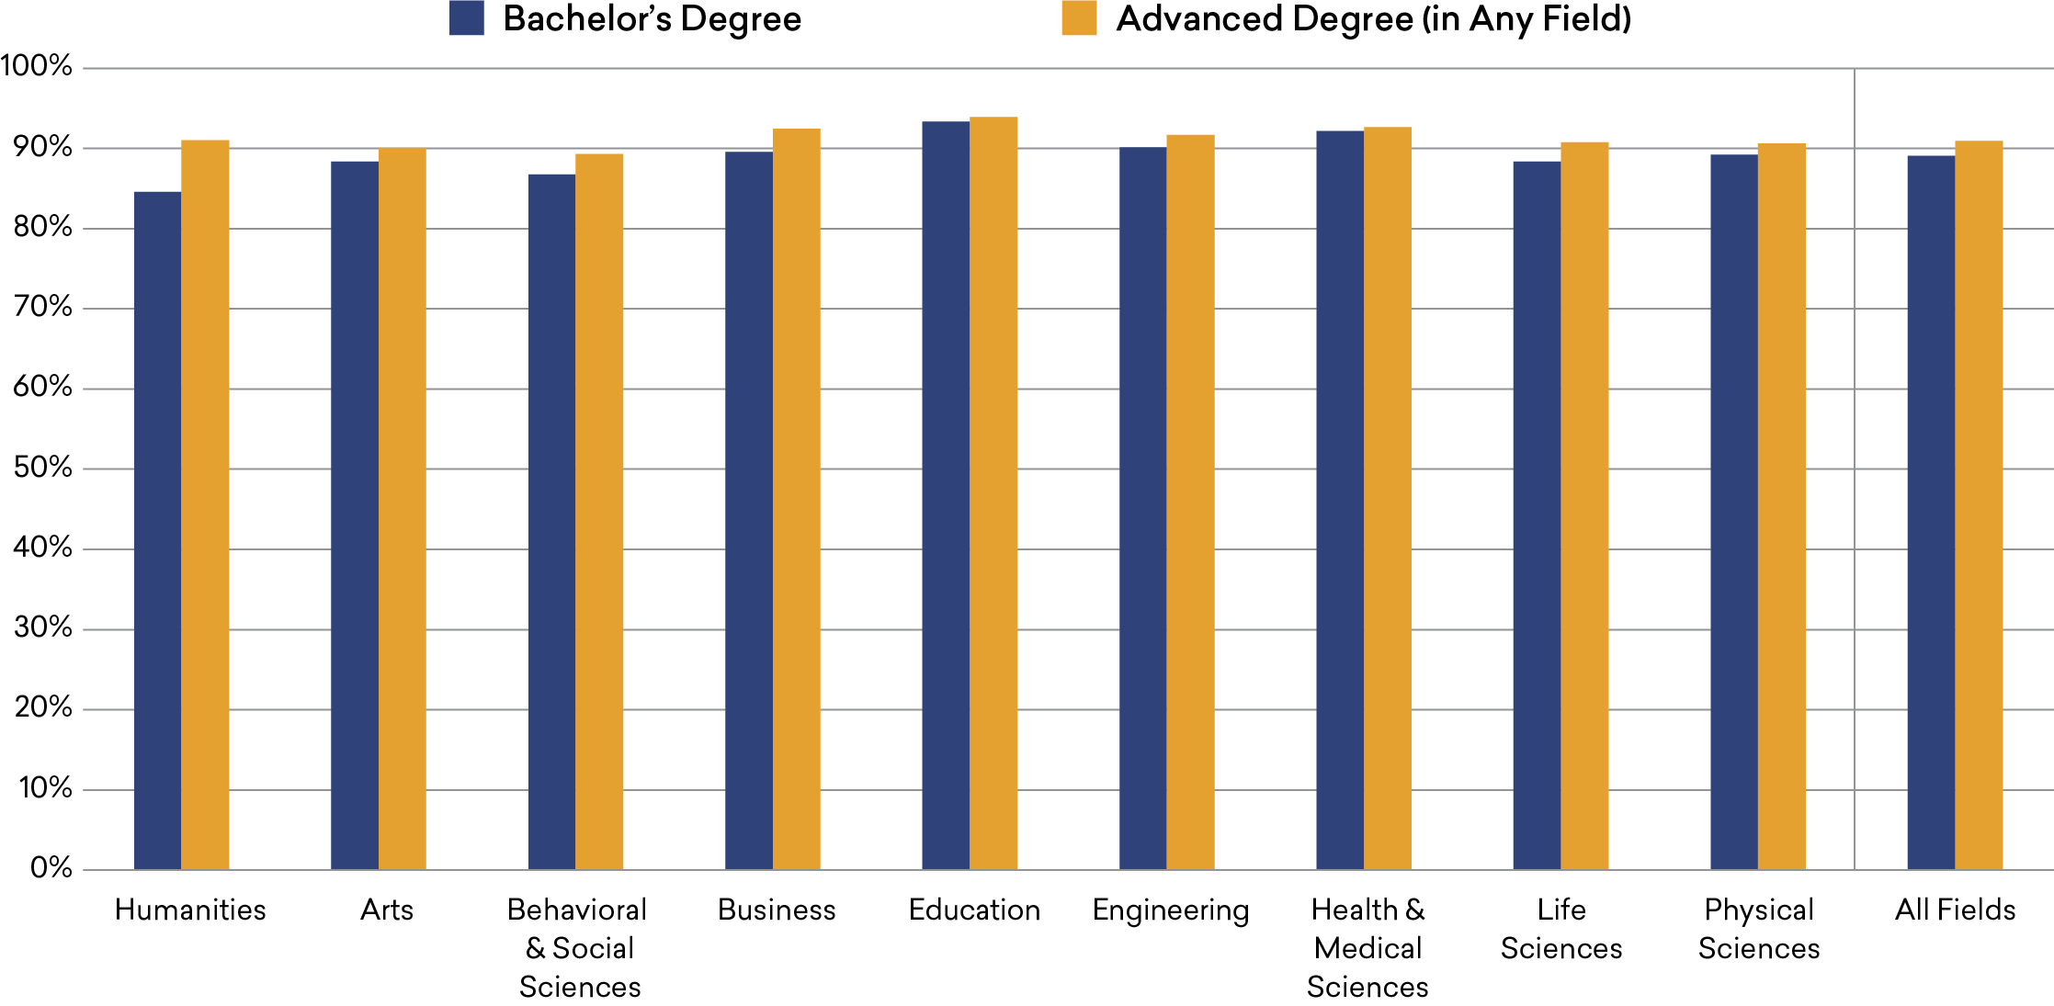
Share of College Graduates Who Are Generally Satisfied with Their Job, by Field of Bachelor’s and Highest Degree, 2019
Source: National Survey of College Graduates, 2019
Notes:
HUMANITIES GRADUATES ARE SIMILAR to those
from most other fields in their level of job satisfaction. Almost 85% of workers with a terminal bachelor’s degree in the humanities reported they were satisfied with their job, which was just a few percentage points smaller than the share for college graduates generally. The difference between the humanities and the fields with the largest shares of satisfied graduates—health/medical sciences and education— was eight and nine percentage points, respectively.
For graduates from most fields, those earning an advanced degree were not appreciably more likely to be satisfied with their jobs. But for bachelor’s degree recipients from the humanities, having an advanced degree was more consequential. While still modest, the difference in job satisfaction between the field’s terminal bachelor’s and advanced degree holders was more than three times greater than for college graduates generally.25

Slide 18
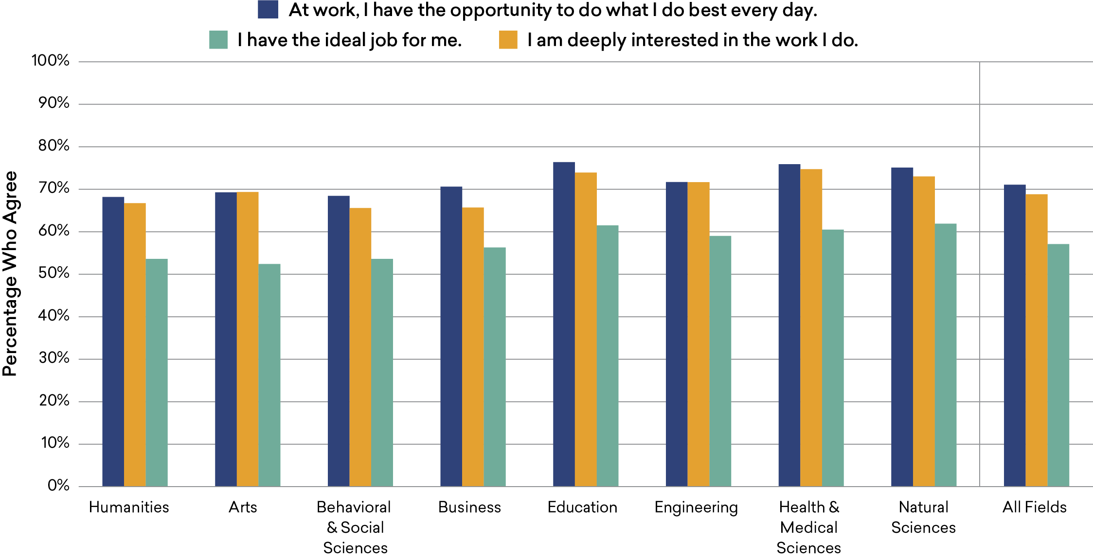
Share of College Graduates with Positive Perceptions of Their Job, by Field of Bachelor’s Degree, 2019
Source: Gallup Alumni Survey, 2019
Notes:
MORE SPECIFIC MEASURES of job satisfaction reveal similarities between the humanities and other fields. For instance, more than half of humanities graduates believe they have the “ideal job” for them, which was similar to college graduates in general but a modestly smaller share than for education or STEM majors (with the exception of behavioral/social sciences graduates).
Approximately two-thirds of humanities graduates reported they were “deeply interested in the work that I do,” and a nearly equal share indicated that their job provided the “opportunity to do what I do best every day.” This was again similar to the share for college students in general but a somewhat smaller percentage than for education or STEM graduates (again excluding behavioral/social sciences majors).

Slide 19
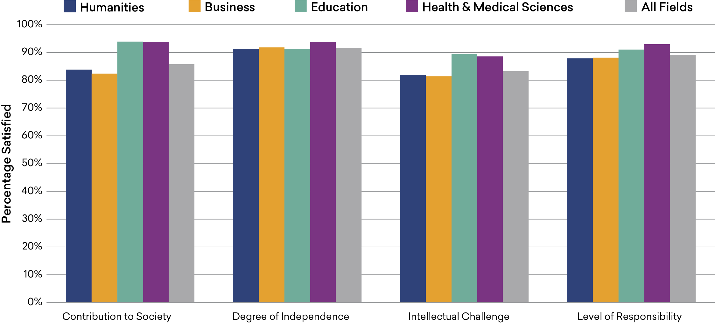
Satisfaction of Humanities Bachelor’s Degree Holders with Nonmonetary Aspects of Their Job, by Field of Bachelor’s Degree, 2019
Source: National Survey of College Graduates, 2019
Notes:
HUMANITIES GRADUATES WERE ALSO SIMILAR to college graduates generally in their attitudes about some of the less tangible aspects of their job. The shares of graduates with bachelor’s degrees in the humanities who expressed satisfaction about the degree of independence and level of responsibility in their job were very similar to the shares for fields to which the humanities is often compared. Two fields, however, stand out for the satisfaction their graduates derive from their work. Education and health/medical sciences graduates were appreciably more likely to express satisfaction (in comparison both to the humanities and to college graduates generally) with the intellectual challenges and contributions to society afforded by their jobs.

Slide 20
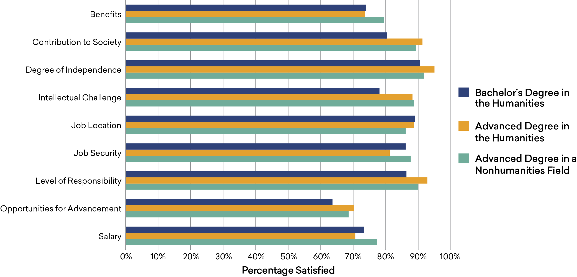
Satisfaction of Humanities Bachelor’s Degree Holders with Aspects of Their Job, by Highest Degree, 2019
Source: National Survey of College Graduates, 2019
Notes:
AMONG THOSE WHO EARNED a bachelor’s degree in the humanities, the rates of satisfaction with various aspects of their job tended to be at least somewhat higher among those who had gone on to complete an advanced degree. Humanities majors who had earned an advanced degree (in either the humanities or a nonhumanities field) were appreciably more likely to be satisfied with the contribution their work allowed them to make to society as well as the intellectual challenge of their job.
Advanced degree holders were also modestly more likely to express satisfaction with their opportunities for advancement. A similar difference—though still quite modest—was observed between terminal humanities bachelor’s degree holders and holders of an advanced degree in the humanities with regard to their level of job responsibility.

Slide 21
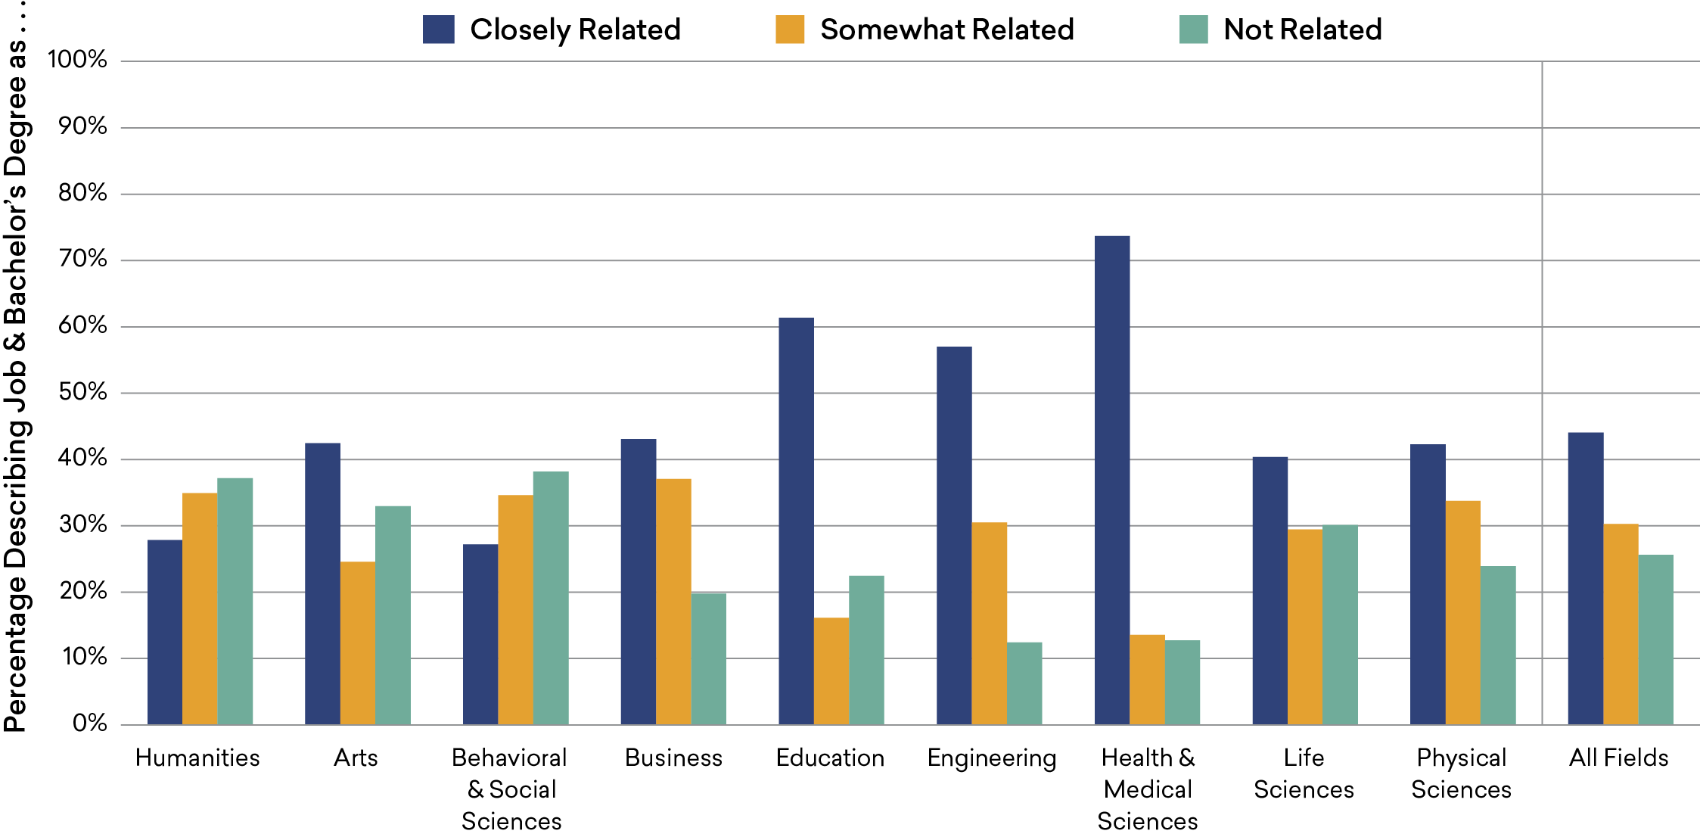
Terminal Bachelor’s Degree Holders’ Perception of How Related Their Job Is to Their Degree, by Field of Degree, 2019
Source: National Survey of College Graduates, 2019
Notes:
THOUGH THE PREVIOUS PAGES have highlighted areas in which humanities graduates tend to be similar to their counterparts in other fields, humanities graduates differ in at least one key way that may reinforce negative perceptions of the field. A wide gap separates humanities majors and graduates from certain professional and STEM fields in their perception of the relationship between their job and their degree. (Graduates from the behavioral/social sciences were
more similar to humanities graduates in this regard.) Excluding those with advanced degrees, more than a third of bachelor’s degree holders from the humanities saw no relationship between their degree and their job, as compared to less than 15% of graduates from engineering and the health/ medical sciences, and approximately 20% of education and business graduates.29

Slide 22
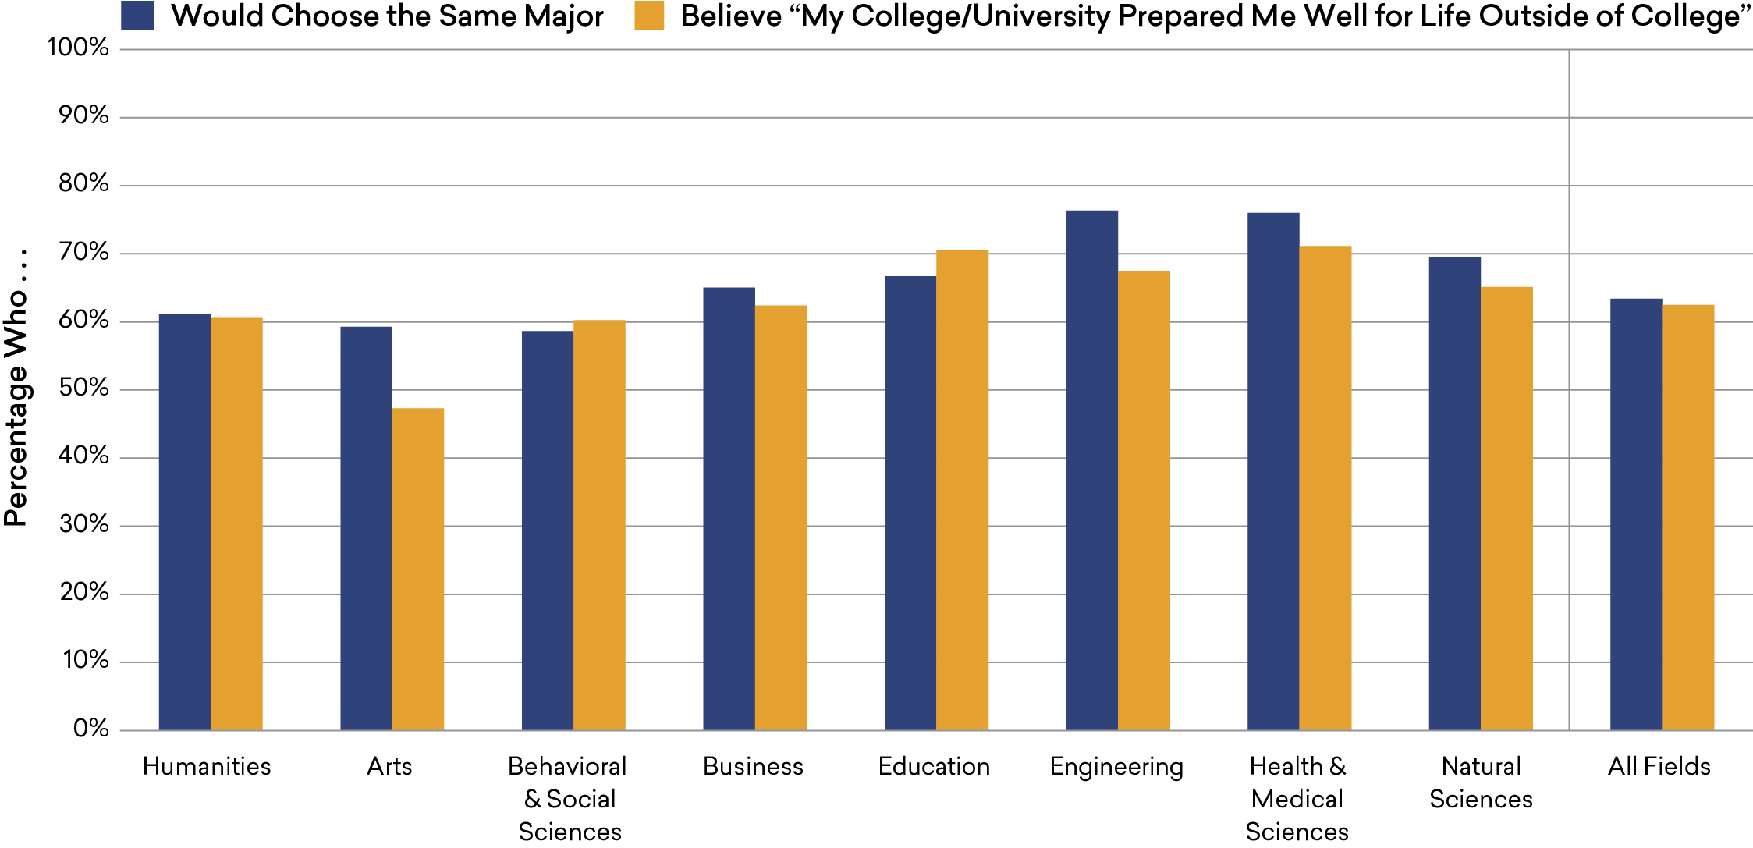
College Graduates’ Perception of the Value of Their Undergraduate Education, 2018/2019
Source: Gallup Alumni Survey, 2019
Notes:
A SUBSTANTIAL SHARE of humanities graduates also expressed ambivalence about their degrees. Approximately 40% indicated that they would not choose the same major again, and a similar share reported they did not believe that their undergraduate institution prepared them for life. In these respects, humanities majors were similar to college students in general and also to business and behavioral/social sciences majors. Engineering and health/medical sciences graduates were considerably more likely to say that they would choose the same major again.
Because graduates were not asked to identify a major they would have preferred, we cannot conclude that they would have chosen a major in a different field. Some humanities graduates, for example, might have chosen to major in a different discipline within the humanities. Nevertheless, this finding and the lack of a perceived relationship between job and degree point to a challenge for the field.

Slide 23
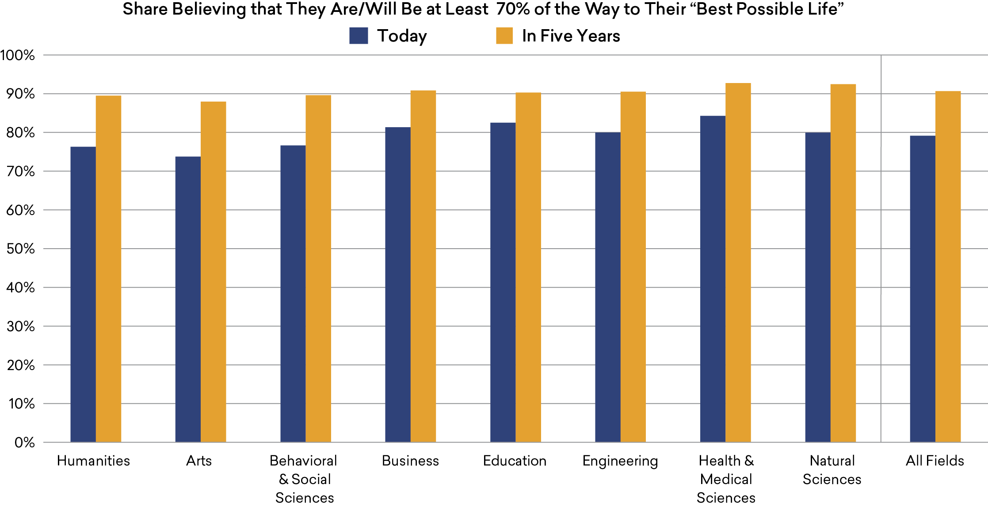
College Graduates’ Assessment of Their Current and Future Progress Toward
“My Best Possible Life,” by Field of Degree, 2019
Source: Gallup Alumni Survey, 2019
Notes:
DESPITE THE AMBIVALENCE about their degrees, more than three-quarters of humanities graduates saw themselves at least 70% of the way to realizing their “best possible” life, a similar share to that for college graduates generally. Health/ medical sciences majors were the most likely to feel they had made that much progress (with a share of 84%).
The difference between the humanities and other fields was even smaller in terms of graduates’ estimate about where they would stand in the future. Ninety percent of humanities majors believed they would be approaching their best life in five years, a share almost identical to that for graduates from each of the other major fields.

Slide 24
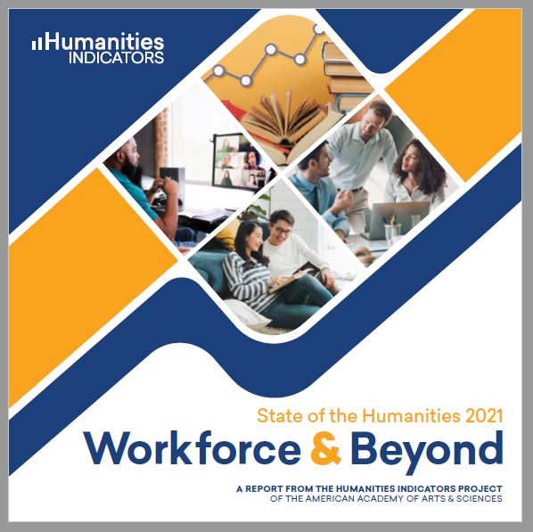
Visit us at www.HumanitiesIndicators.org
          Contact us with specific questions at rtownsend@amacad.org or on Twitter @rbthisted
And sign up for email updates at http://bit.ly/IndicatorsUpdates

