Slide 1
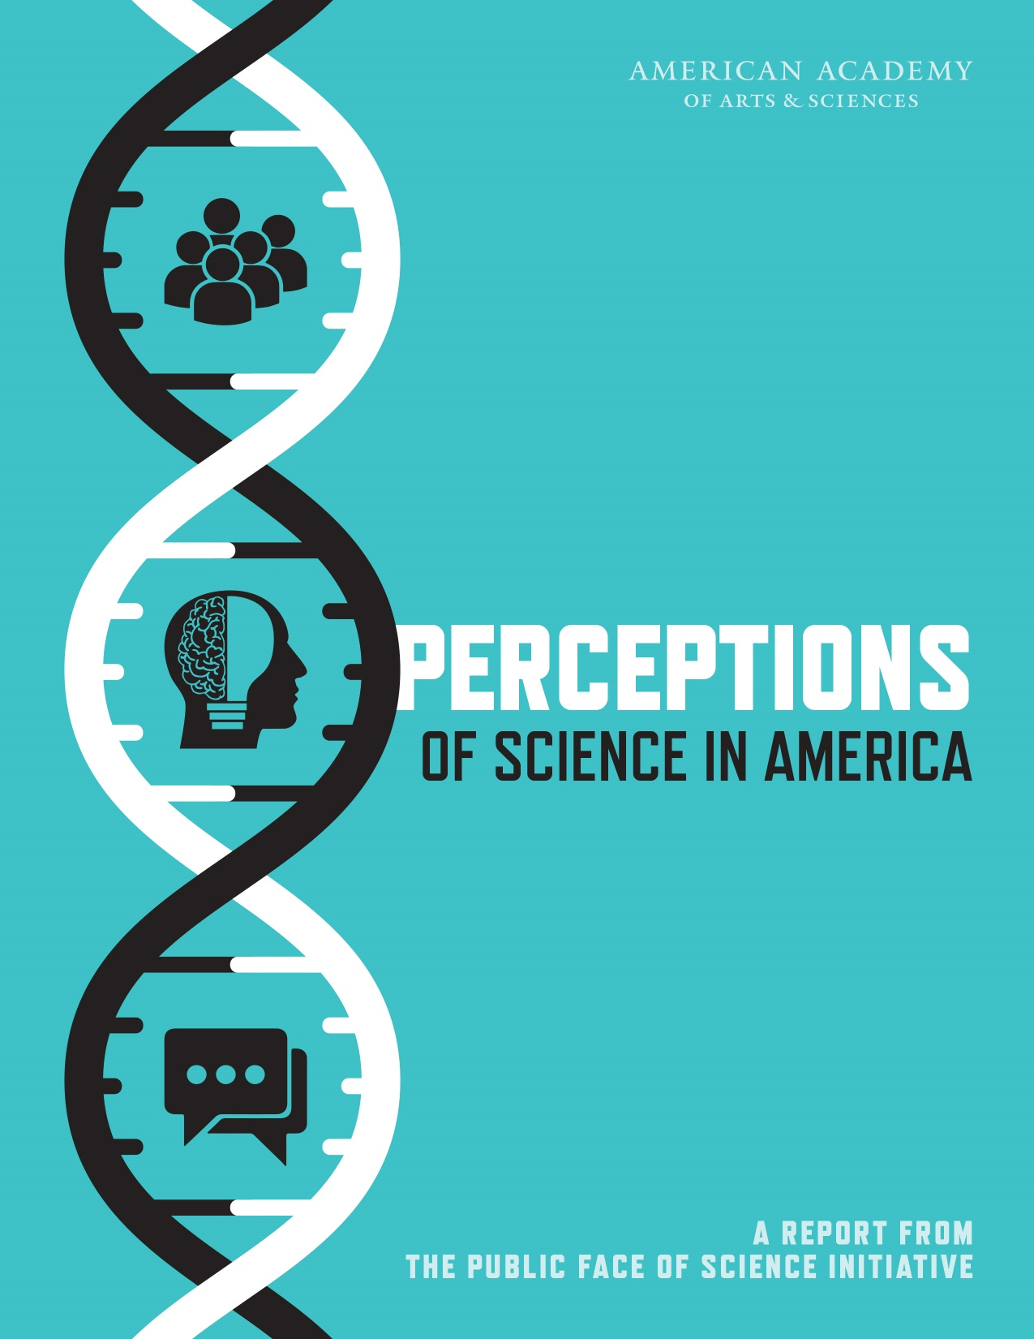
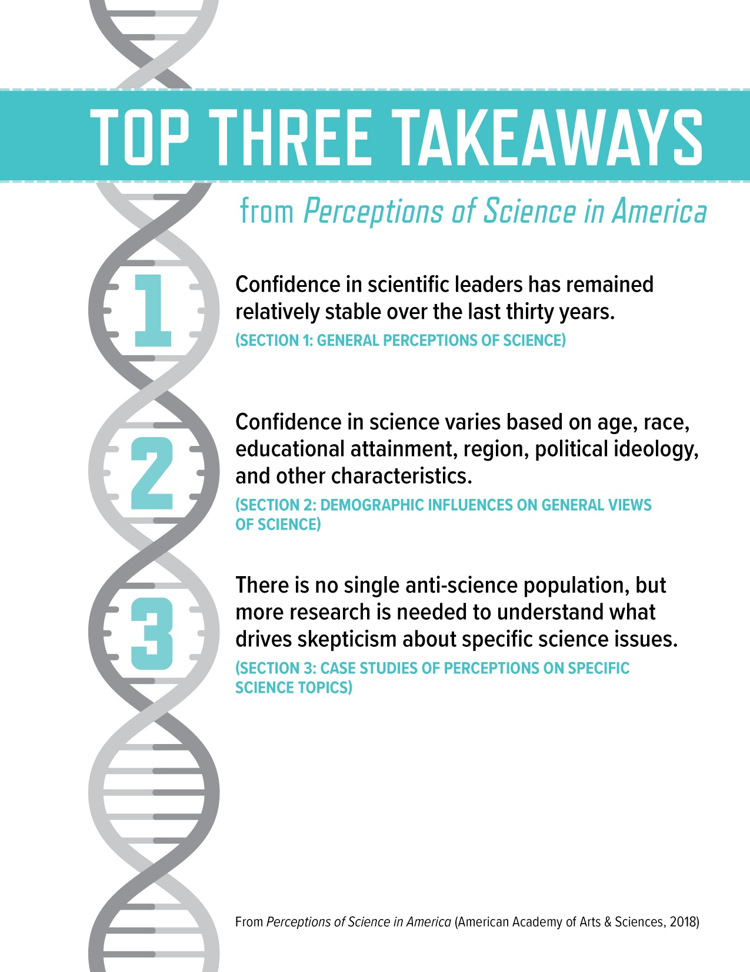

Slide 2
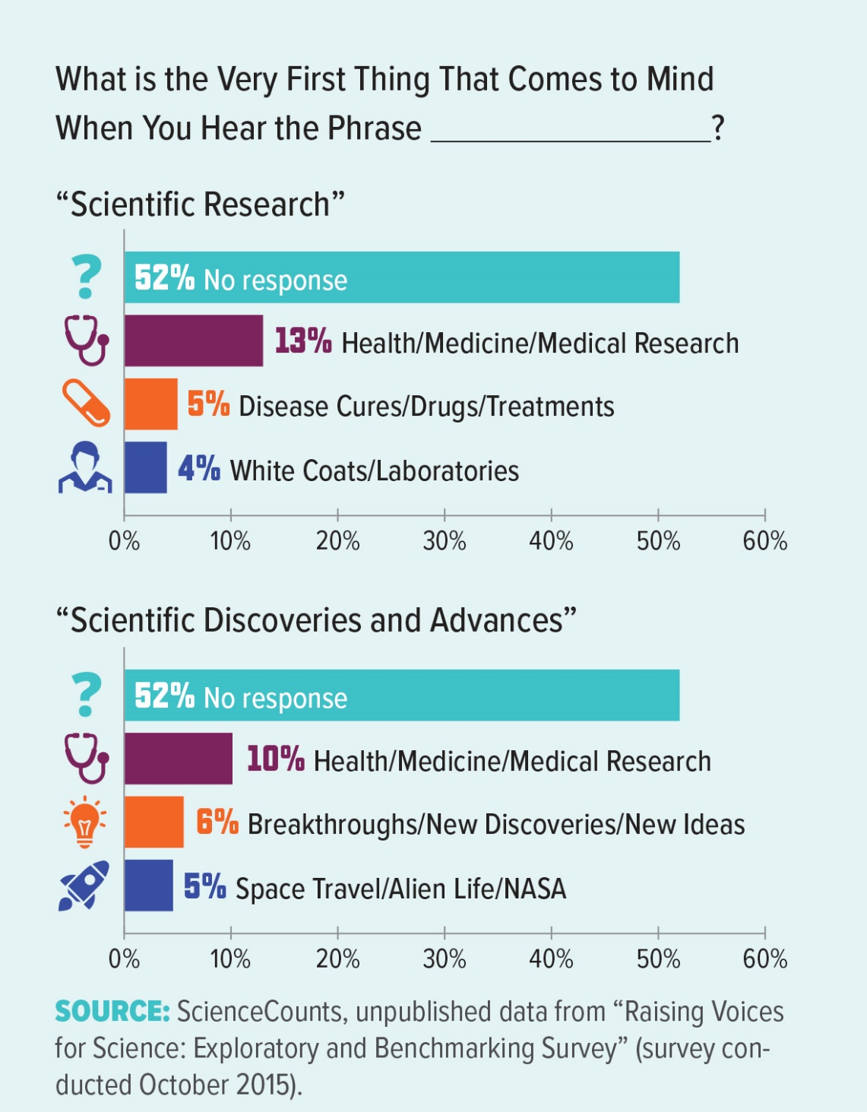
Notes:
Defining “Science”
The term “science” encompasses a range of disciplines in the physical, social, and life sciences, along with applied fields, such as engineering and medicine. Science can be defined as “the use of evidence to construct testable explanations and predictions of natural phenomena, as well as the knowledge generated through this process.”2 However, the word “science” is interpreted differently by different individuals. Often, public opinion polling does not identify whether an individual perceives “science” to mean medical treatments, technological advancements, or fundamental research in either a particular field or across multiple fields (such as chemistry, physics, biology, psychology, or sociology). Based on the context, science may also be viewed generally as an institution, a body of facts, or a process. When interpreting the available survey data, it is important to consider the range of responses a question might prompt.

Slide 3
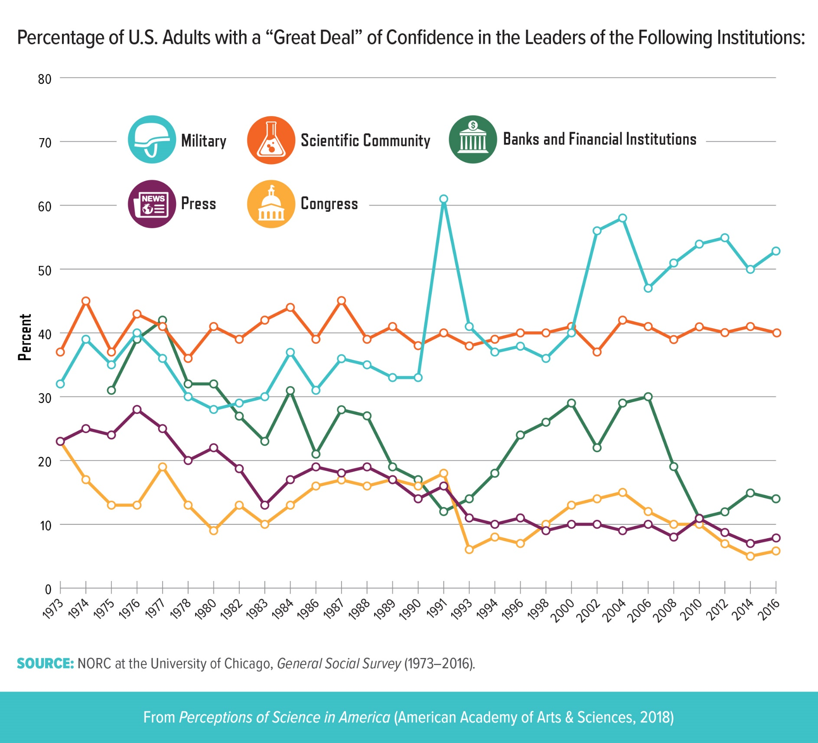
Notes:
One of the longitudinal indicators of public perceptions is institutional confidence. In the 1970s, the National Opinion Research Center (NORC) at the University of Chicago began surveying the degree of confidence in the leaders of numerous institutions, including the scientific community, as part of its General Social Survey (GSS). This figure depicts the percentage of people who express a “great deal” of confidence as opposed to “only some” or “hardly any confidence at all.” For at least four decades, about 40 percent of the public had a “great deal” of confidence in the scientific community. As of 2016, approximately 90 percent of Americans had either a “great deal” or “only some” confidence in the scientific community (see pages 14–15), in line with the military and far above the press, Congress, and banks and financial institutions (all below 50 percent; data not shown).

Slide 4
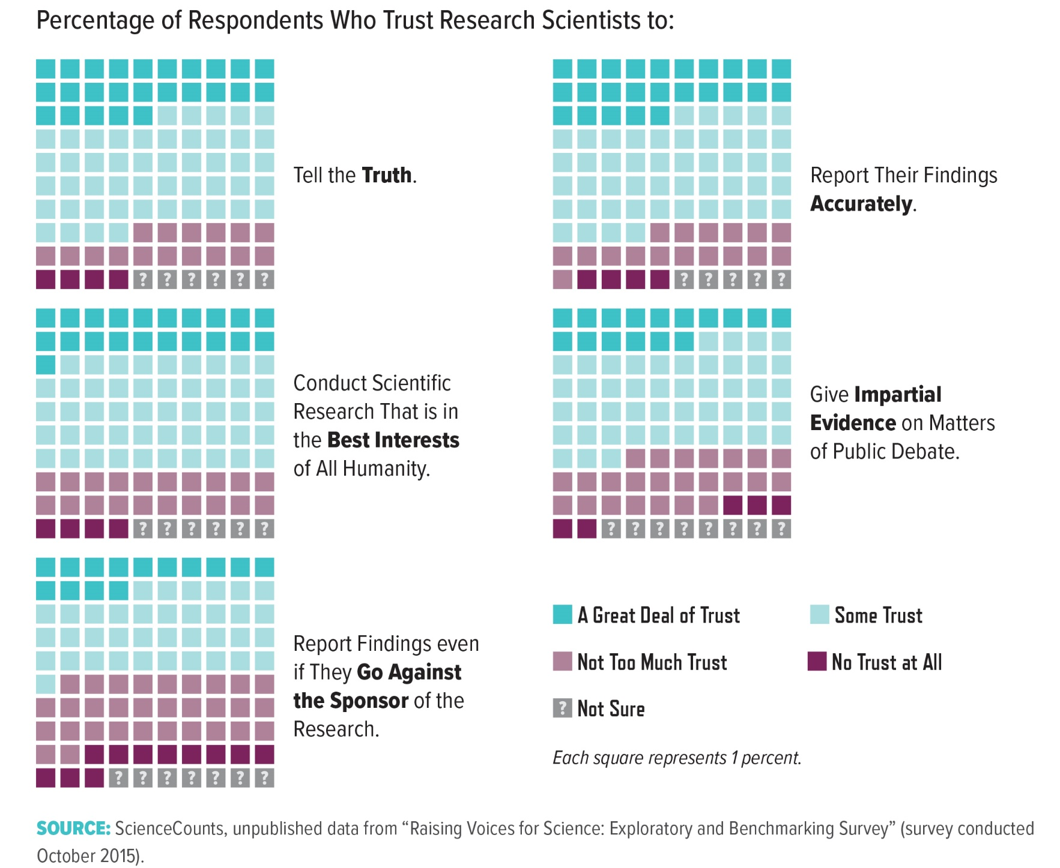
Notes:
Although overall confidence remains high, the level of trust in research scientists may vary based on their perceived responsibilities. In a recent exploratory market research study by ScienceCounts, approximately three-quarters of respondents placed either a “great deal” or “some” trust in research scientists to tell the truth and to report their findings accurately. By comparison, respondents expressed less trust in scientists to report findings that disagree with the interests of the research sponsor. Recent studies suggest that communicators should use approaches that convey trustworthy intentions rather than attempts at persuasion, which may be seen as indicative of an underlying agenda.6

Slide 5
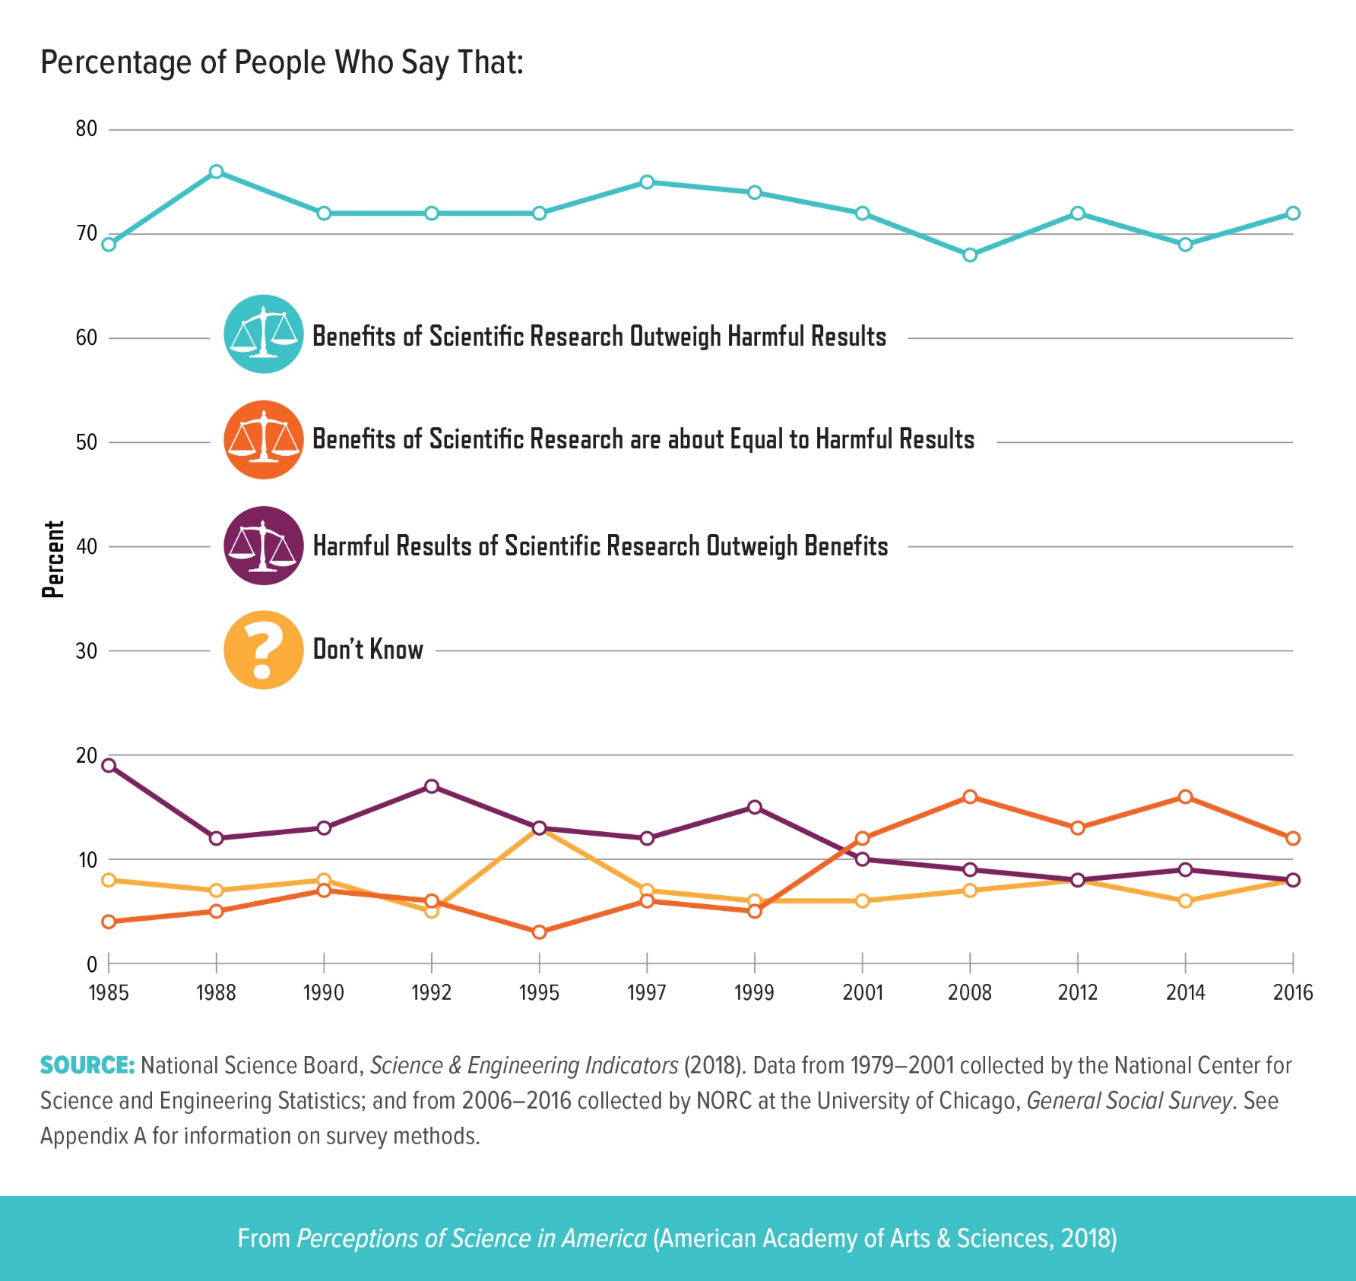
Notes:
Many surveys have examined how the public perceives the impact of science on societal progress, well-being, and the economy. In 2016, 72 percent of U.S. adults thought the benefits of scientific research either strongly or slightly outweighed harmful results. Consistent with this observation, a 2015 Pew Research Center study revealed that 79 percent of U.S. adults believe science has made life easier for most people, whereas only 15 percent believe that science has made life more difficult (data not shown).7 Although a clear majority perceives science as beneficial, this sentiment varies with demographic criteria, including education, income, age, and science knowledge (see page 16)

Slide 6
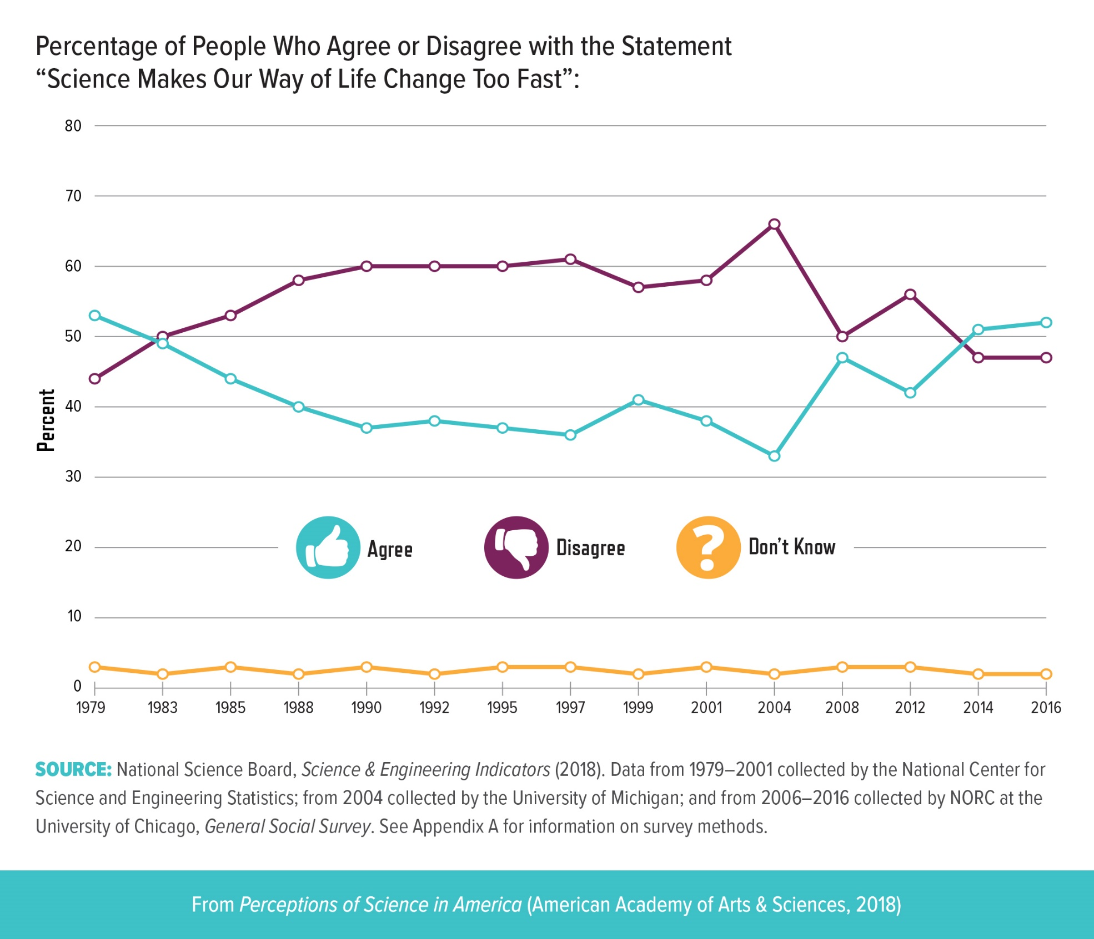
Notes:
Although U.S. adults generally believe that scientific research is beneficial, other indicators of the perceived impact of science are less conclusive. For more than thirty years, U.S. adults have been asked about the extent to which they agree or disagree with the statement “Science makes our way of life change too fast.” From 1983 to 2012, the majority either disagreed or strongly disagreed with the statement. In 2016, Americans were split on the sentiment, with 52 percent agreeing and 47 percent disagreeing. A caveat for interpreting these results is the potential for acquiescence bias, a phenomenon in which respondents tend to agree with the questioner when they are uncertain about the answer. Research into how people interpret the word “science” during surveys would be helpful for understanding the results of such studies (see Defining “Science” on page 3).

Slide 7
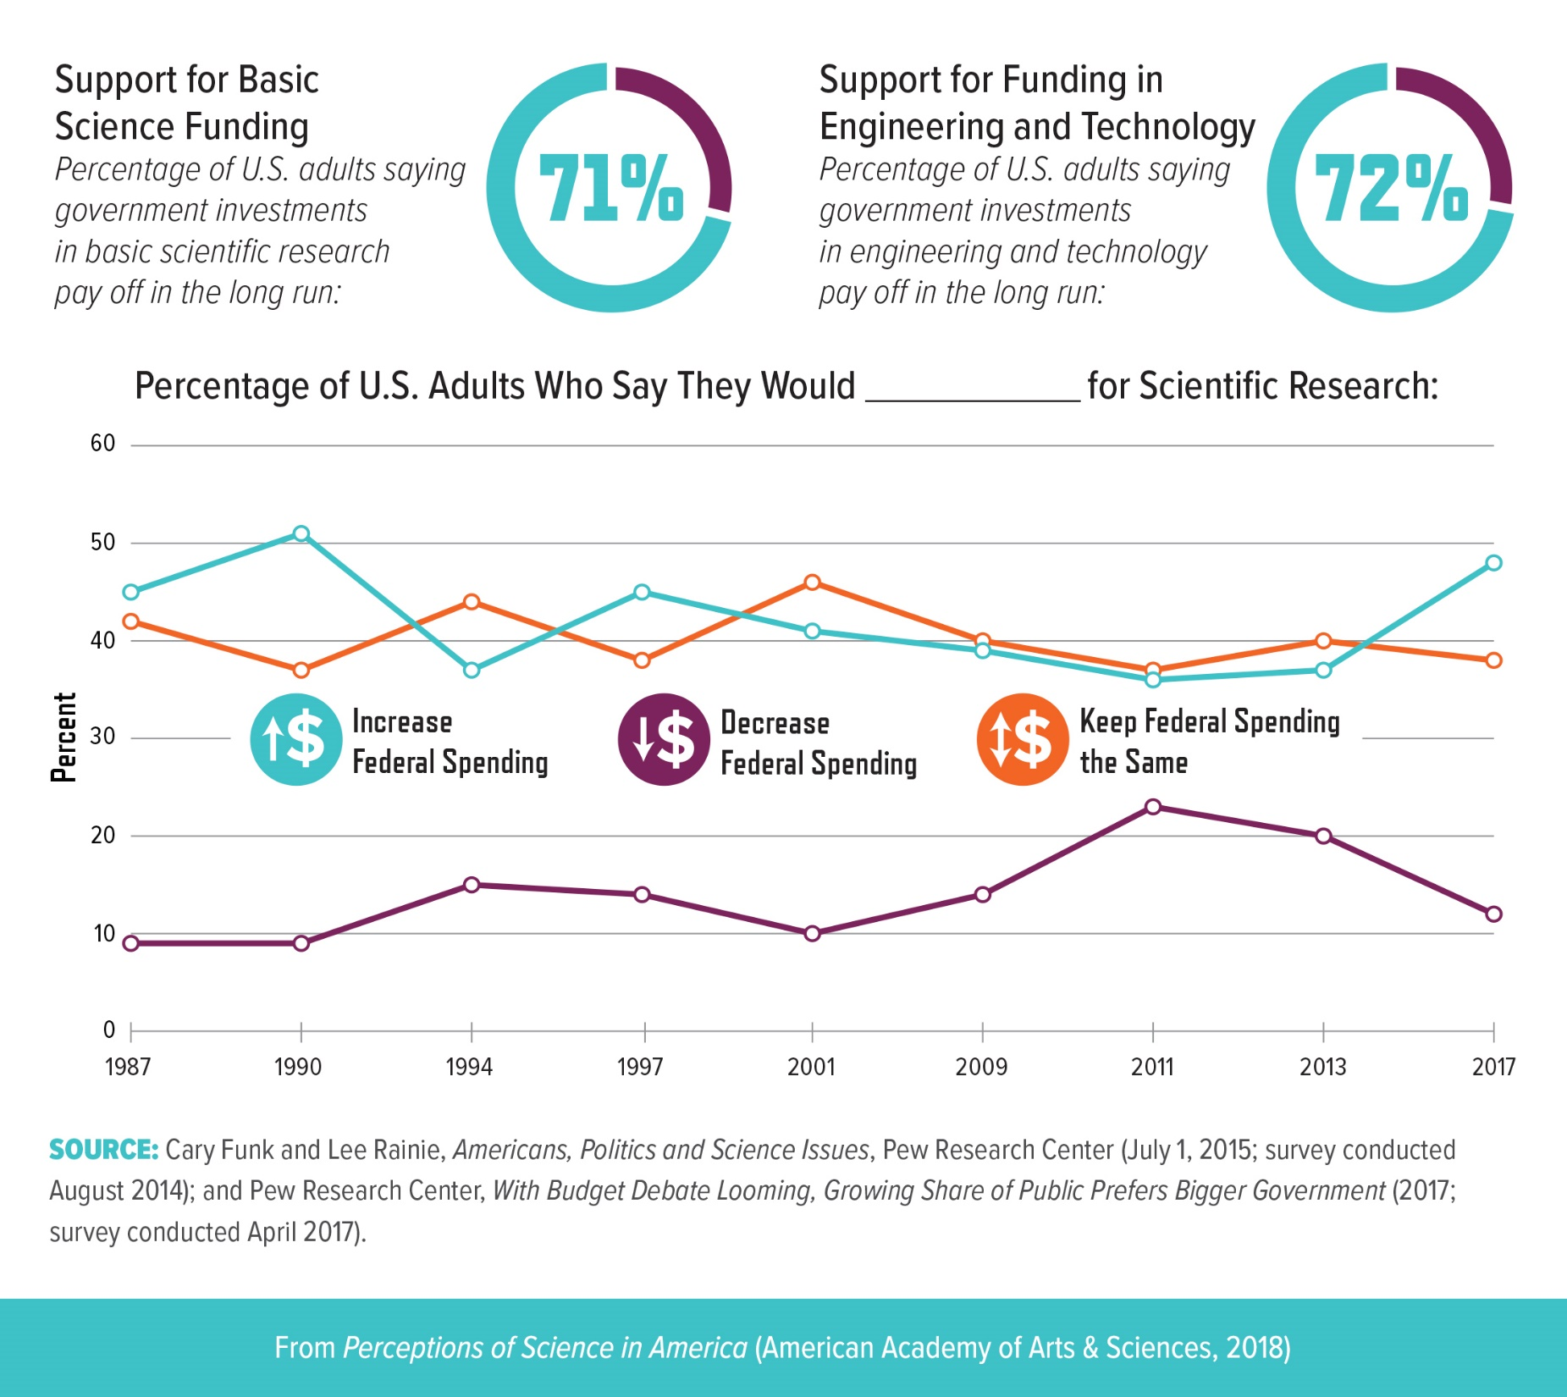
Notes:
A majority of the public supports federal funding of basic science research and investments in engineering and technology. Support for research funding has been relatively steady over the last two decades (data not shown).8 In a 2017 Research!America survey, 79 percent of respondents thought research investment was either “very important” or “somewhat important” for job creation, technological breakthroughs, and economic growth (data not shown).9 Despite a recent uptick in Americans who would like to see federal funding for scientific research increase, about half of Americans say funding should be kept the same or decreased. Recent research suggests that people become more supportive of increases in funding when misconceptions of the current funding levels in relation to the overall budget are corrected.10

Slide 8
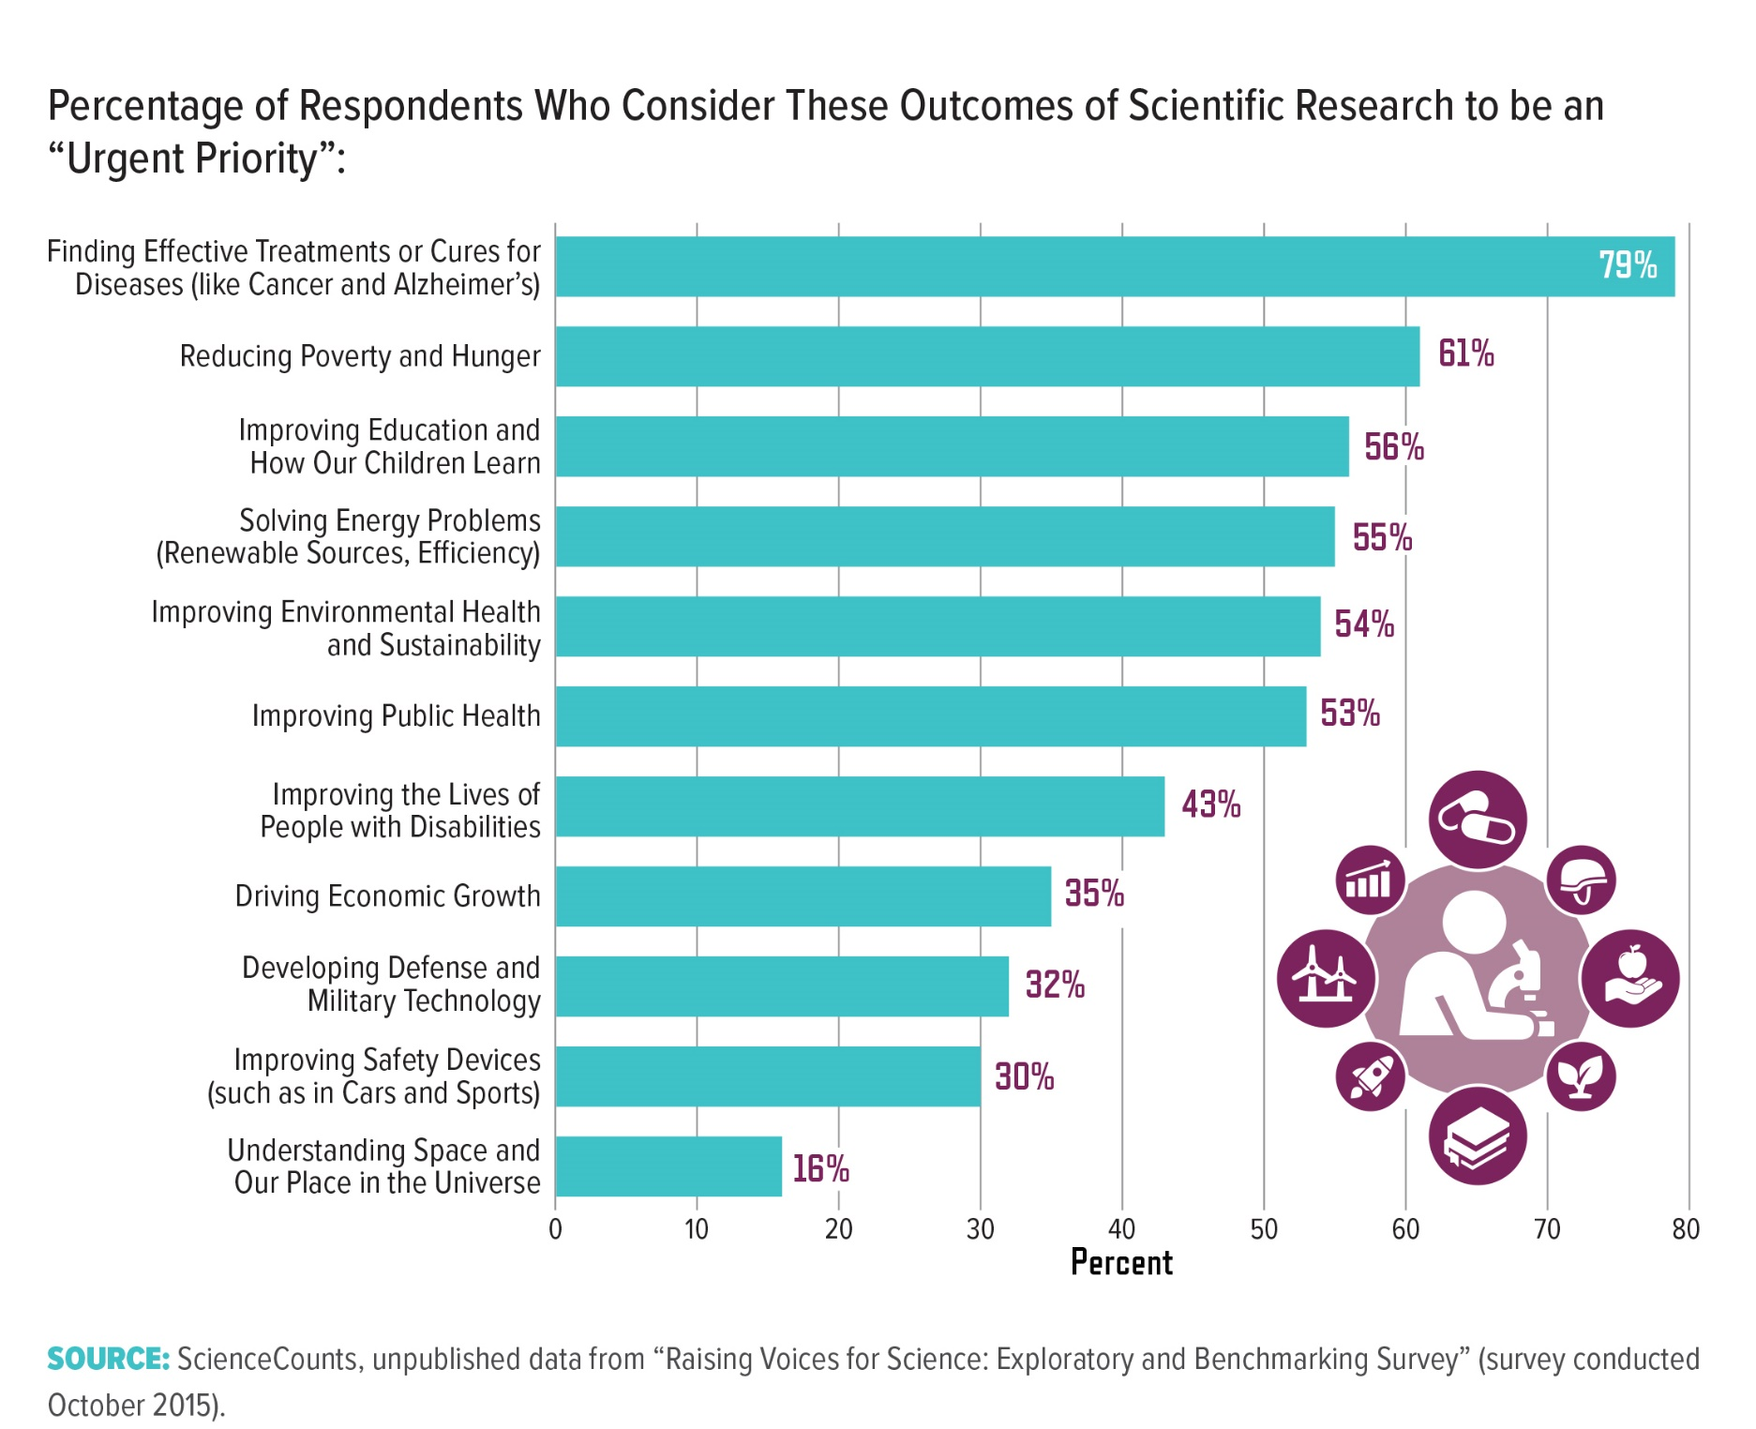
Notes:
Americans generally recognize science as a critical contributor to solving societal issues. In an exploratory survey commissioned by ScienceCounts, respondents were asked to rate several potential outcomes of scientific research as “urgent,” “important but not urgent,” “not important at this time,” or “not sure.” More than 60 percent of respondents considered each of the indicated research outcomes to be “urgent” or “important” (data not shown). While more studies will be needed to confirm and extend the results of this market research survey, they illuminate potential differences in how individuals perceive different scientific outcomes. For example, although climate change is a politically polarizing issue (see Section 3), approximately 55 percent of respondents considered “solving energy problems” and “improving environmental health and sustainability” to be “urgent” priorities.

Slide 9
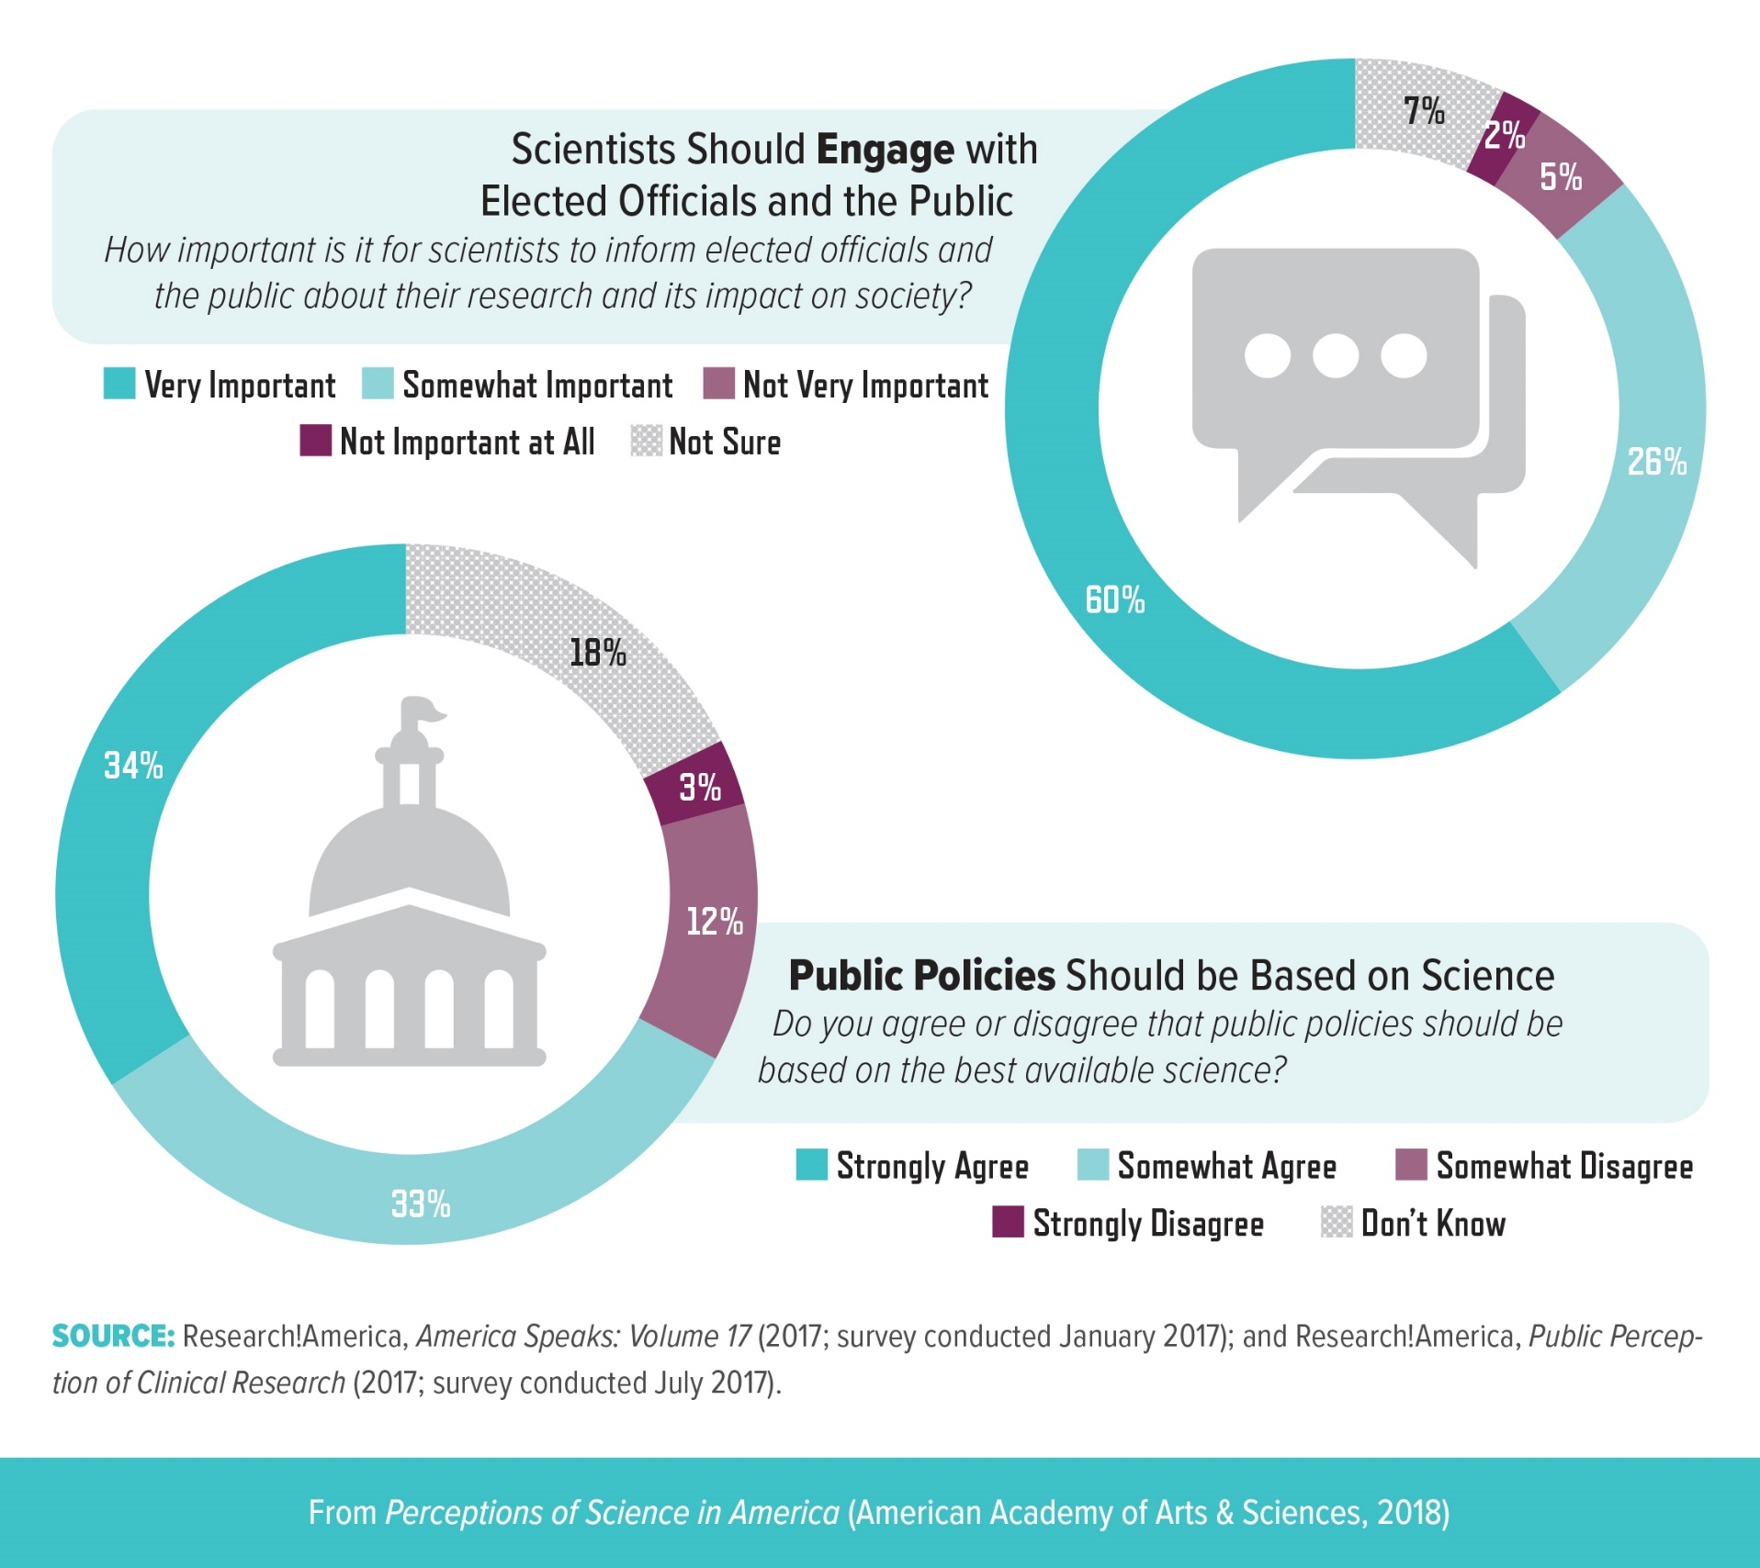
Notes:
Polling suggests relatively high confidence in scientists and awareness of the societal benefits of scientific research. But does this confidence translate to support for scientist engagement or science in policy? In a 2017 Research!America market research survey, 67 percent of respondents indicated that they “strongly agree” or “somewhat agree” that public policies should be based on the best available science. Another 2017 Research!America survey found that 86 percent of respondents agreed that it is either “very” or “somewhat” important for scientists to inform elected officials and the public about their research and its impact. The number of respondents who think engagement is “very important” increased 9 percent from a 2015 survey (to 60 percent), although this shift corresponded with a 7 percent decrease in those who consider engagement “somewhat important” (26 percent).11

Slide 10
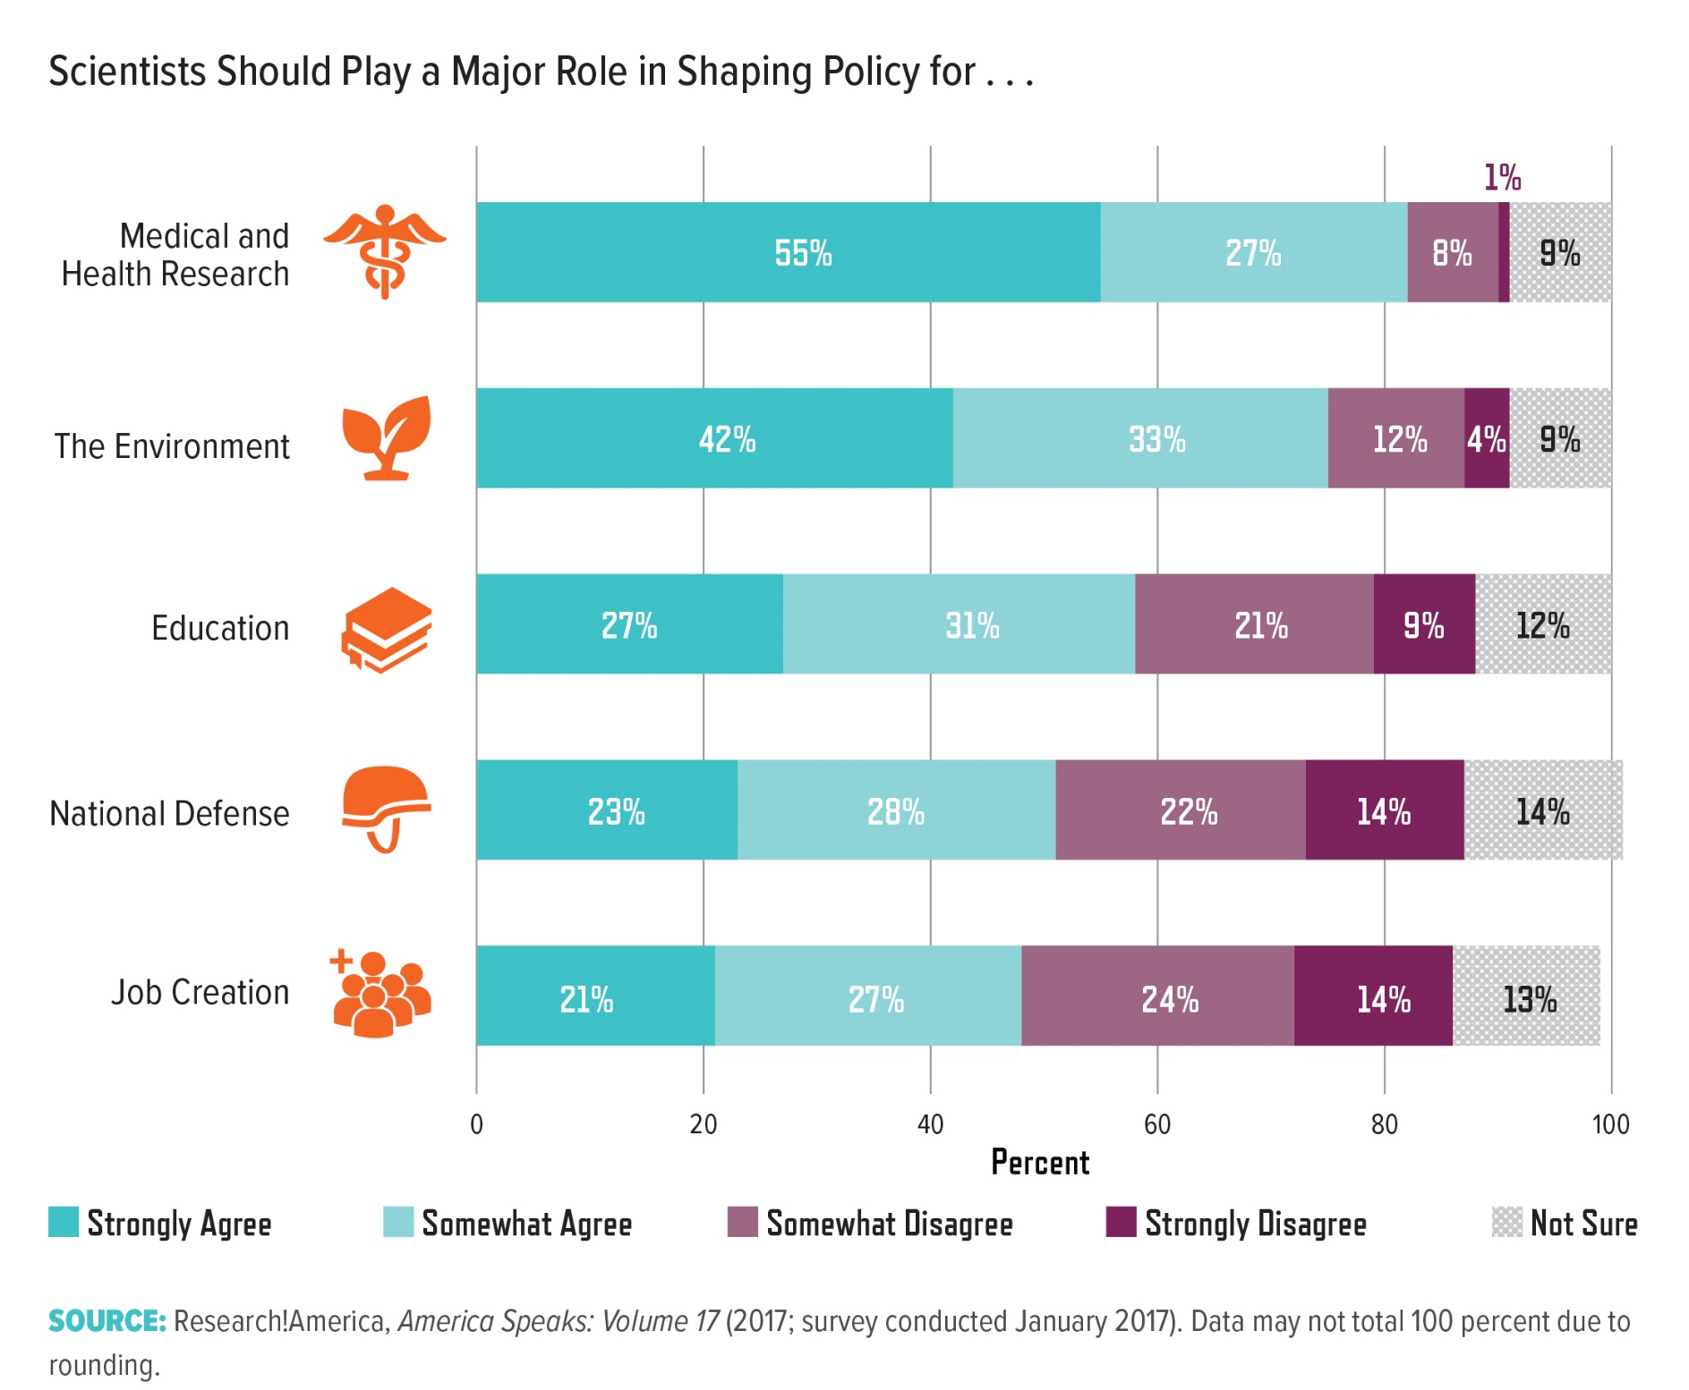
Notes:
Views on scientists’ role in shaping policy vary based on the issue. While 82 percent of respondents to a Research!America market research survey agreed that scientists should help shape medical and health research policy, fewer support scientist participation in job creation and national defense policy. This gap aligns with the prioritization of research to find disease cures rather than drive economic growth or develop military technology (page 9). Likewise, Pew Research Center studies show that 73 percent of Americans say medical scientists should have a major role in childhood vaccine policy12 and 67 percent say climate scientists should be involved with global climate change policy.13 More research is necessary into how a person’s understanding of science’s role in policy affects his or her perceptions.

Slide 11
Research Considerations:
Contextualizing Trust in Science and Scientists
How do people interpret the words “science” and “scientists” when responding to survey questions?
To what extent are individuals’ perceptions of science and trust in scientists influenced by their variable understanding of the scientific process, including issues related to study design, peer review, reproducibility, and the iterative nature of scientific discovery?
How does trust in science and scientists change based on where the research is performed? Is there more trust in federally funded versus privately funded research?
Notes:
1. Interpretations may vary based on demographic background and life experience, so understanding this question is critical for interpreting survey results. For example, the words “science” and “research” may bring to mind distinct scientific disciplines, products, or experiences for different people.
Some of these questions could be answered through the administration of new and more nuanced surveys, while others will require partnerships between public opinion researchers and social scientists. A finer distinction among different groups and contexts would also be beneficial. An expanded understanding of the interplay of factors that shape trust in science may identify areas of weakness that require greater attention from the scientific community. Moreover, these insights may inform science communication efforts to counteract any potential erosion of trust. Expanded polling and research also will be important for addressing emerging scientific questions that have policy implications. For instance, understanding trust in technology companies and their researchers is an important context for understanding attitudes toward innovations such as artificial intelligence and the many emerging regulatory and policy issues related to privacy and security.

Slide 12
Research Considerations:
Perceptions of Science Funding and the Role of Science in Policy
What do people know about how policy processes incorporate the results of scientific research? Do positive attitudes toward science and/or a greater knowledge of the policy process lead to more support for the use of science in policy?
What do people know about the role of science institutions (like research universities) in their communities? Does a greater understanding of science institutions improve perceptions within local communities?
What do people know and understand about science funding? To what extent is public support for investment in research dependent on their understanding of how science is funded and the relative roles of public and private support? How do current social, political, and economic trends influence the prioritization of science funding by policy-makers and their constituents?
Notes:
Research on these questions would provide insight into the potential causes of negative perceptions, such as whether misperceptions of the role of public funding influence the desire to maintain or decrease funding for research. Such research would also contribute to an expanded definition of science literacy (see Reexamining the Deficit Model on page 3). Moreover, when conducting these studies, it will be important to consider how external factors, such as the state of the economy, may shift support for science funding. To help craft effective research questions on public policy, researchers will need to work with experts familiar with the use of science in policy. Due to the expansive nature of these science funding and policy questions, researchers should identify and focus on the areas in which an improved understanding would have the highest impact. For example, the data indicate less support for scientist engagement in job creation and national defense policy than in medical and health research (page 11). The results of these studies could help guide efforts to advocate for greater support in these areas.

Slide 13
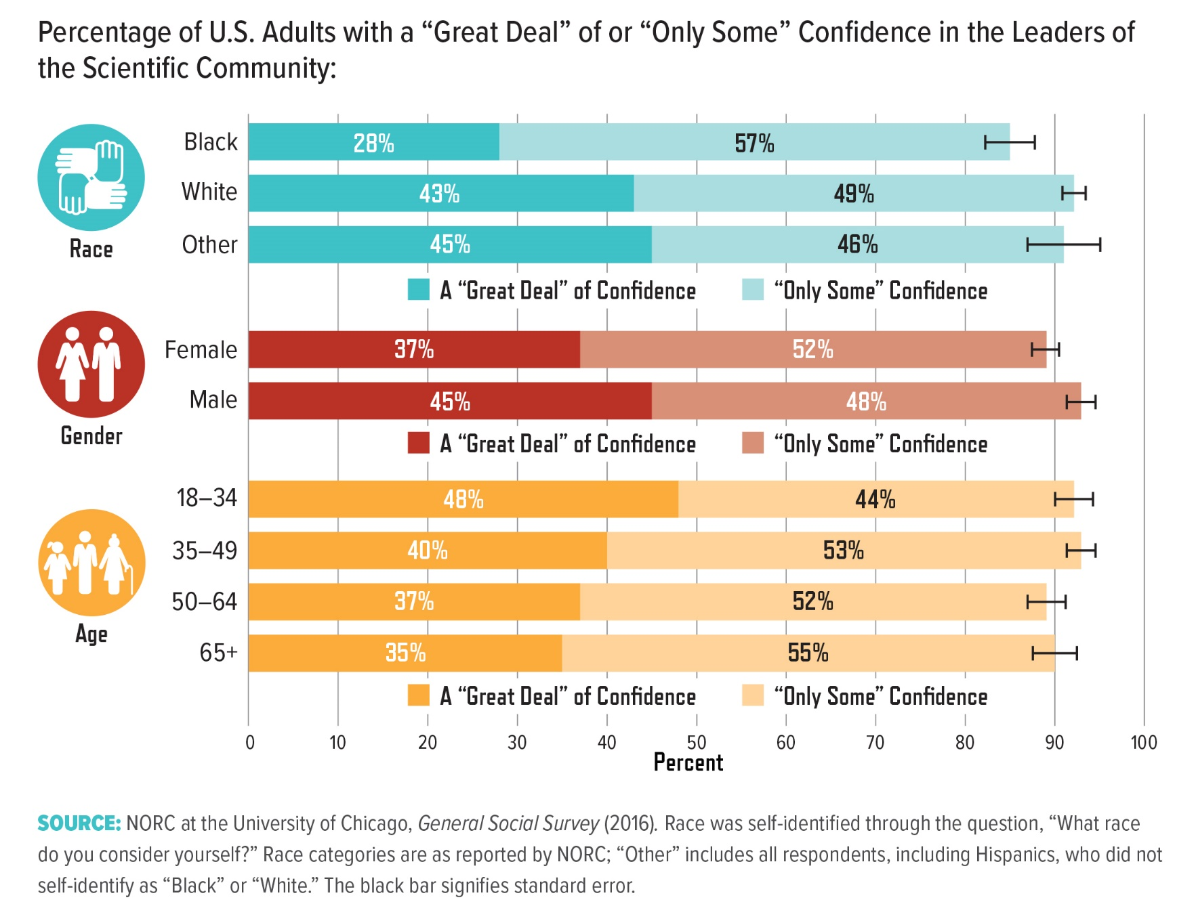
Notes:
Overall, 90 percent of Americans express either a “great deal” or “only some” confidence in scientific leaders; this number does not significantly vary among various demographic groups. In contrast, black and female adults are less likely to report a “great deal” of confidence in scientists, while younger Americans are more likely to. Black and female adults did not report comparatively lower trust in other institutions, such as education and banks/financial institutions (data not shown).14
gss data show that the gap between black Americans and other groups was narrower at certain points, such as the late 1980s and 2010. One recent analysis determined that inequitable educational experiences account for approximately one-third of the difference in trust.15 Other cultural elements, including religious beliefs, accounted for most, but not all, of the remaining gap. More research is needed to understand the influence of additional factors, such as the historical relationship between science and race.

Slide 14
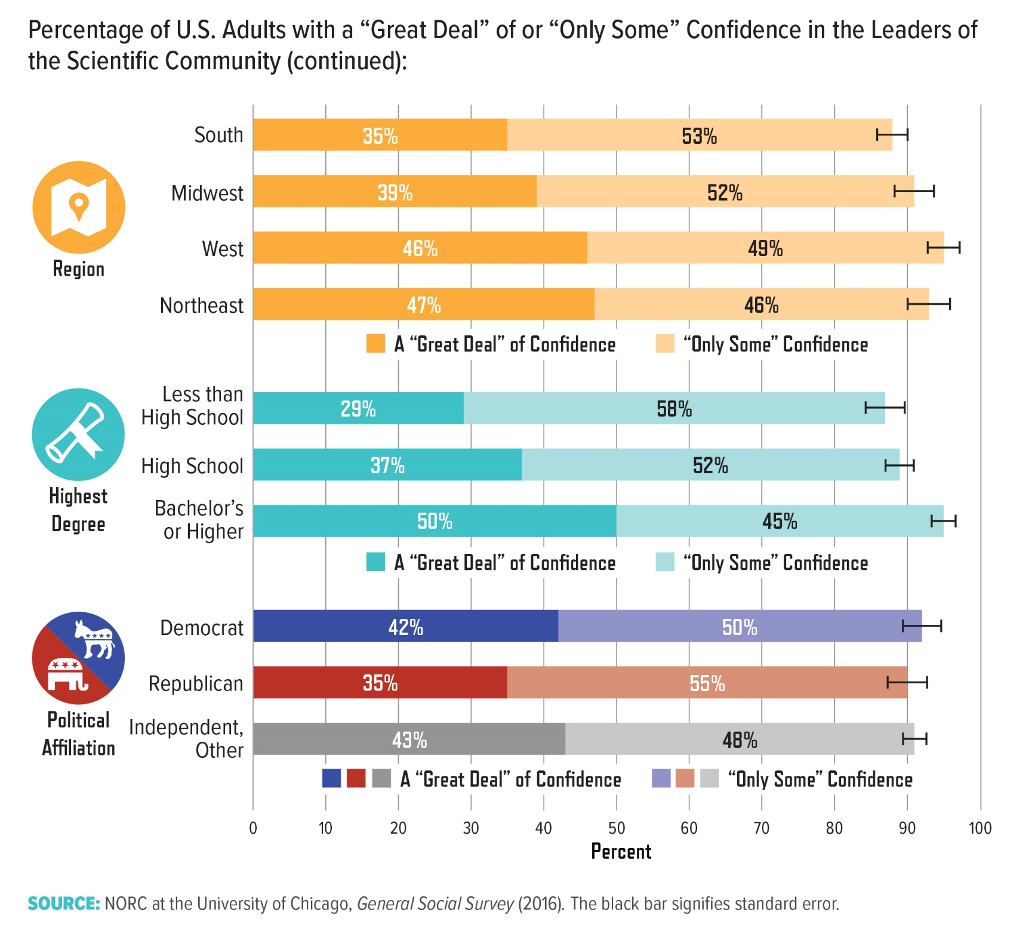
Notes:
The 2016 gss data also reveal that while 50 percent of college-educated adults have a “great deal” of confidence in scientific leaders, only 29 percent of respondents without a high-school diploma expressed this level of confidence. The positive relationship between
education and trust is reversed for other institutions: people with higher educational attainment are less likely to have confidence in the military and education (data not shown).16

Slide 15
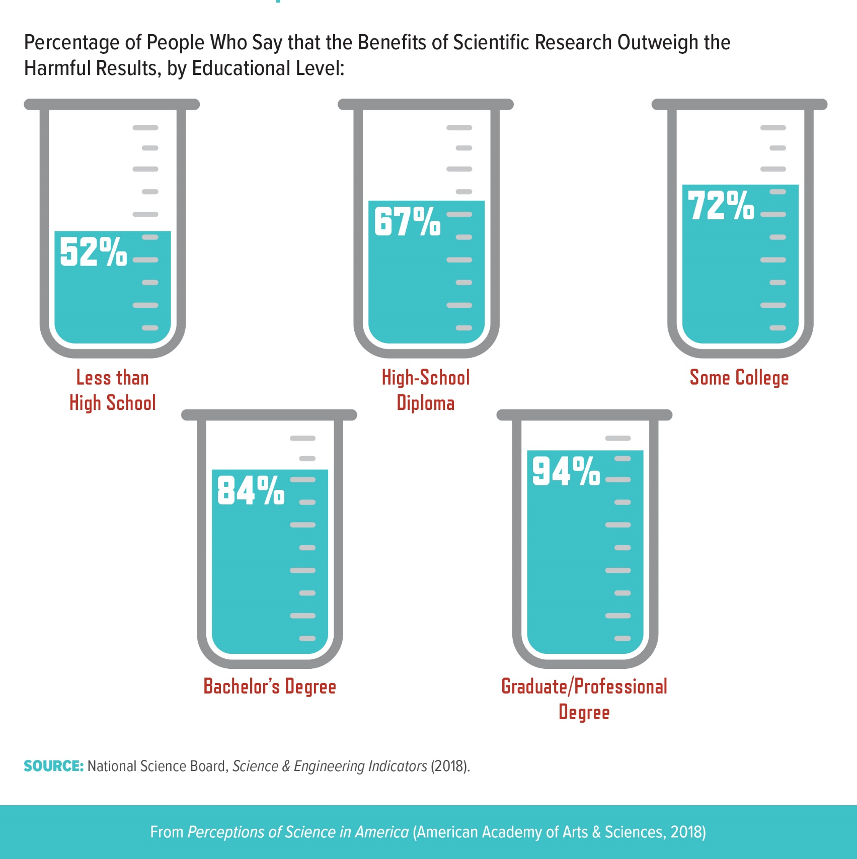
Notes:
The nsb assessment of whether U.S. adults believe the benefits of scientific research either strongly or slightly outweigh the harmful results reveals a similar divide by education level. The 2016 data show that although 72 percent of the overall population agrees the benefits outweigh the harms, only 52 percent of people without a high-school diploma agree. Similar trends are observed with increasing family income, science knowledge, and age (although there is a dip in this perception among those 65 and older).

Slide 16
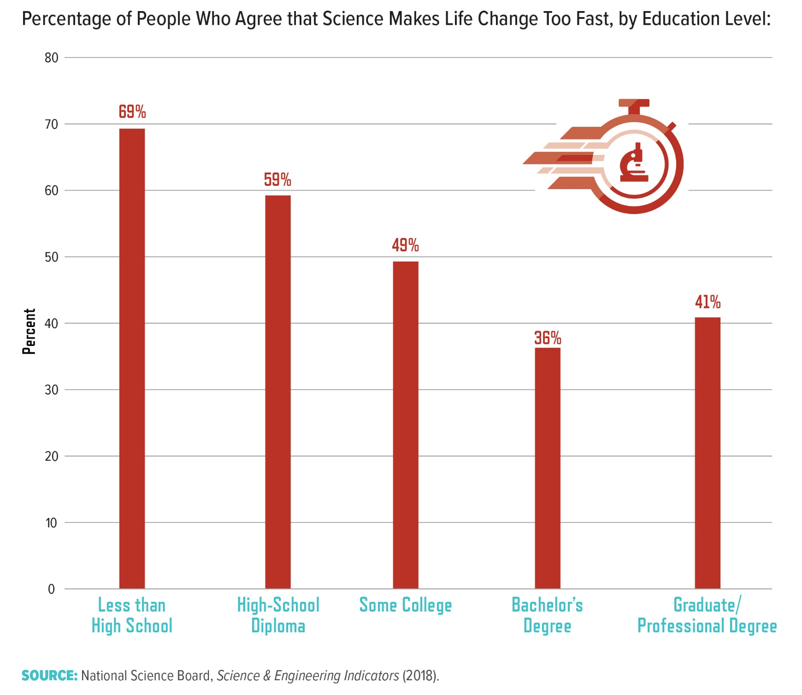
Notes:
People were also asked about the extent to which they agree or disagree with the statement “Science makes our way of life change too fast.” For the approximately 10 percent of Americans who did not complete high school, the vast majority (69 percent) agreed that science makes life change too fast.17 In comparison, 36 percent of those with a bachelor’s degree expressed this sentiment. Consistent with the strong correlation between education and income in the United States,18 respondents with lower family income also were more likely to agree with the statement (data not shown)

Slide 17
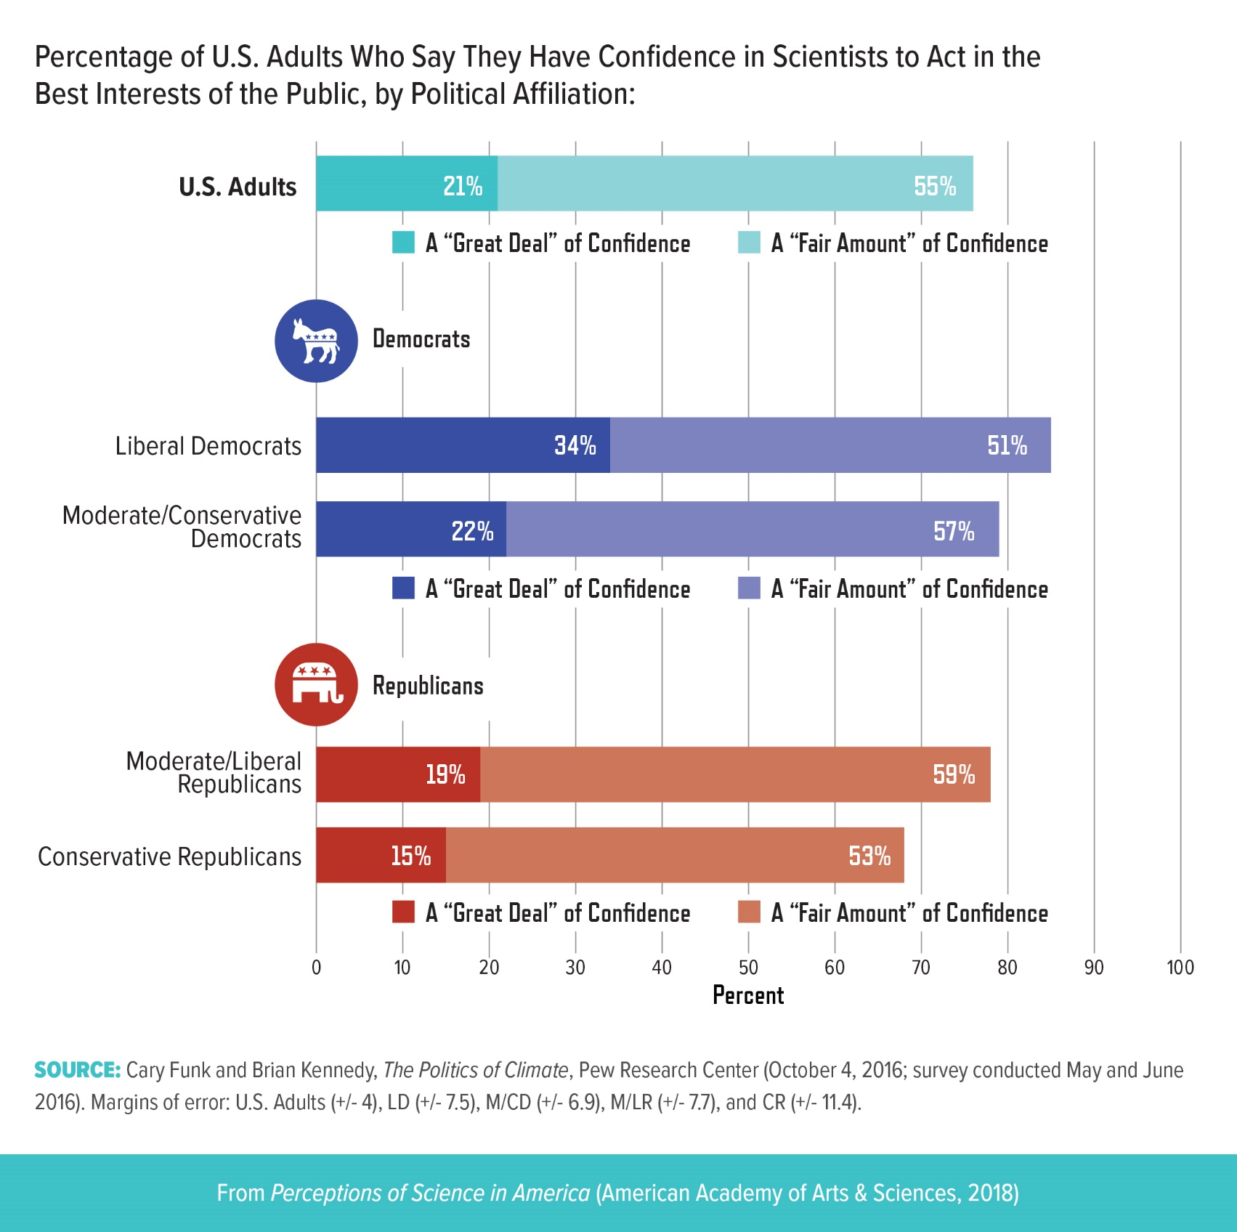
Notes:
A majority of both Democrats and Republicans express some degree of confidence in the scientific community. But a 2016 study from the Pew Research Center found that 34 percent of liberal Democrats expressed a “great deal” of confidence in the scientific community, while only 15 percent of conservative Republicans did the same. Studies suggest that skepticism among conservatives may originate from concerns with the relationship between science and government.19

Slide 18
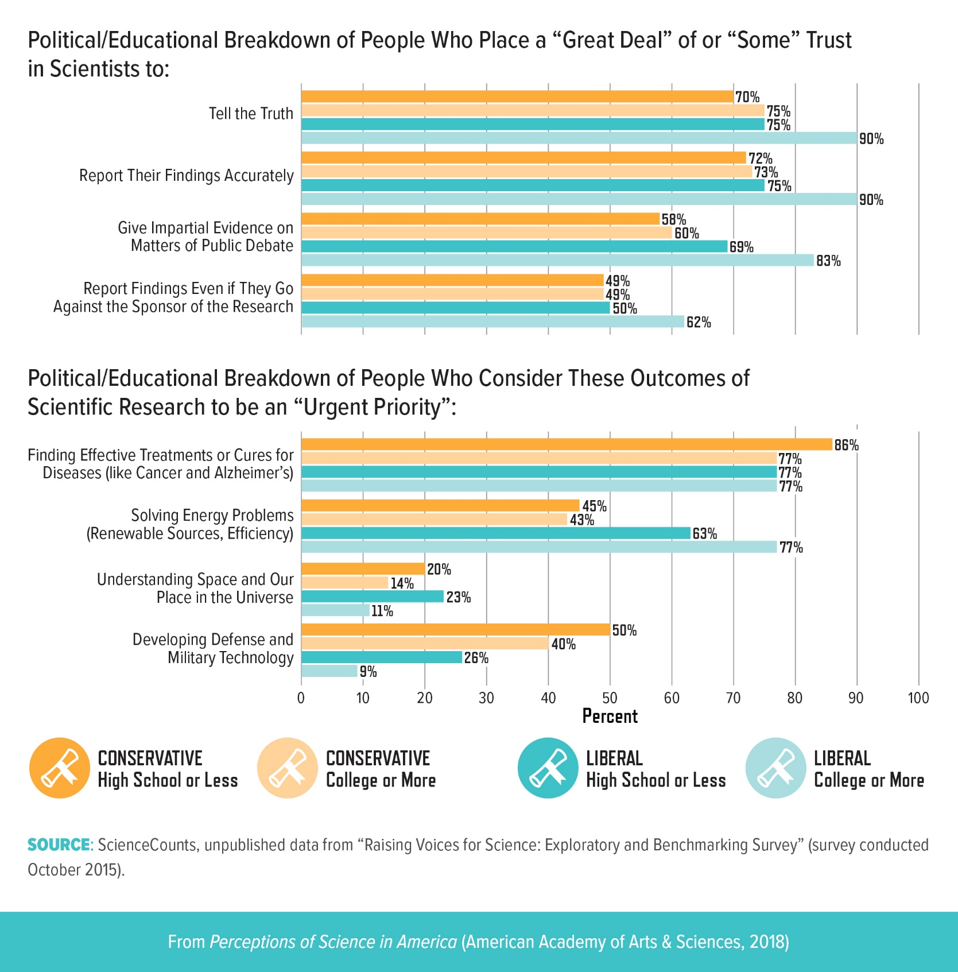
Notes:
A recent exploratory market research survey from ScienceCounts included several questions to assess general public perceptions of scientists and priorities for public funding of scientific research (see pages 5 and 9). The survey examined answers based on political ideology and education level. Liberal respondents with a college degree or more placed the highest amount of trust in scientists in different scenarios— such as reporting their findings accurately—although trust among all groups still remained relatively high. Conservatives tended to cluster together in their responses despite their educational background, while the responses from liberals were more varied. With respect to research priorities, all groups highly prioritized “finding effective treatments or cures for diseases.” A higher percentage of conservative respondents considered outcomes related to “developing defense and military technology” a greater priority compared with college-educated liberal respondents.

Slide 19
Research Considerations:
Examining the Underlying Influences on Trust and Perception
What causes an individual to trust science messengers?
How do an individual’s experiences with science shape his or her attitudes? How flexible are these attitudes once established?
How and when do people become curious about science? Are there general trends in how attitudes and curiosity change during a person’s lifetime?
What influence do various forms of news media, social media, and entertainment media have on trust? How do messages and cues provided by political leaders and like-minded peer groups influence trust and attitudes?
Notes:
When assessing the influence of individuals’ experiences and worldviews on attitudes toward science, social scientists have the task of establishing a consensus on how to define fundamental terms such as “values” and “perceptions.” There is also a need for targeted research on how specific values influence specific perceptions. In line with the questions contextualizing trust in Section 1, understanding the underlying factors that shape trust in science will help strengthen science communication efforts. More-extensive collaborations between social scientists and science communicators could improve the application of these concepts to communication strategies

Slide 20
Research Considerations:
Exploring Group Identity and Specific Communities
How do we understand the role of social norms and the media in shaping cultural perceptions of science? Studies on the role of culture should explore a range of media, such as poetry, literature, television, and movies, and should evaluate possible differential effects among different subpopulations.
What barriers to accessing science exist in low-income and marginalized communities? How does infrequent contact with high-quality scientific content affect perceptions of science?
How do communication approaches prime a person to respond with a particular group identity? Are there communication strategies that elicit positive attitudes toward science? These questions should seek to identify the approaches that encourage discussion around shared identities and interests instead of the differences accompanying group identity.
Notes:
Social scientists should specifically consider how perceptions of science are influenced by group identities based on gender, race, religion, political ideology, and other factors. Historical case studies could be useful for providing insights on this topic. When considering questions of group identity, it will be necessary to consider how the definitions of the subgroups and the scientific field in question can influence the quality and interpretation of these data. It is also important not to treat these groups as monolithic, since perceptions of science may vary even among those sharing a particular group identity. Further research on group identities should explore

Slide 21
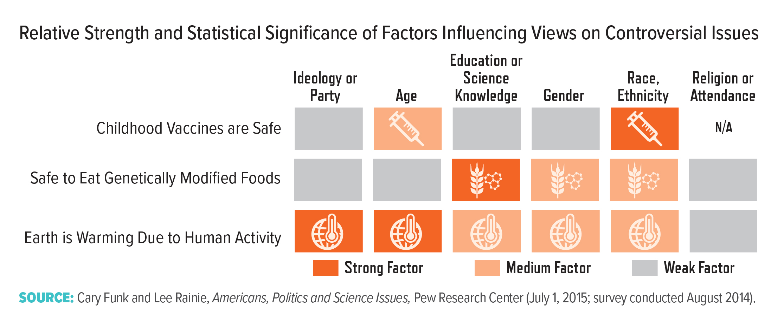
Notes:
This figure does not identify how a particular characteristic correlates with views of the science; indeed, a given demographic group may report greater acceptance on some issues and less acceptance on others. For example, younger respondents are more likely than older respondents to agree with scientific findings on the cause of climate change but less likely to view childhood vaccines as safe. The relationship between race or ethnicity and agreement with the scientific consensus also varies for each of these three issues. Black and Hispanic Americans are less likely to say vaccines are safe compared with
non-Hispanic whites, but Hispanics are more likely to say the Earth is warming due to human activity compared with non-Hispanics of any race.

Slide 22
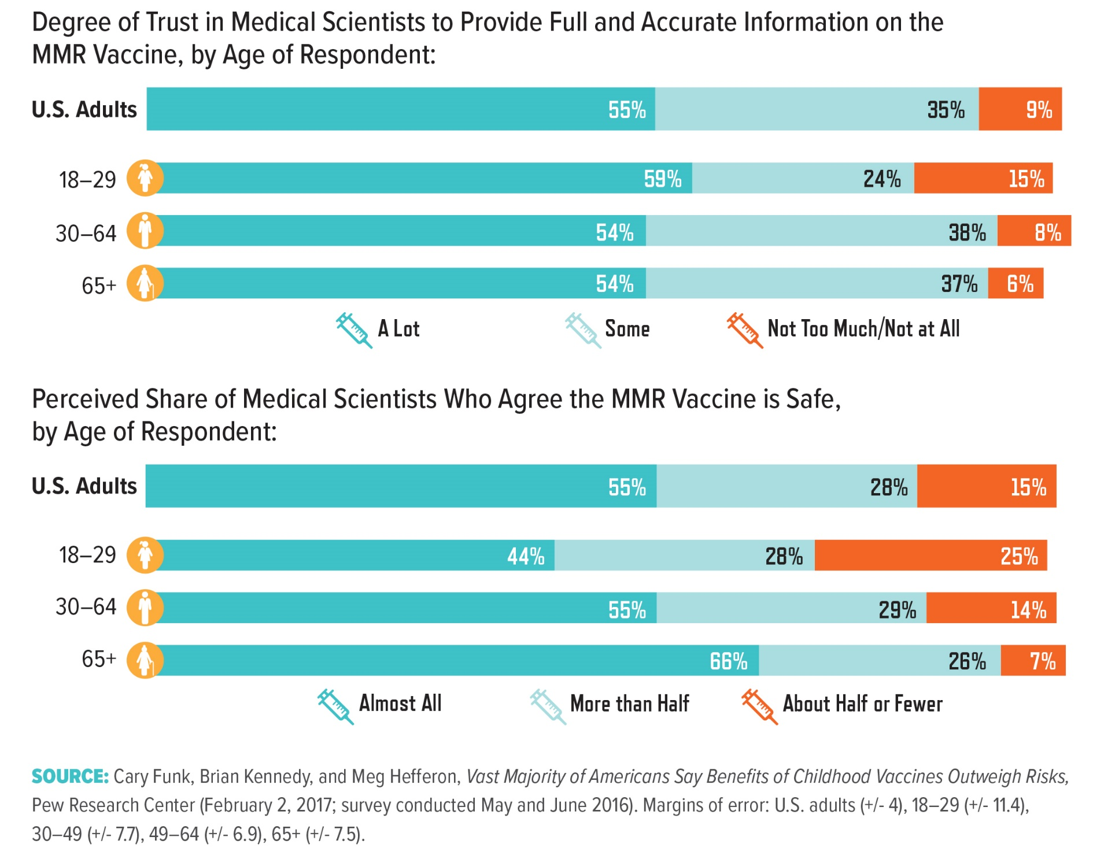
Notes:
A 2017 Pew report found no statistical difference in the extent to which younger and older Americans trust medical scientists to provide accurate information about the safety of the mmr (mumps, measles, and rubella) vaccine, yet younger people expressed more skepticism of the scientific consensus that childhood vaccines are in fact safe. Researchers do not yet understand this discrepancy, since these data do not reveal respondents’ justifications for their beliefs. For instance, researchers do not know whether the differences in views are related to the shared generational experiences of a given age group, a change in perception associated with the process of aging, lack of personal experience with vaccine-preventative diseases, or some other factor or combination of factors. More research is necessary to determine the underlying causative relationships between population demographics and views on vaccine safety.

Slide 23
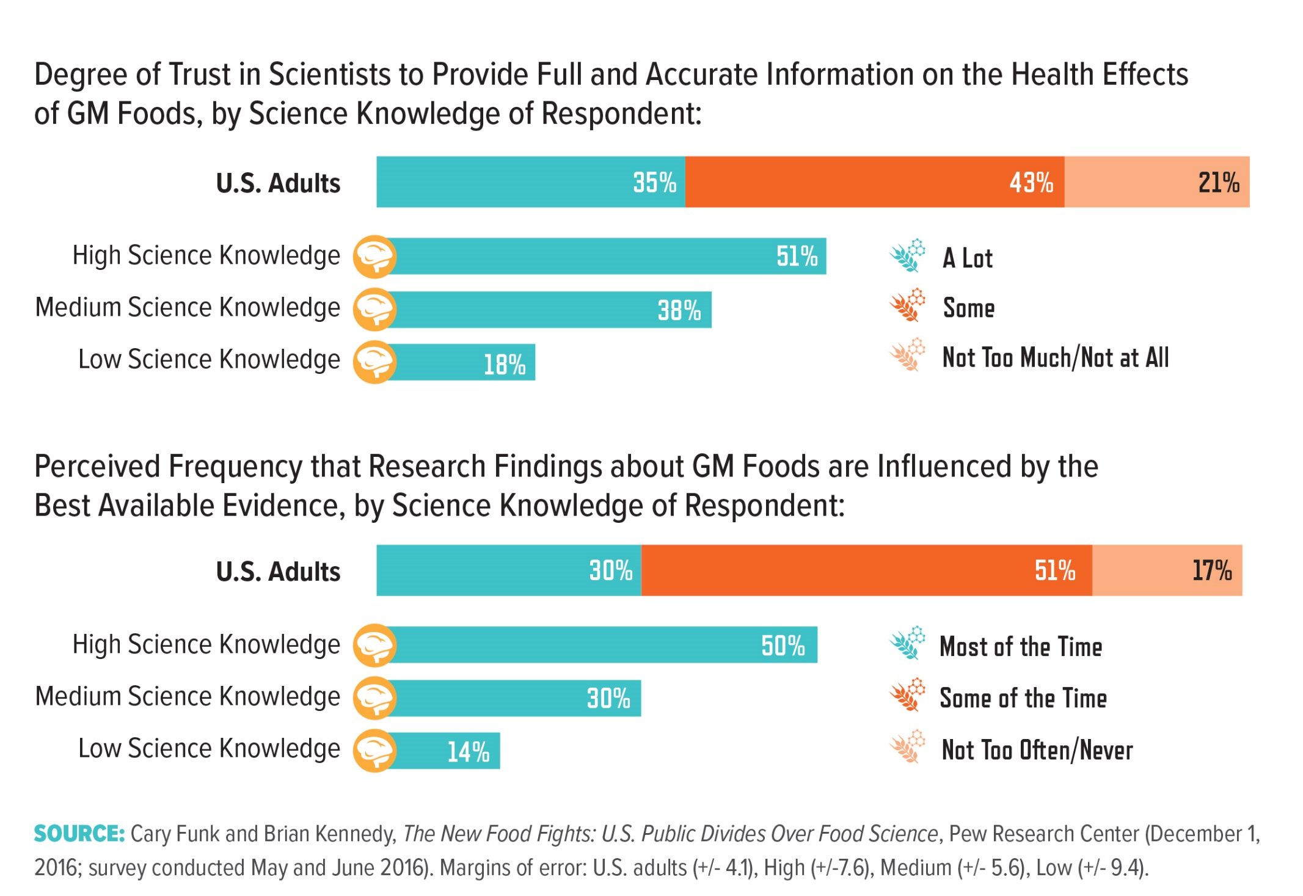
Notes:
The Pew Research Center has also examined perceptions of genetically modified foods and found that only 42 percent of U.S. adults believe that most scientists agree that it is safe to consume genetically modified (gm) foods (data not shown). The perception that scientists have deemed gm foods safe to eat increases to 64 percent when only those with high science knowledge are considered (versus only 28 percent with low science knowledge). Pew assesses science knowledge through a nine- question index on the life sciences, Earth sciences, numeracy, and the scientific method. U.S. adults who answered at least seven questions correctly are categorized as having high science knowledge; these individuals were also more likely to trust scientists to provide full and accurate information on genetically modified foods and to base their research findings on the best available evidence. However, people with low science knowledge were slightly less likely to say that research findings are influenced by scientists’ desire to help their industries. Further research is required to understand the influence of science knowledge on perceptions toward gm foods and trust in scientists on this issue. In addition to food safety, future studies should also investigate public perceptions of gm foods’ effects on the environment and related ethical concerns.

Slide 24
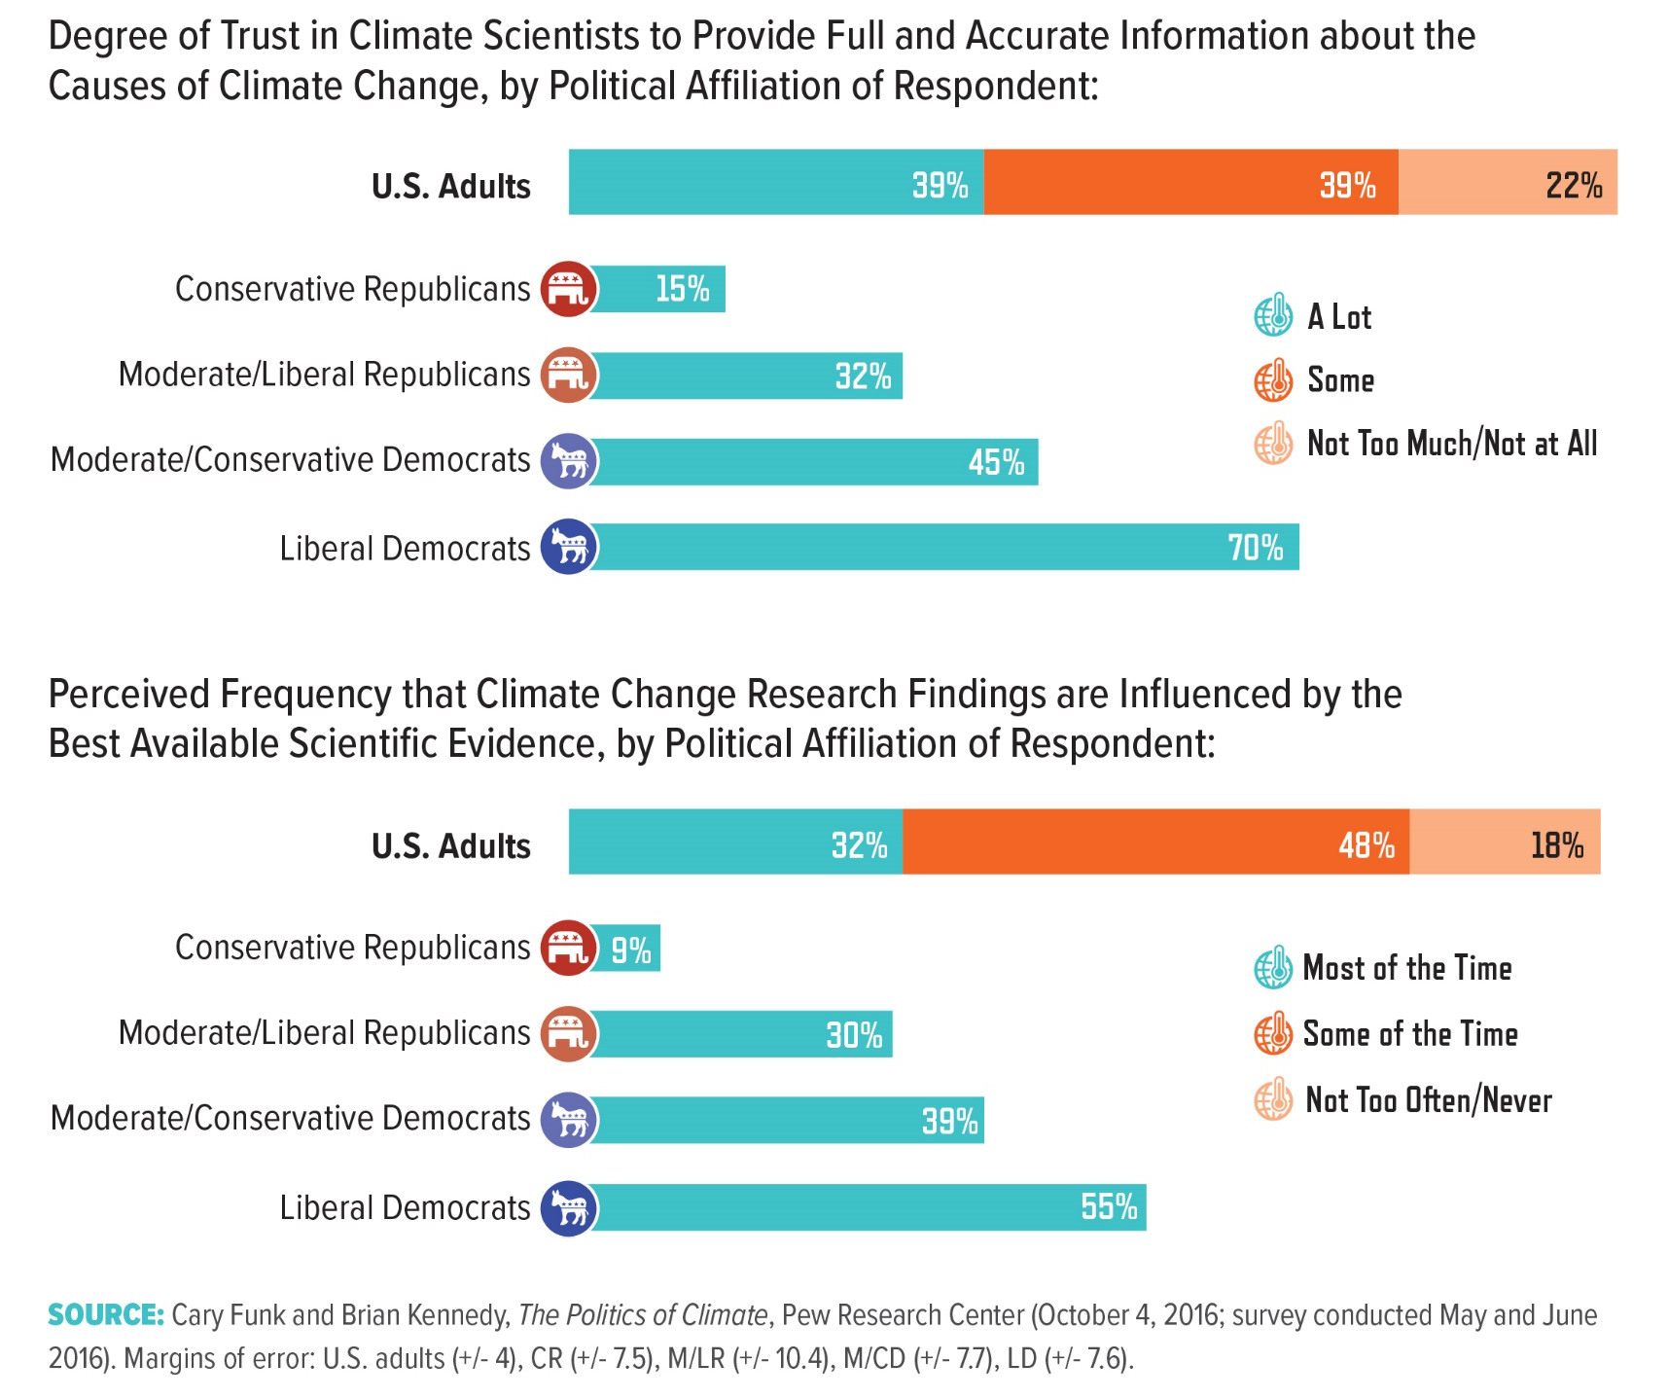
Notes:
When the Kyoto Protocol to the United Nations Framework Convention on Climate Change was adopted in 1997, a roughly equal proportion of Democrats and Republicans (46 and 47 percent, respectively) believed that the effects of global warming had already begun.20 Since that time, however, a well- established link has emerged between conservative ideology and skepticism that global warming is caused by human activity. This skepticism also extends to a lower level of trust in climate scientists among conservative Republicans. The Research Highlight on the next page provides insight into the relationship between political polarization, science knowledge, and views of climate science.

Slide 25
Research Considerations
How does a scientific topic become associated with a particular group identity?
How can communicators better identify the values or experiences that may inform attitudes on a particular scientific topic?
Once a topic becomes associated with a group identity, are there communication strategies that can produce a receptive or positive response to scientific information on the topic? These questions should seek to identify the approaches that encourage discussion along shared identities and interest
Notes:
Moreover, longitudinal studies are necessary to account for the potential fluidity of group-identity associations with a specific issue. Ultimately, pilot programs that explore new approaches to communicating science on controversial issues need to be developed in conjunction with strategies seeking to improve the overall practice of science communication

Slide 26
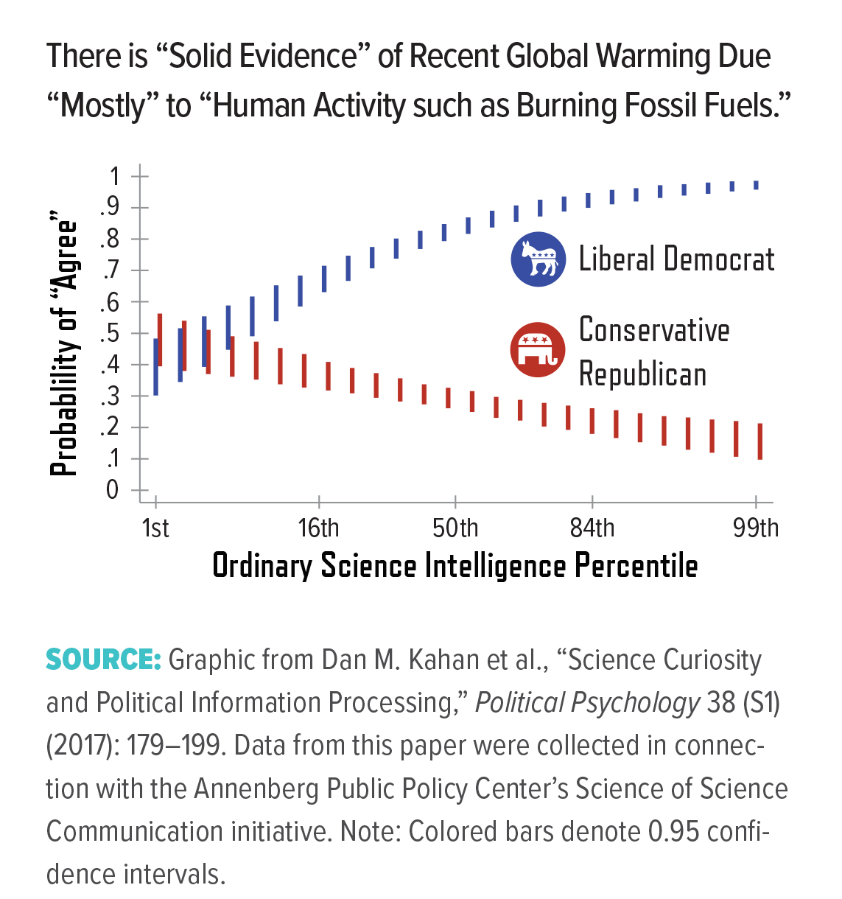
Research Highlight: Polarization and Science Knowledge
Notes:
The public opinion data in this section reveal a high degree of divergence on climate science between liberal Democrats and conservative Republicans. Perhaps counterintuitively, recent research suggests that this political polarization is particularly severe among those with higher educational attainment, science education, or science literacy.21 However, this phenomenon is limited only to a few areas of science; others, such as genetically modified foods, exhibit no such association.22 Moreover, recent research suggests that conservative Republicans with a higher curiosity about science “for personal pleasure” are more likely to agree with the science of climate change.23 Such insights demonstrate the value of additional research into the underlying factors that inform group identity, as well as the potential efficacy of various evidence-based communication strategies.

